Slide 1
Bridging Urban Divides & Breaking the Cycle of Humiliation:
Adaptive Leadership Approach
Mara Alagic & Glyn Rimmington
Wichita State University, Wichita, Kansas, USA
27th Annual Conference of Human Dignity and Humiliation Studies 'Cities at Risk - From Humiliation to Dignity'
in Dubrovnik, Croatia, September 2016

Slide 2
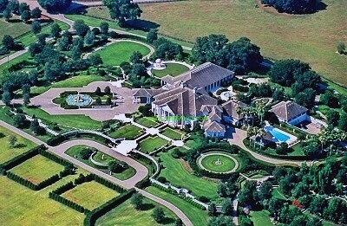
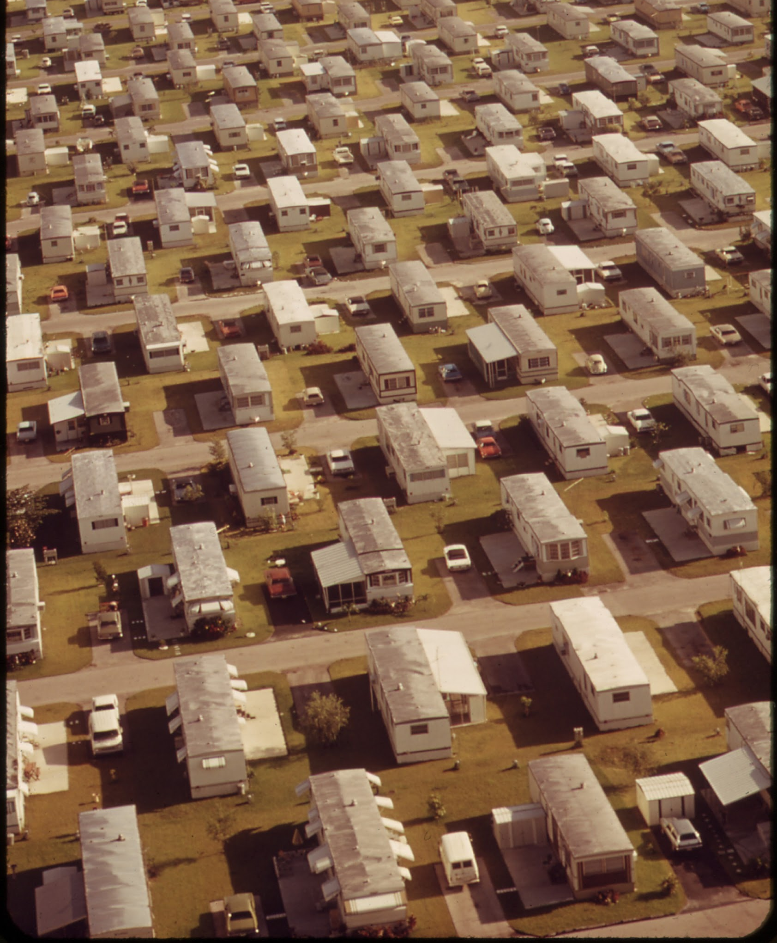
Bridging Urban Divides &
Breaking the Cycle of Humiliation:
Adaptive Leadership Approach
Mara Alagic & Glyn Rimmington
Wichita State University, Wichita, Kansas, USA

Slide 3
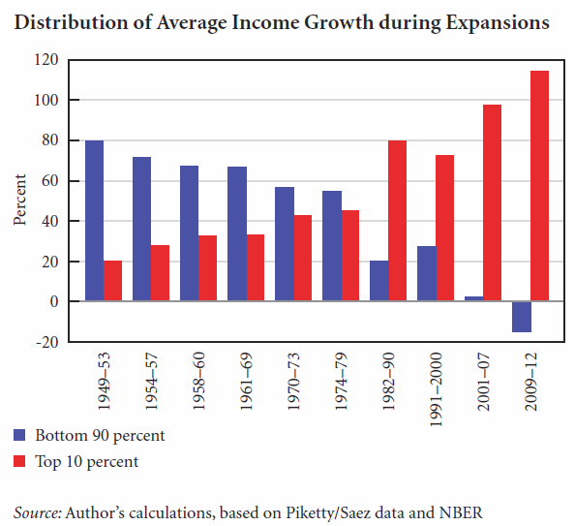
1:4
12:1

Slide 4
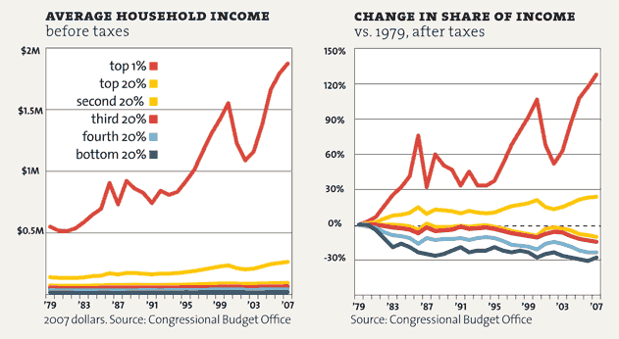

Slide 5
Purpose
Distressed Communities Index. Wichita Example
Urban Divide Context
Relational Criteria (RC) Context
Adaptive Vs. Technical Challenge
Adaptive Leadership
Adaptive Leadership in the RC Context
What next?
OUTLINE

Slide 6
Purpose
Understanding the nature of the challenge: Urban Divide and Related Cycle of Humiliation
Adaptive vs. Technical Elements of the Challenge
Dubrovnik Example; Wichita Example
Why/Who/How to approach adaptive elements
Established governmental/societal structures… (?)
Adaptive leadership from within communities
Need for (ThirdPlaceLearning? “Critical incident” …)

Slide 7
The Distressed Communities Index (DCI)
The Distressed Communities (DCI) combines seven complementary “well-being metrics to present an overall picture of economic distress–or prosperity–in U.S. communities:
Source: Economic Innovation Group (2016) An analysis of community wellbeing across the United States.

Slide 8
No High School Degree
Percent of the population > 25 years without a high school degree)
Housing vacancy
Percent of habitable housing that is unoccupied, excluding properties that are for seasonal, recreational, or occasional use
Adults not working
Percent of the population 16 years and over that is not currently employed
Poverty
Percent of population living under the poverty line (in USA, $24,036 for 4-persons family)
Change in employment
Percent change in the number of individuals employed
Change in business establishments
Percent change in the number of business establishments
Median income relative to state
Ratio of the median income
DCI

Slide 9
DCI for zip codes across Lower 48
DC - Wichita Example
Wichita
http://eig.org/
US Census Bureau
Kansas
Prosperous (1%)
Distressed 99%

Slide 10
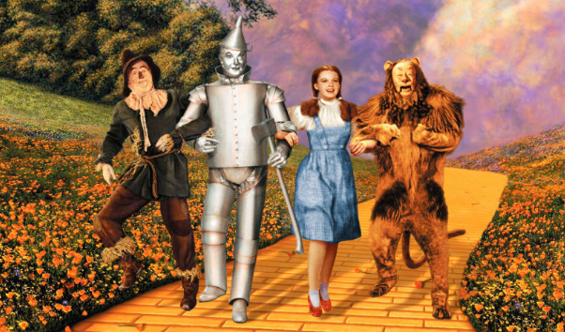
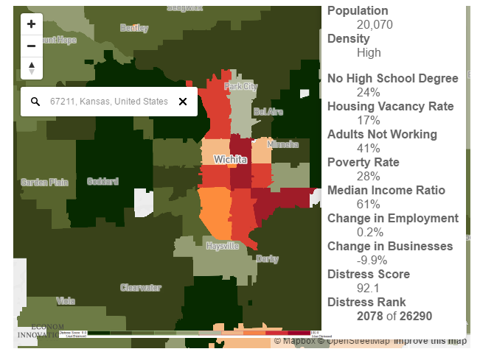
In the Land of OZ:
Wichita, Kansas
1868
48th
389,965
644,610
… an allegory about the 19th-century debate regarding monetary policy in America ...

Slide 11
Distressed Communities Index - Wichita Example
US Census Bureau - http://eig.org/
Notes:
Vertical red distressed zone is mainly African American with the canal route through the middle of it
Horizontal red distressed zone in SE is cheap housing and trailer parks for unskilled workers in the aircraft industry most of whom may be out of work. Green prosperous zones to the West are Goddard and Maize. Derby in the south is not on the map
To the East is Andover and NE Wichita where most of the doctors, lawyers, executives and business owners live

Slide 12
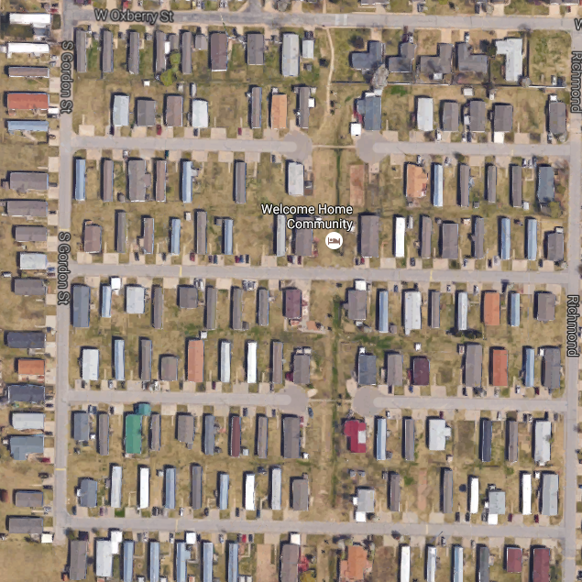
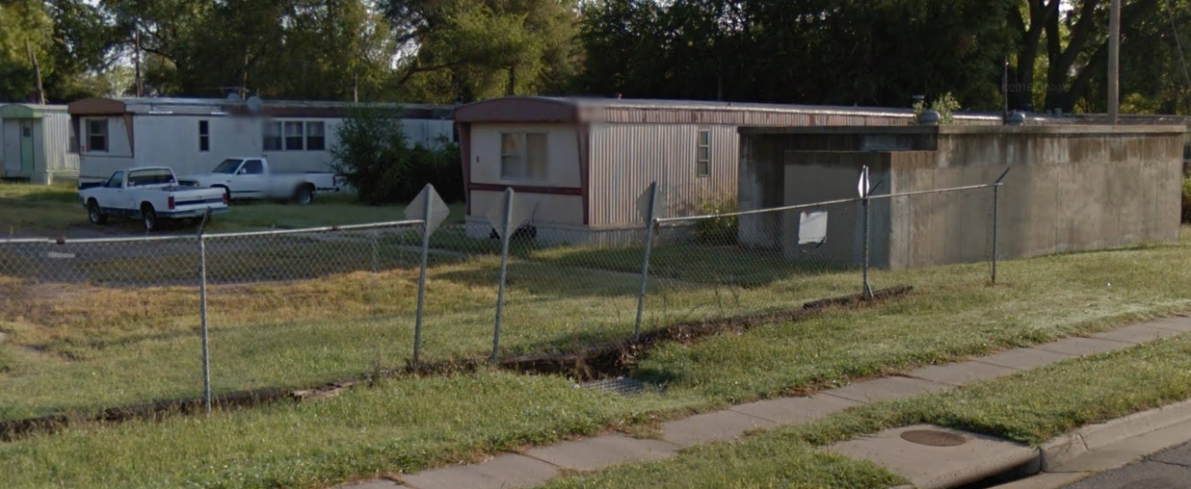
Google Maps
67214 43.8% Poverty
Median Income $14,817
Predominantly Black
Distressed Communities Index - Wichita Example
Distressed
67210 19.4% Poverty Median Income $11,979
Predominantly White
US Census Bureau http://eig.org/
http://zipatlas.com/us/ks/wichita
Notes:
Vertical red distressed zone is mainly African American with the canal route through the middle of it
Horizontal red distressed zone in SE is cheap housing and trailer parks for unskilled workers in the aircraft industry most of whom may be out of work. Green prosperous zones to the West are Goddard and Maize. Derby in the south is not on the map
To the East is Andover and NE Wichita where most of the doctors, lawyers, executives and business owners live

Slide 13
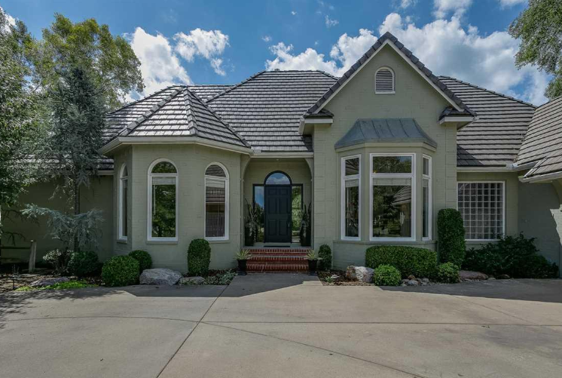
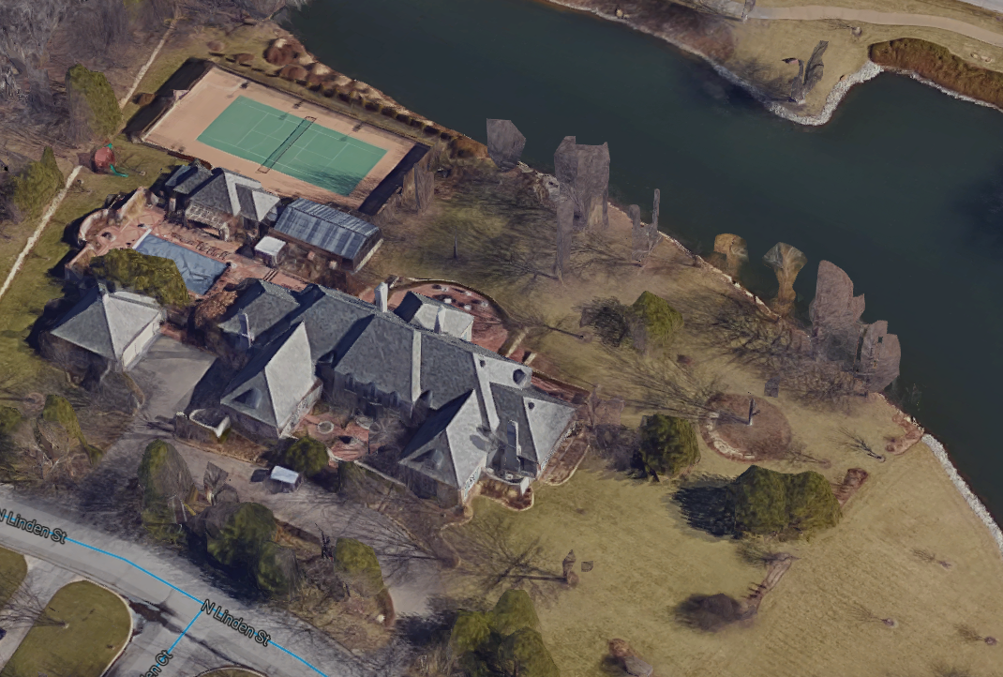
Google Maps
Prosperous
67226 4.3% Poverty
Median Income $26,355
Predominantly White
Distressed Communities Index - Wichita Example
67206 7.84% Poverty
Median Income $26,999
Predominantly White
US Census Bureau http://eig.org/
http://zipatlas.com/us/ks/wichita
Notes:
Vertical red distressed zone is mainly African American with the canal route through the middle of it
Horizontal red distressed zone in SE is cheap housing and trailer parks for unskilled workers in the aircraft industry most of whom may be out of work. Green prosperous zones to the West are Goddard and Maize. Derby in the south is not on the map
To the East is Andover and NE Wichita where most of the doctors, lawyers, executives and business owners live

Slide 14
Google Maps
67214 43.8% Poverty
Median Income $14,817
Predominantly Black
67226 4.3% Poverty
Median Income $26,355
Predominantly White
Google Maps
Prosperous
Distressed Communities Index - Wichita Example
67206 7.84% Poverty
Median Income $26,999
Predominantly White
Distressed
http://eig.org/
US Census Bureau
67210 19.4% Poverty Median Income $11,979
Predominantly White
Urban Divide
Notes:
Vertical red distressed zone is mainly African American with the canal route through the middle of it
Horizontal red distressed zone in SE is cheap housing and trailer parks for unskilled workers in the aircraft industry most of whom may be out of work. Green prosperous zones to the West are Goddard and Maize. Derby in the south is not on the map
To the East is Andover and NE Wichita where most of the doctors, lawyers, executives and business owners live

Slide 15
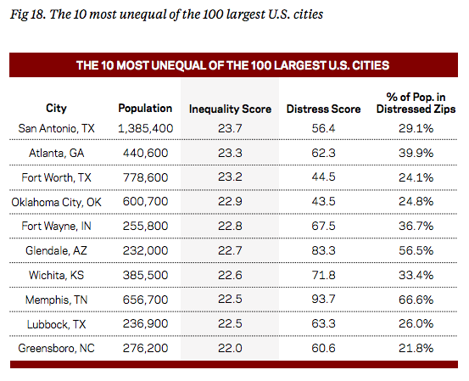
1
2
3
4
5
6
7
8
9
10
8
6
9
10
4
2
3
1
5
7
6
3
9
8
4
2
5
1
7
10
Distressed Communities Index - Wichita Example
http://eig.org/
US Census Bureau
Notes:
When The Inequality Score, Distress Score and % of population in Distressed Zipcode are ranked, Wichita has the nation’s 7th highest for Inequality, 3rd highest for Distress and 5th highest for % living in Distressed Zipcode areas.

Slide 16
Urban Context and Communication Within
Spatial
Temporal
Relational
Historical
Nakayama’s dialectic perspective
Urban Context/ Environment | Power Relationships
Culture | Communication

Slide 17
Urban Divide Context
The concepts of vulnerability, humiliation and deprivation, are critical in understanding urban divide context.
Vulnerability and Humiliation, defined as states of dependency, point to various social, economic, and physical forms of enslavement.
Deprivation is multi-faceted and concerns the access to meeting one’s fundamental needs, from individual spatial-physical to a broader neighborhood related, and up to regional and global levels.
Consequently, there is a significant gap in human capital as well as in social capital which further explicates adaptive nature of the urban divide challenge.
Urban Divide Context

Slide 18
Adaptive Nature of the Urban Divide Challenge
A diagnostic work in recognizing adaptive nature of the Challenge involves deep understanding of the human dimensions of change.
This challenge is bound to stir up intense emotions because it is anchored in the intricacy of beliefs, values, and the cultural and political allegiances, contrary to the technical complexity elements which can be resolved by unemotional analysis.
Bridging the urban divide and breaking the related cycle of humiliation requires people to change their ways, to shift their perspectives.

Slide 19
Nature of the Urban Divide Challenge
This indicates
multidimensionality of urban divide as well as
a cycle of humiliation within urban context, and
established power relationships.
The system creating this kind of power relationships cannot be used to improve one’s own situation

Slide 20
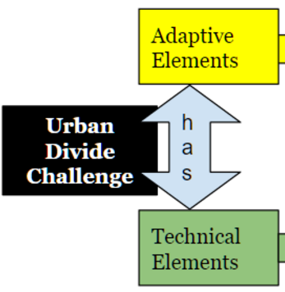
Adaptive Nature of the Urban Challenge
Unlike so called technical problem solving for which past ways of thinking and managing are sufficient, adaptive challenges require
(1) figuring out what to support from past practices,
(2) finding out what to discard from past practices, and
(3) inventing new necessary ways of coexisting.

Slide 21
Four Adaptive Challenge Archetypes
Gap Between Espoused Values and Behavior
Programs for homeless and poverty limited by revenue shortfalls due to tax breaks for businesses 2. Competing Commitments
Keep sponsors of re-election campaigns happy with tax breaks, subsidies and less social programs; greater need to support unemployed, unskilled, poorly educated, living in poverty, medical problems due to pollution
3. Speaking the Unspeakable
Admitting that current policies worsen the level of inequality and distress
4. Work Avoidance-diversion of attention and displacement of responsibility
Emphasizing photo opportunities to showcase farcical policies to bridge the urban divide

Slide 22
Adaptive Culture
Adaptive cultures engage in at least five practices. They
(1) name the elephants in the room,
(2) share responsibility for the organization’s future,
(3) exercise independent judgment,
(4) develop leadership capacity, and
(5) institutionalize reflection and continuous learning.

Slide 23
Adaptive Culture
The complexity of this challenge requires functioning in a way different from the existing one; the solution requires new learning and shifting the authority and responsibility to the people who are actually affected; some sacrifice of the past ways of doing things, working/living; and it requires some experimenting before we are sure it will work.
Adaptive vs Technical Challenges

Slide 24
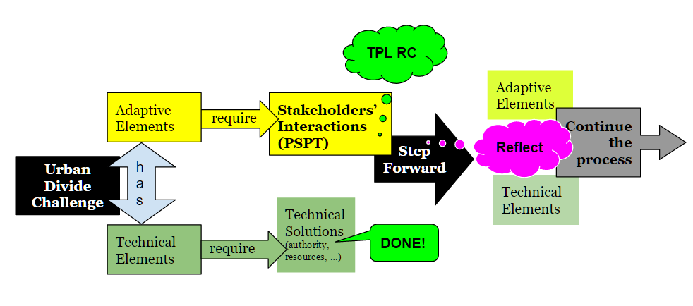
Adaptive vs Technical Challenges
Adaptive work requires adaptive leadership within the TPL context.
Notes:
http://cambridge-leadership.com/adaptive-leadership/

Slide 25
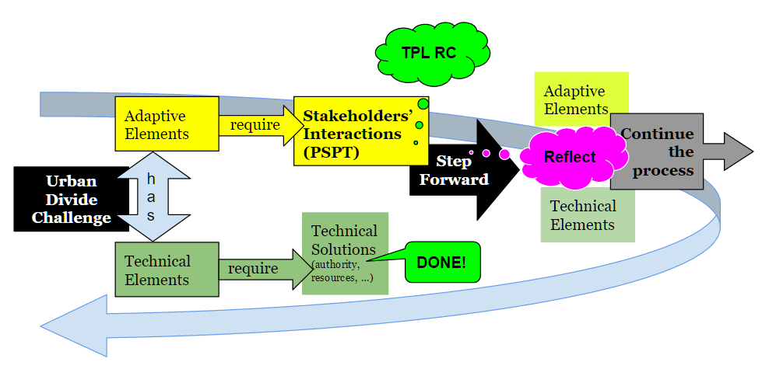
Adaptive vs Technical Challenges

Slide 26
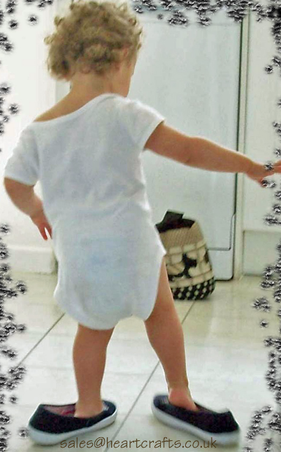
Communication Challenges:
Perspective Sharing,
Perspective Taking, and
Perspective Shift

Slide 27
Communication Challenge: Perspective Shift
“ Cows,” said the frog to the fish. “Cows ! They have four legs, horns, eat grass, and carry pink bags of milk.”

Slide 28
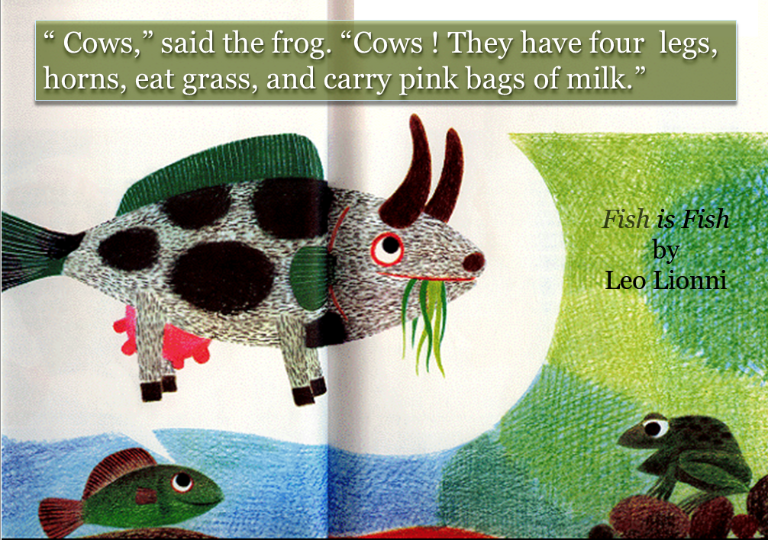
Communication Challenge: Perspective Shift

Slide 29
Communication Challenge: Perspective Shift
A core of constructive dialogs/dignilogs for solving an adaptive challenge comprises perspective sharing, perspective taking and perspective shift.

Slide 30
Context Design: Relational Criteria
Active listening
Dialectic flow of thinking
Intercultural sensitivity
Critical co-reflection
Conscientization
Bodymindfulness

Slide 31
Intercultural Sensitivity | Active Listening | Bodymindfulness
Dialectic Thinking | Critical Coreflection | Conscientization

Slide 32
Intercultural Sensitivity | Active Listening | Bodymindfulness
“...the affective dimension of intercultural communication competence...” (Chen & Starosta, 2000, 4) and refers to feelings and attitudes in our relationships and communication with stakeholders from other cultural groups, being careful to not identify culture directly with nation per se. | Enryo-Sasshi model.The focus is on applying our understanding of the other’s perspective, when interpreting (Sasshi) what the other has written or said and then processing the derived interpretation to then shape (Enryo) a response that we hope the other will interpret as we intend (Ishii, 1984). | The dimension of Somatic Emotional State (SES) in stakeholders’ understanding of each other’s perspectives and to some degree being able to respond to each other’s SES and achieve resonance and harmony necessary for meaningful involvement in emotional topics during interactions in diverse and interculturally complex contexts ( Nagata, 2002, 2007).
Dialectic Thinking | Critical Coreflection | Conscientization
In the dialectical approach to complexities and dynamics of BUD, similarly as in the studies of ICC, (Martin & Nakayama, 1999, 2008) there are two points of reference - context and power - relative to which we need to recognize multiple, contradictory viewpoints in the domains of culture and communication. Dialectic pairs | Reflection, on its own, as a rigorous way of thinking (Schön, 1983), but is not necessarily critical. Critical reflection is a deeper, more intense, probing form of reflection that focuses on power relationships during co-reflection (Mezirow, 1998); when we identify and challenge the criteria that define how things should be problematized; how certain conventions came to constitute the accepted norms… | The critically conscious stakeholder realizes that (a) the maintenance of power differences in society is associated with restrictions placed on social discourse, as well as the design of education, religious beliefs, laws, and mass media; and (b) the actions needed to redress large power differences associated with privilege and oppression (Freire, 1968|1970).

Slide 33
Urban Divide
Trigger
Third Place Learning
Dialectic
Thinking
Intercultural
Sensitivity
Active
Listening
Prosperous
Stakeholders
Dialogic Co-construction
Conscientization
Shared
Perspectives
Power Difference
Conscientization
of Meaning
Distressed
Stakeholders
Body
Mindfulness
Critical
Co-reflection
Urban Context - Spatial, Temporal, Relational, Historical
Notes:
Conscientization of stakeholders creates a tendency to decrease the effects of power position and consequent power difference, which brings into play the other five TPL Relational Criteria: Active Listening, Dialectic Thinking, Intercultural Sensitivity, Body Mindfulness and Critical Co-reflection
The trigger for the change in power may come from some common activity in which wealth or position are not an advantage, or it could come from systematically exposing Stakeholders to each others’ contexts as part of K-12 education programs. Affirmative Action programs for places in education and positions in government organizations and elected leadership roles may be needed to provide opportunities for distressed stakeholders to become more prosperous. This all takes place in the Urban context, which has spatial, temporal, relational and historical elements that will vary with each city.

Slide 34
Classification of System Domains
Adaptive Leadership
Unpredictable
Non-Linear
Evolutionary
Instability
Feedback Loops
Self-Organization
Emergent Behaviors
Complexification
Traditional (Technical)
Leadership / Management
Larger Problems
Same Approach
Complex
Complicated
Interactions
Relations
Disordered
Elaboration
Crisis Management
Multiple States
Sudden Divergence
Sensitivity to Initial Conditions
Traditional (Technical)
Leadership / Management
Linear
Cause & Effect
Predictable
Fixed Structures
Based on Past Experience
Simple
Known
Chaos
Unexpected
Change
https://www.youtube.com/watch?v=N7oz366X0-8
Notes:
Cynefin Framework for System Domains and Associated Leadership
Complex systems tend to be irreducible with traditional methods - Crypticity
Multiple Stakeholders and Contexts; Competing Interests
Systems within systems
Kurtz, C. F., & Snowden, D. J. (2003). The new dynamics of strategy: Sense-making in a complex and complicated world. IBM systems journal, 42(3), 462-483.

Slide 35
Complex Adaptive Leadership
Paradigm
Shift
Prosperity Centered
Governance with Empty rhetoric for the
Distressed Stakeholders
Proactive Stakeholder Perspectives
with Adaptive Leadership
TPL
Relational
Criteria
Dialogic co-construction of meaning
Anarchy
Elaboration
Conventional View of Leadership
Prosperity
Centered
Governance
Crisis
Unexpected
Disaster
Notes:
Crisis, such as a natural disaster, war, exhaustion of natural resources, such as water; or rising sea levels, tends to expose lack, or absence, of infrastructure and contingency plans or any capacity to survive in the poorer side of the urban divide. This set of pre-conditions to a disaster can make disaster relief efforts even more difficult and exacerbate its negative effects. On the other hand, communities with closely integrated governance and contingency planning are more resilient in the face of the same types of crisis. An example is the contrast between the recovery of New Orleans, LA from the Category 5 Hurricane Katrina in late August, 2005 and the recovery of Joplin, MO from a massive supercell over the MidWest that spawned a multiple-vortex F5 tornado in late May, 2011. The infrastructure for New Orleans failed the poorer communities, who were left with no means of escape. The lack of prior evacuation and lack of any coordinated relief efforts for over a week afterwards resulted in many deaths and great hardship. The Joplin community, on the other hand, had planned for such an event with close integration between citizens, organizations and government at the city level and recovery plans went into effect immediately. Recovery was smooth and deaths and hardship were minimized.
The emphasis on local stakeholder involvement in planning and implementation required open channels of effective communication and productive dialog.
https://en.wikipedia.org/wiki/Complex_adaptive_leadership

Slide 36
Contrasting Stakeholder Perspectives across Urban Divide
Ongoing Dialog
Complexified Governance Structure
& Processes
Complexity
Absorption
Absorbed
Perspectives
Continuous Change
Proactive Stakeholder- based Solution
to Urban Divide
Awareness of Perspectives
Lowered DCI
& Inequality
Notes:
To implement a transition from traditional leadership/management that worked in simpler contexts, an early step is to seek perspectives of all stakeholders, especially those living in distressed conditions of poverty and to involve them in the governance process. With increased exposure to and discussion of different perspectives, the stakeholders are able to take each other’s perspective, which can make communication more meaningful. The government and its leadership/management can then be restructured to meet the needs of both sets of stakeholders. Eventually, with an ongoing dialog and evolving (adaptive) management structure and processes, the urban divide should lessen and the DCI minimized.

Slide 37
Adaptive nature of the challenge
Interconnectedness of the system(s)
Relational Criteria

Slide 38
Adaptive nature of our challenge
Interconnectedness of our system(s)
Relational Criteria/Interactions …
What next?

