Slide 1
Midtown Global Market: Growing Immigrant Enterprises & New Communities
Conference on Human Dignity and Humiliation Studies – Dubrovnik, Croatia – September 2016
Dr. Tom Borrup
University of Minnesota

Slide 2
Midtown Global Market
Cultural and economic empowerment and building social capital with immigrant communities
Cultural continuity & exchange
No Ordinary Marketplace

Slide 3
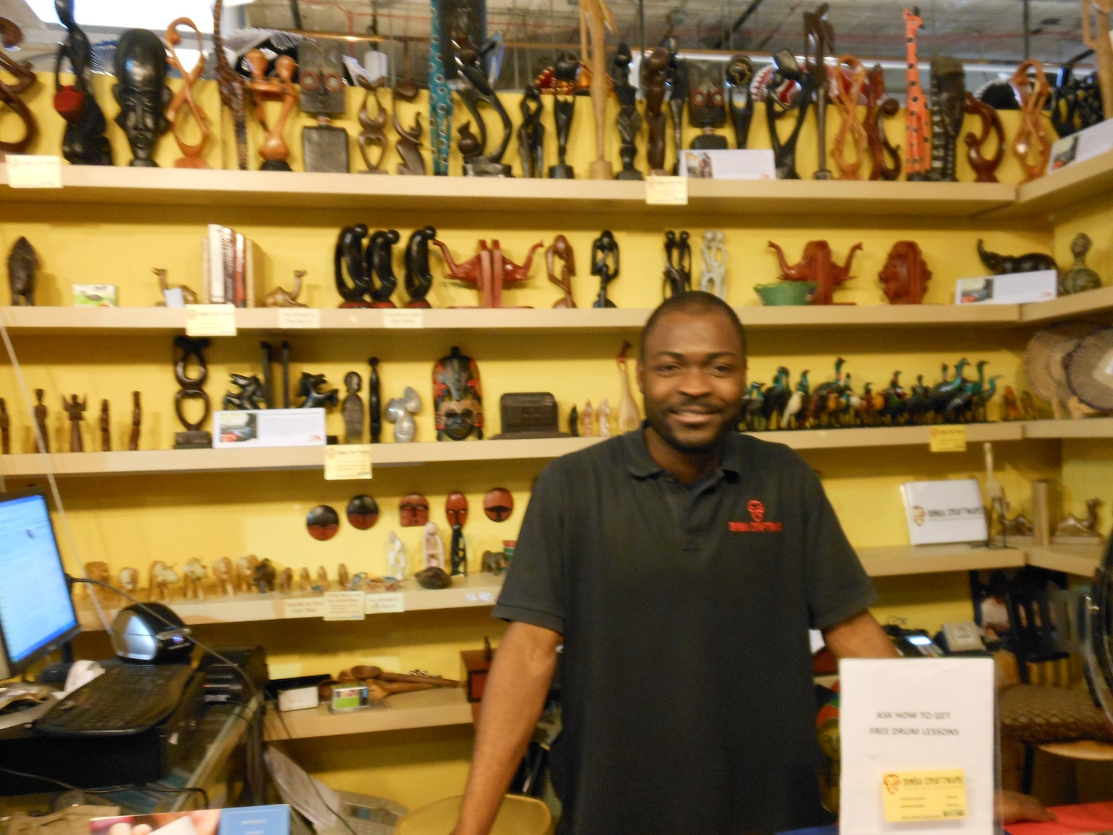
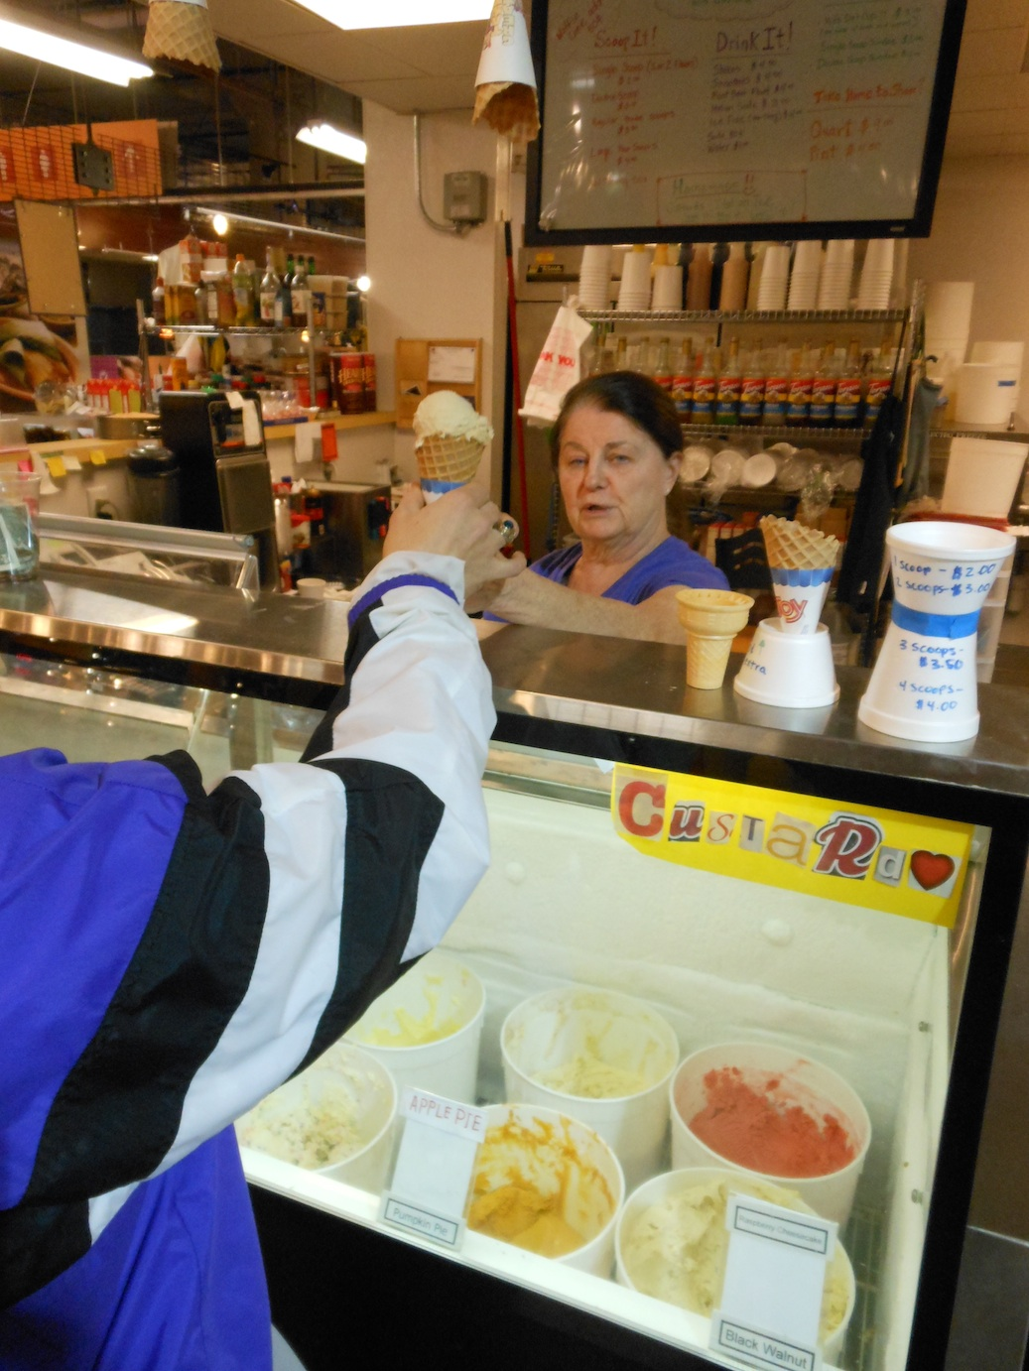
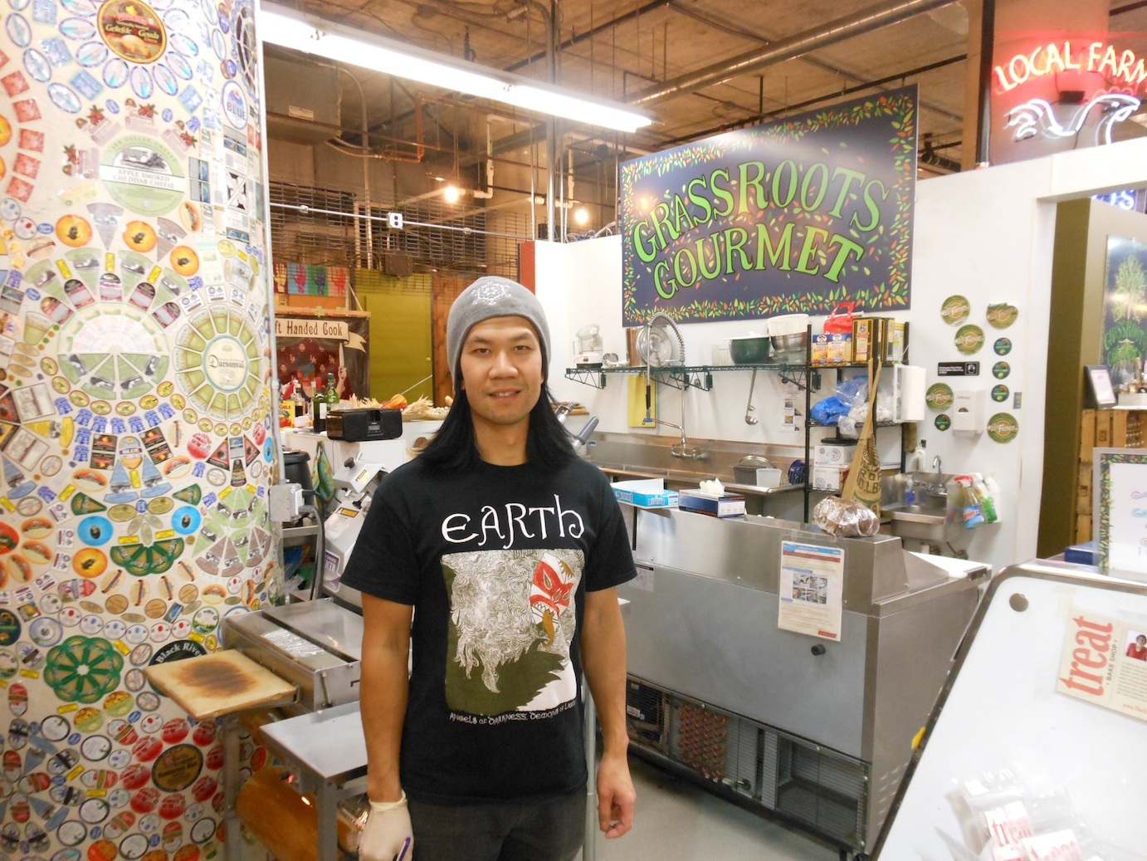
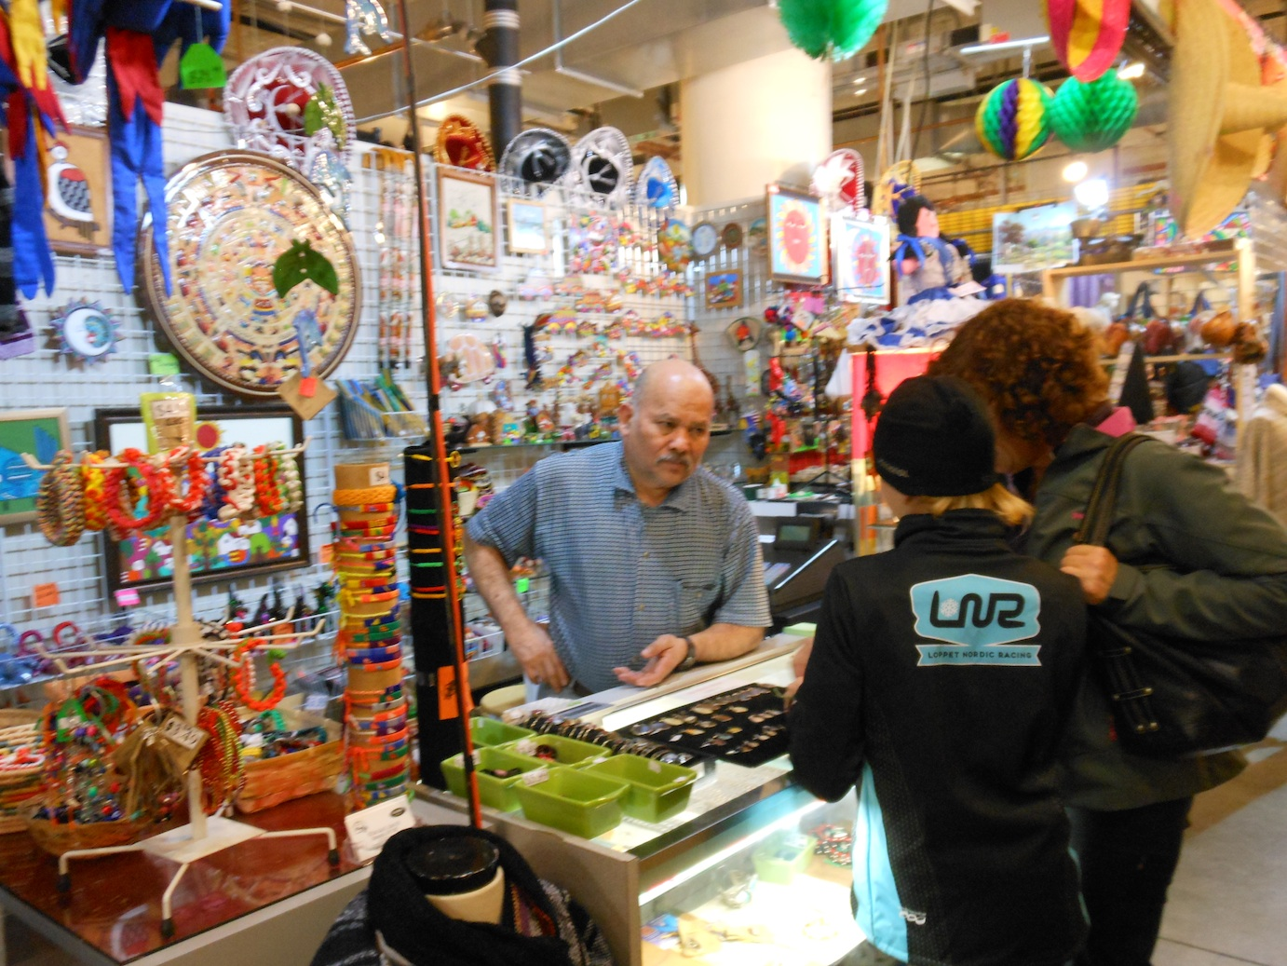
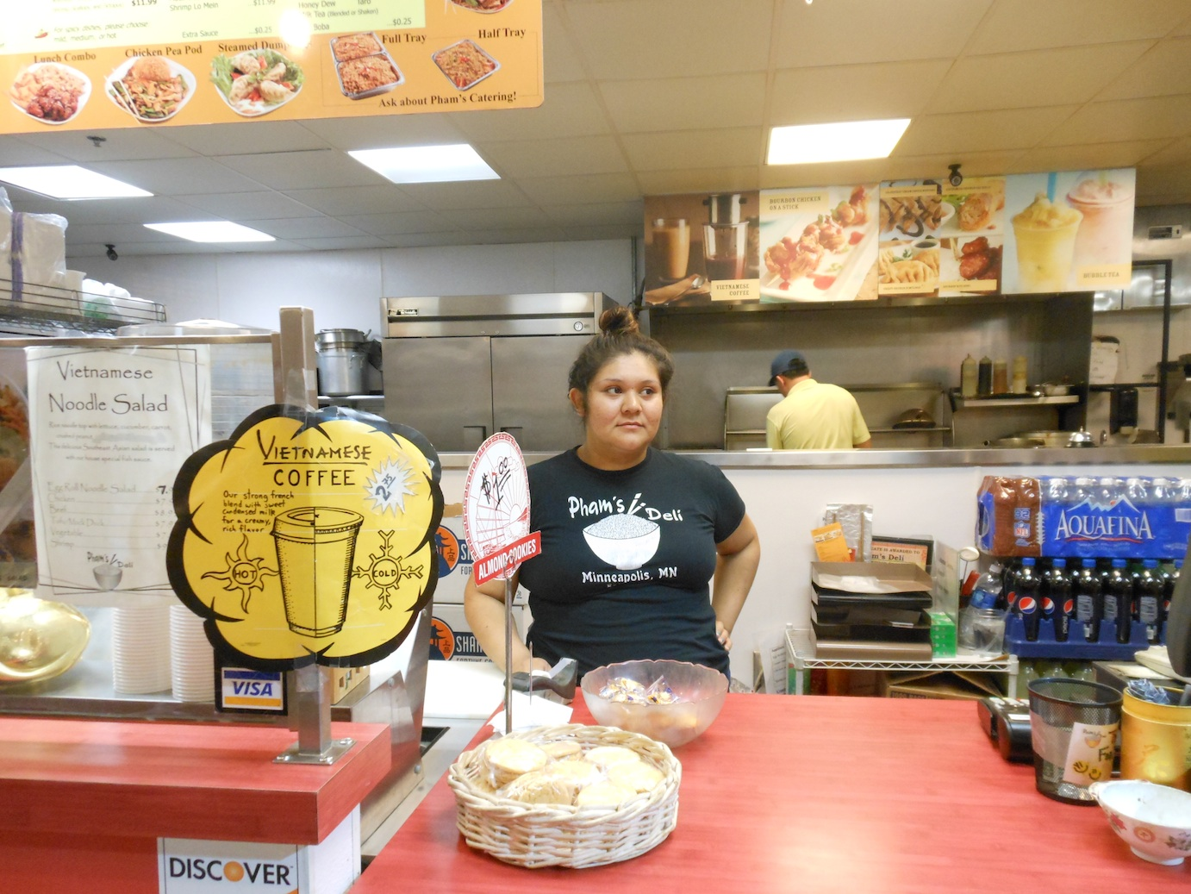
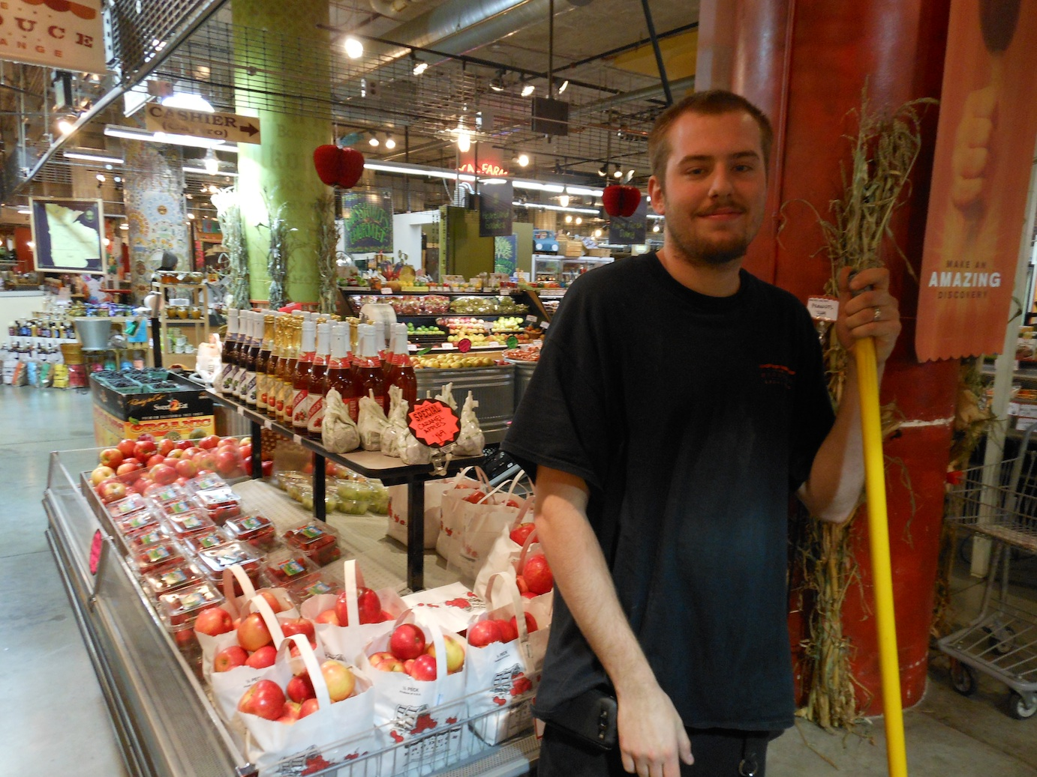
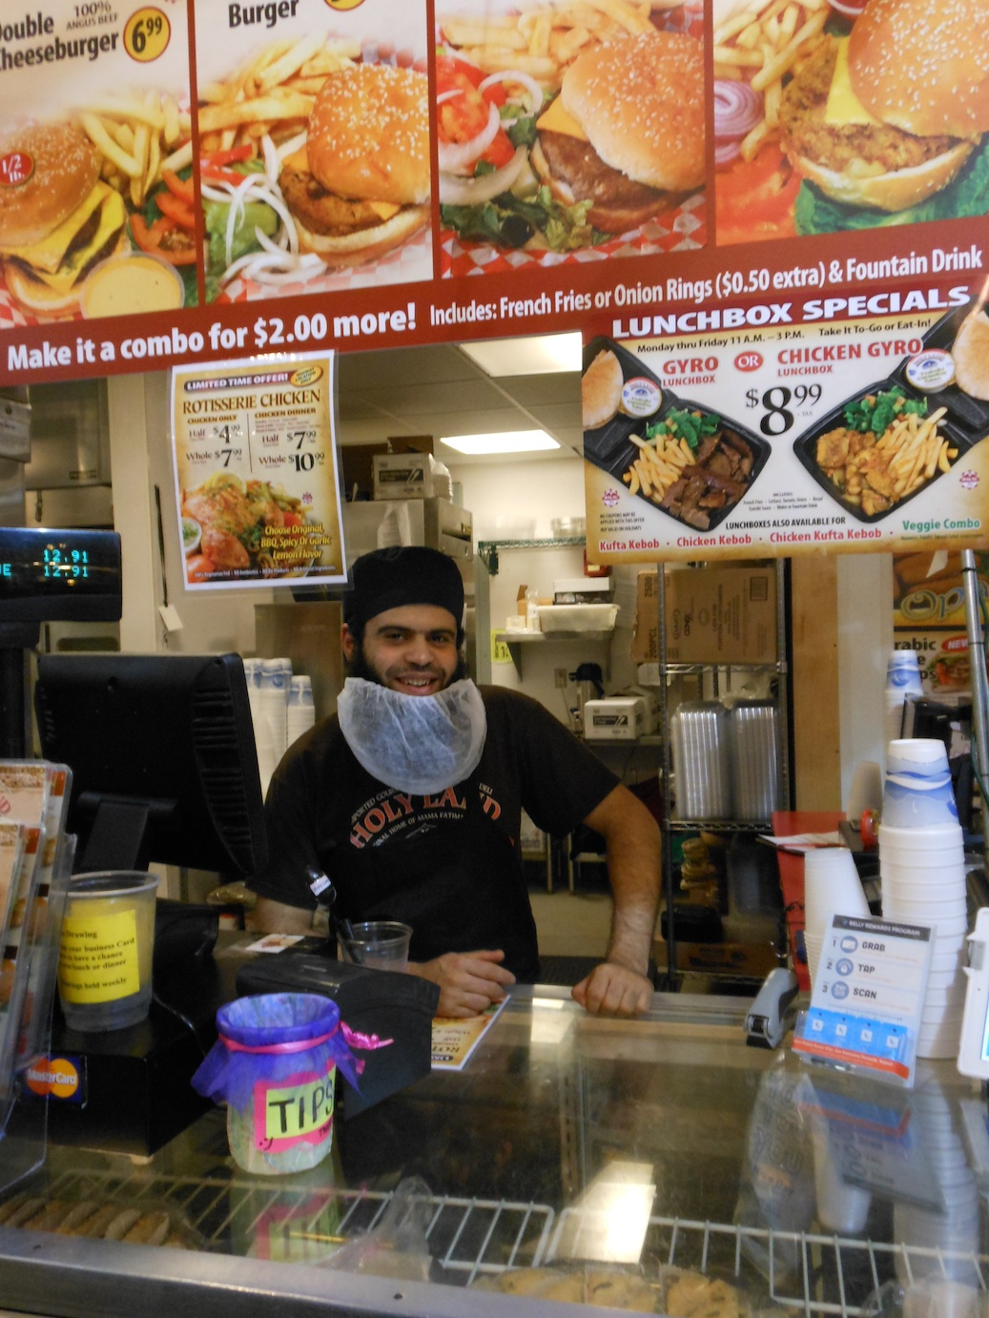
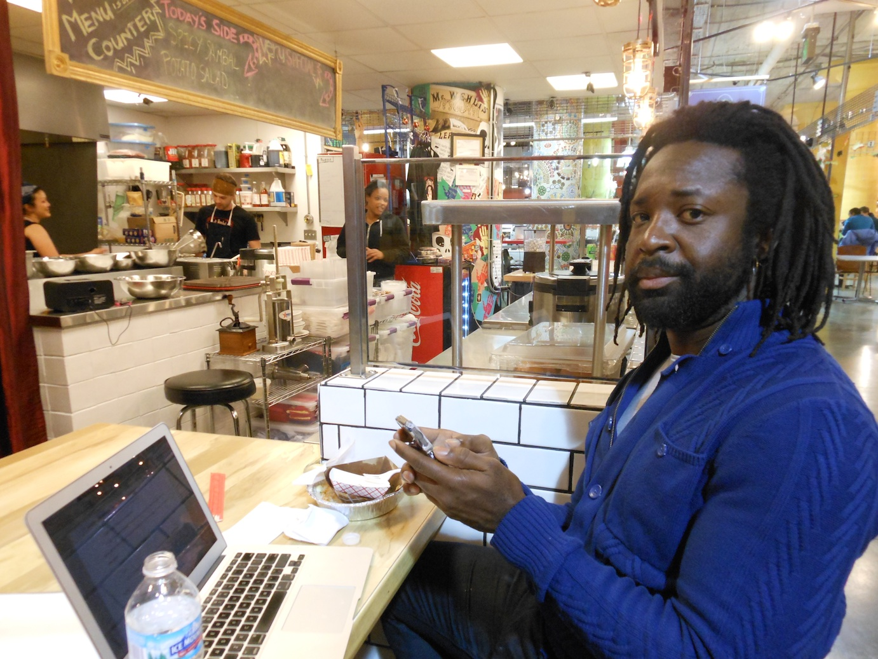
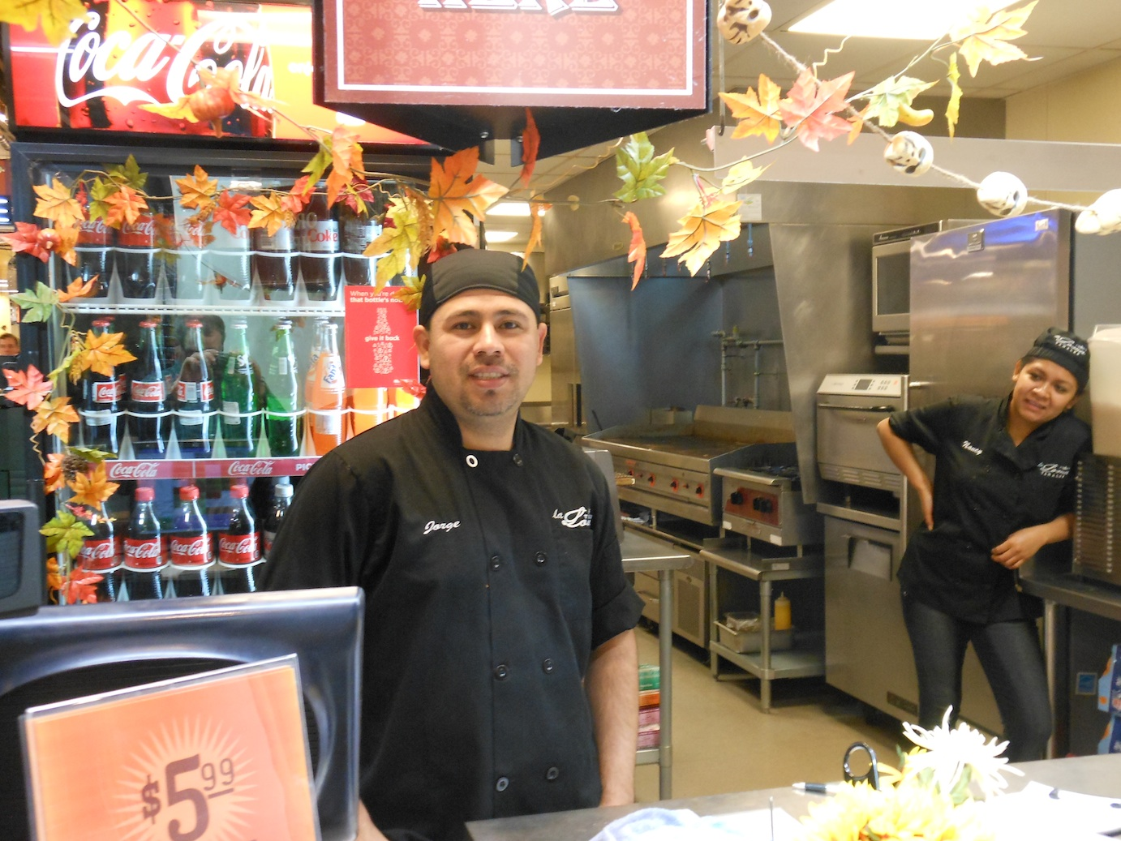
My Neighborhood

Slide 4
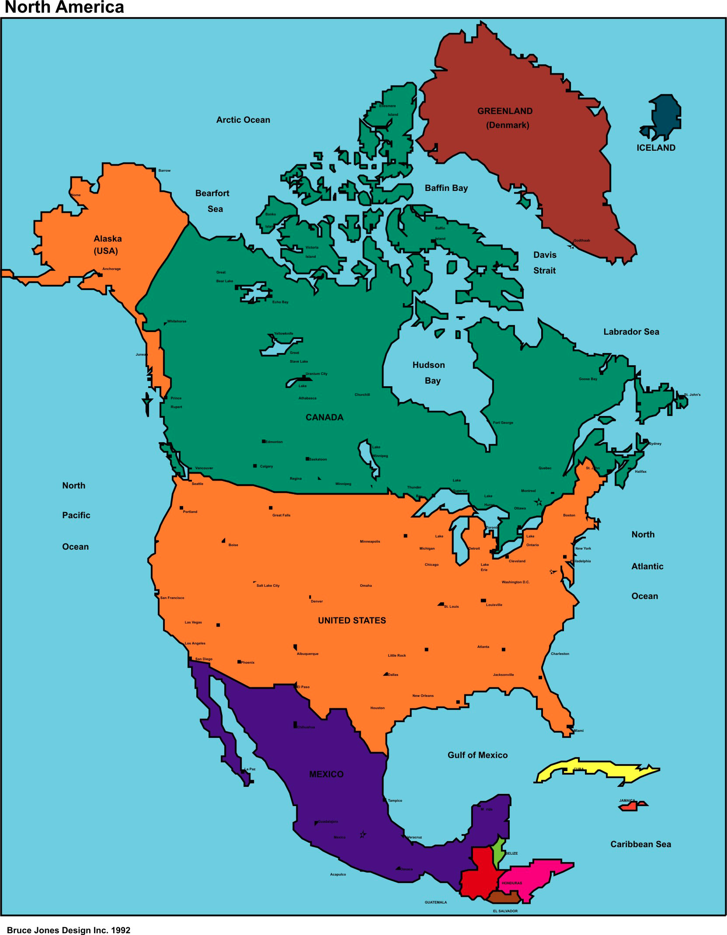
Minneapolis & St. Paul – USA X Marks the Spot
X

Slide 5
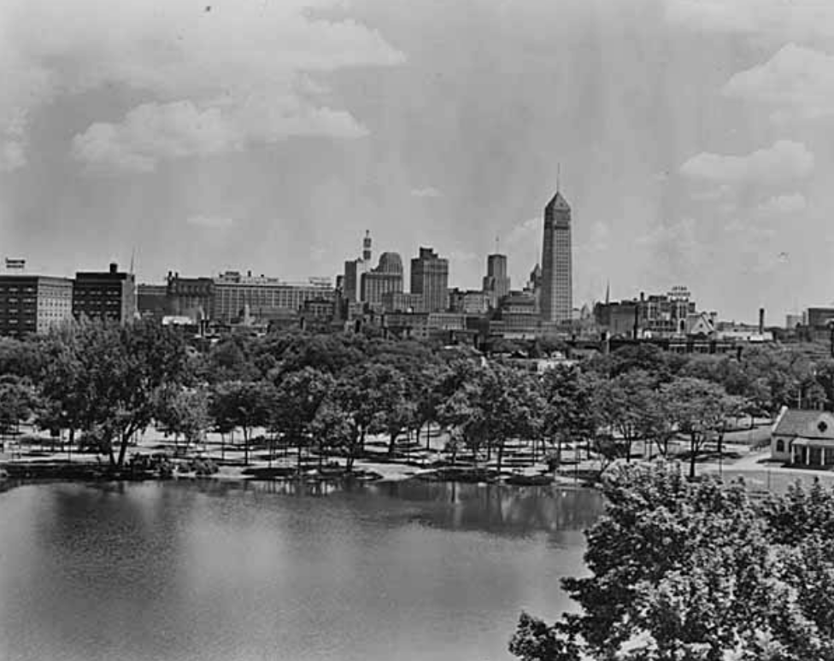
Minneapolis Population
1950
521,000 pop. 98.4% ethnically white, mostly Northern European ancestry

Slide 6
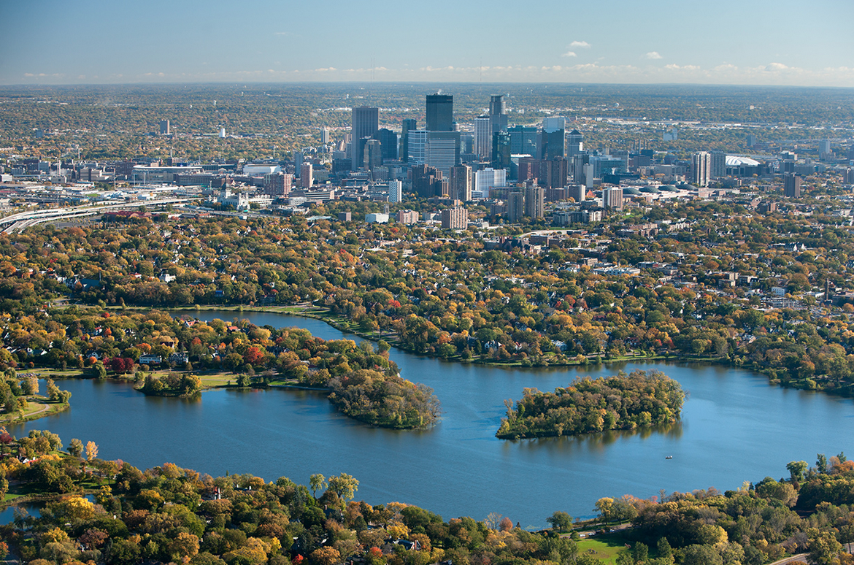
Major Shift in Population
1950 – 1980
“White flight” to suburbs city reduced to 370,000;
From late 1970s, a U.S. refugee re-settlement area

Slide 7
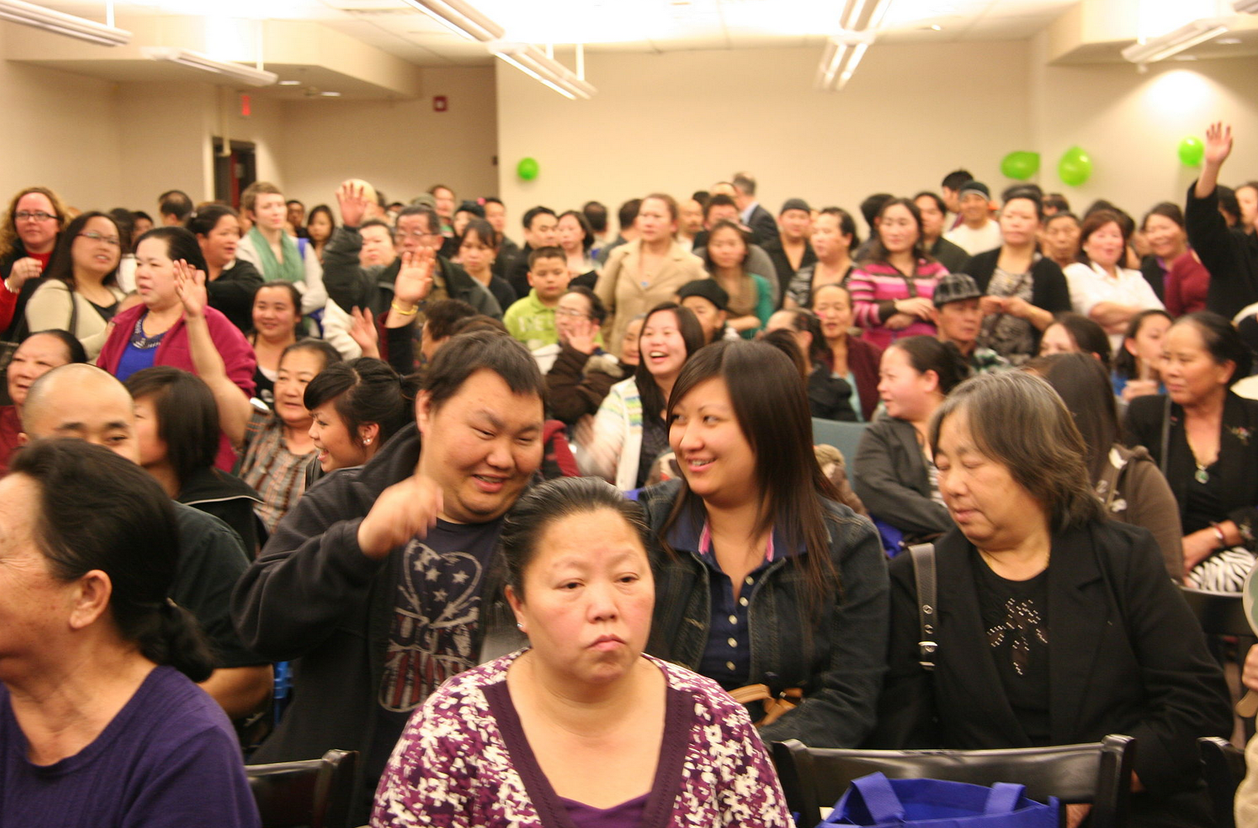
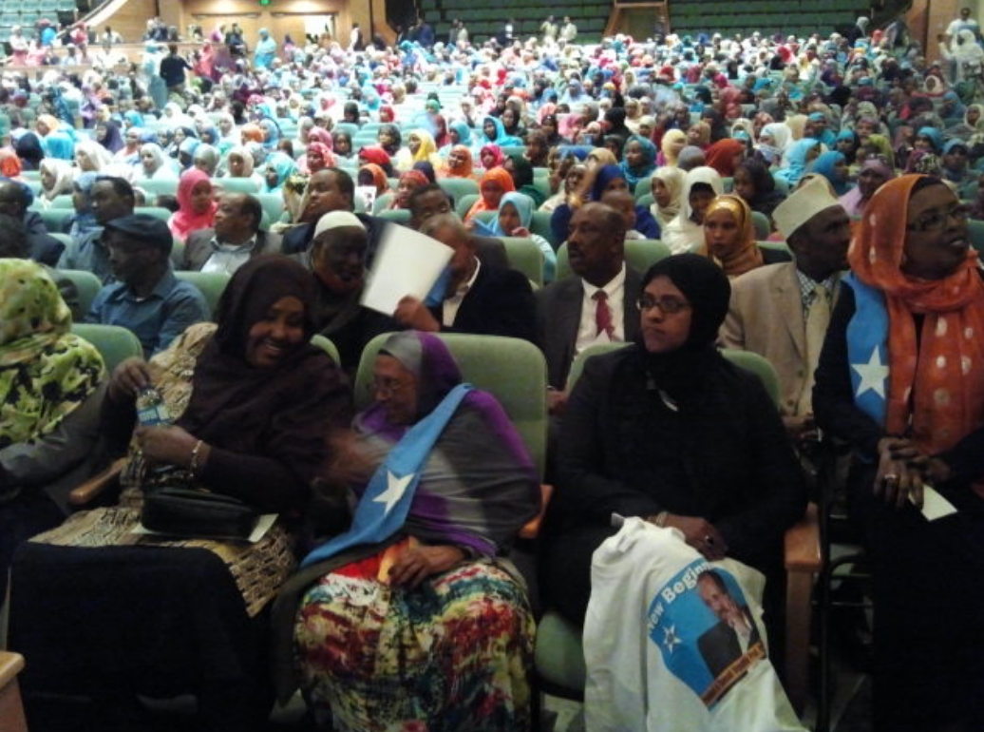
Immigration Returned the City to Growth by the 1990s
Home to the largest populations of Hmong, Somali, and Tibetans outside those home territories; Fast-growing Latin American, other East African, and South Asian communities

Slide 8
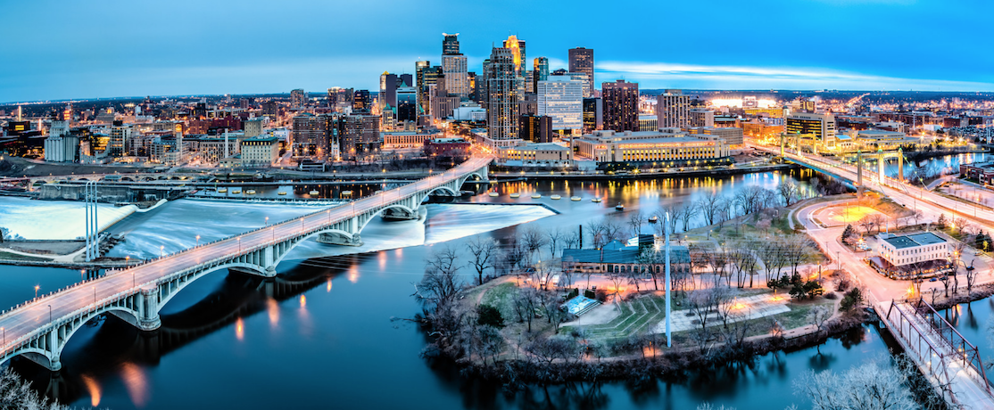
Immigration Returned the City to Growth by the 1990s
By 2014, the city of 400,000 was 60.3% white; 32% of public school students white

Slide 9
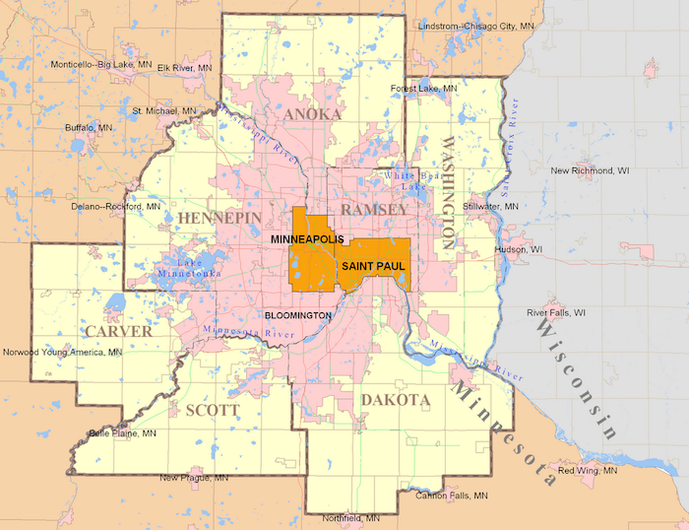
Minneapolis – St. Paul, MN
Metropolitan area of 3.4 million;
From 2000 to 2012 foreign-born increased by 140,000 to 400,000; almost 12% of the regions population

Slide 10
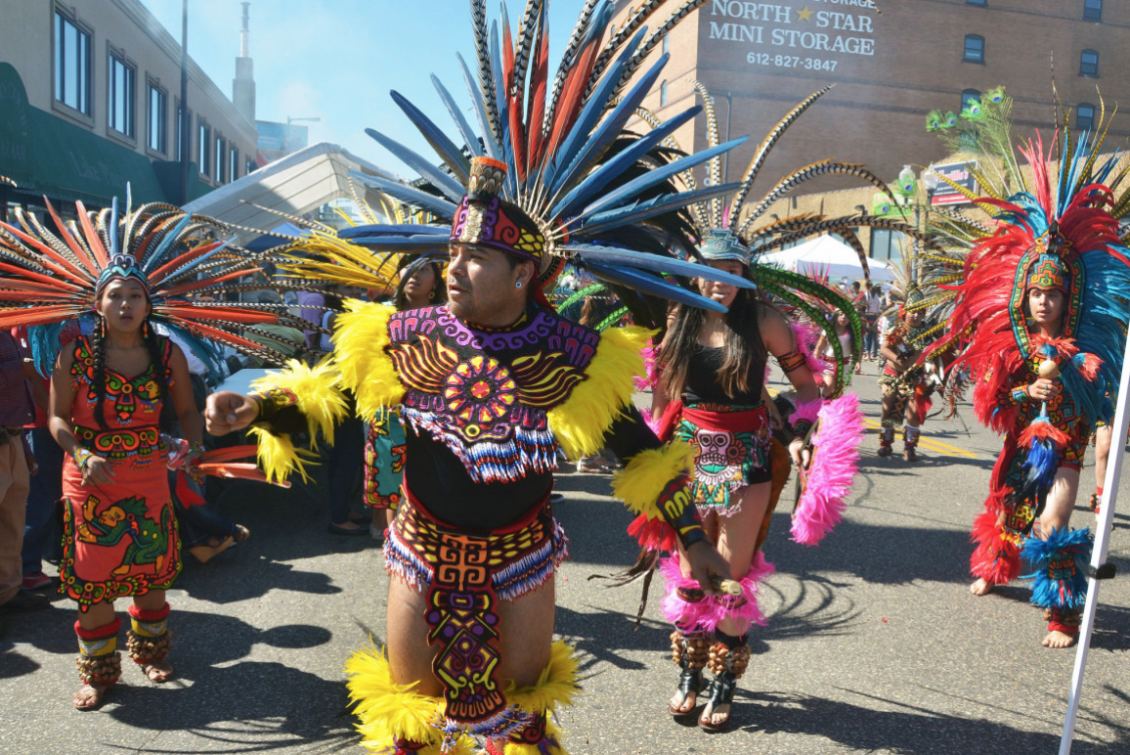
Twin Cities
Immigrant communities concentrate in Minneapolis & St. Paul with combined total population of 700,000

Slide 11
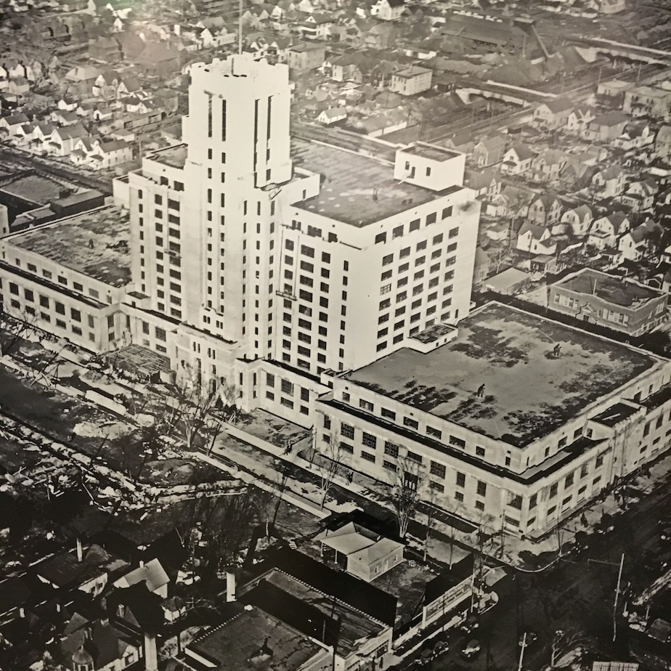
Sears Retail & Catalogue 1927

Slide 12
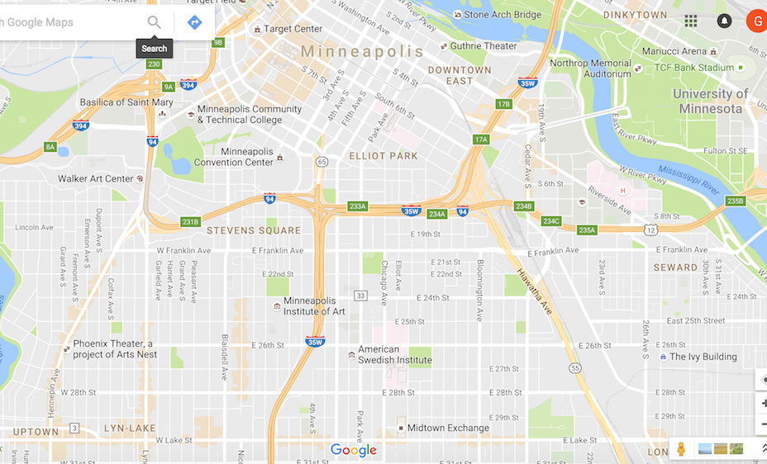
1 Mile South of Downtown
O

Slide 13
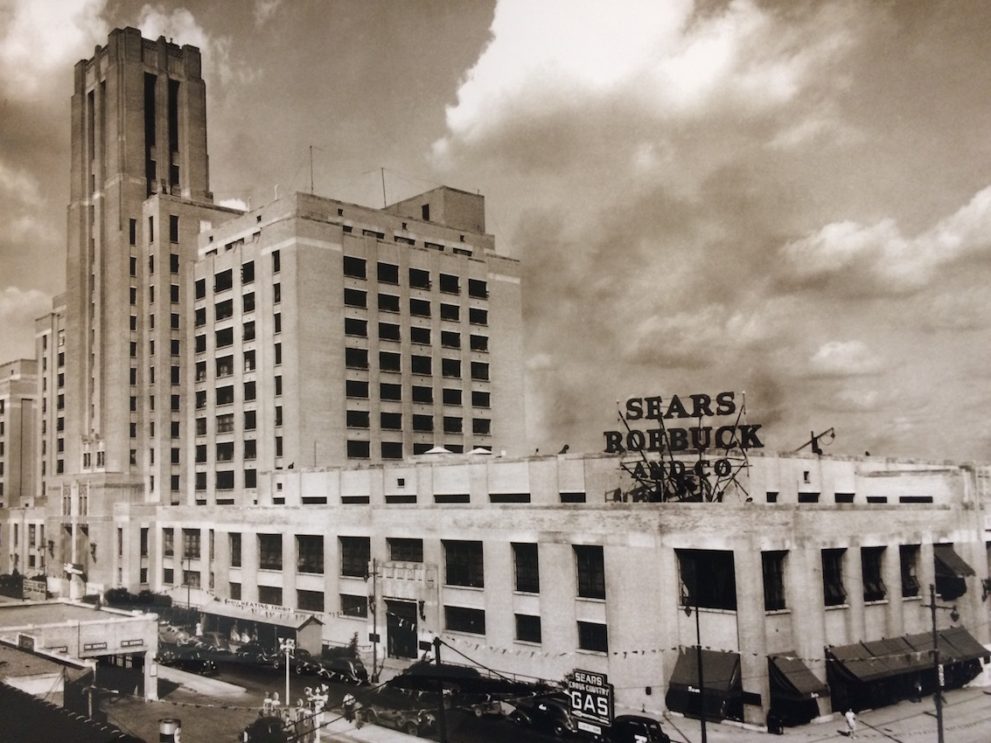
1940

Slide 14
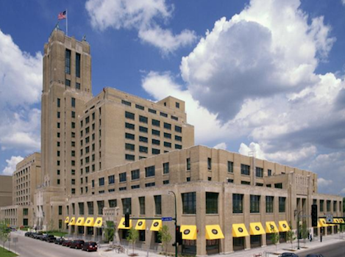
2006

Slide 15
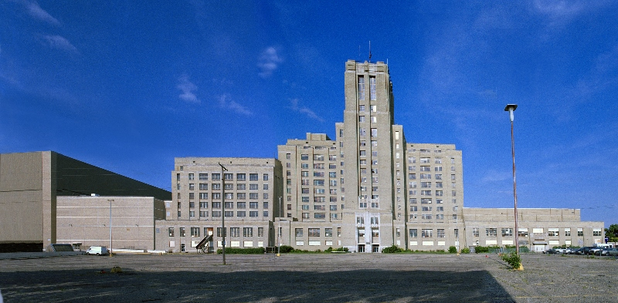
Vacant 1995 - 2005

Slide 16
Vacant 1995 - 2005

Slide 17
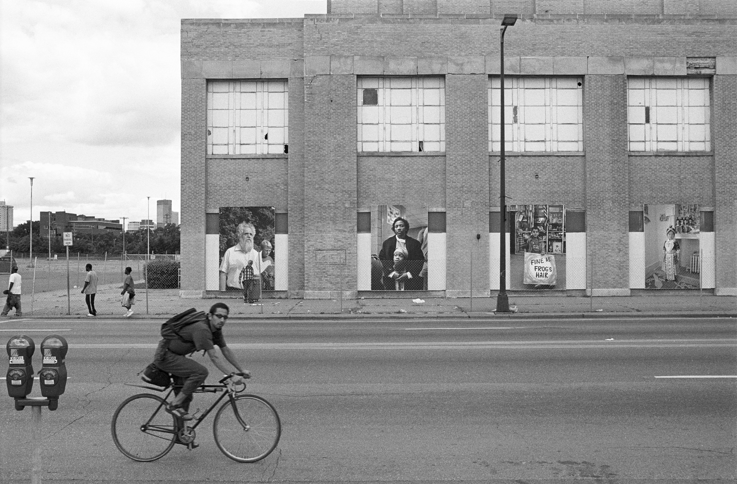
Site of Art Project 2000
Photo by Wing Young Huie

Slide 18
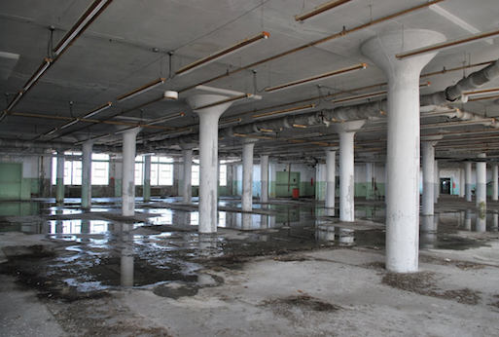
Vacant 1995 - 2005

Slide 19
Global Market Opens 2006

Slide 20
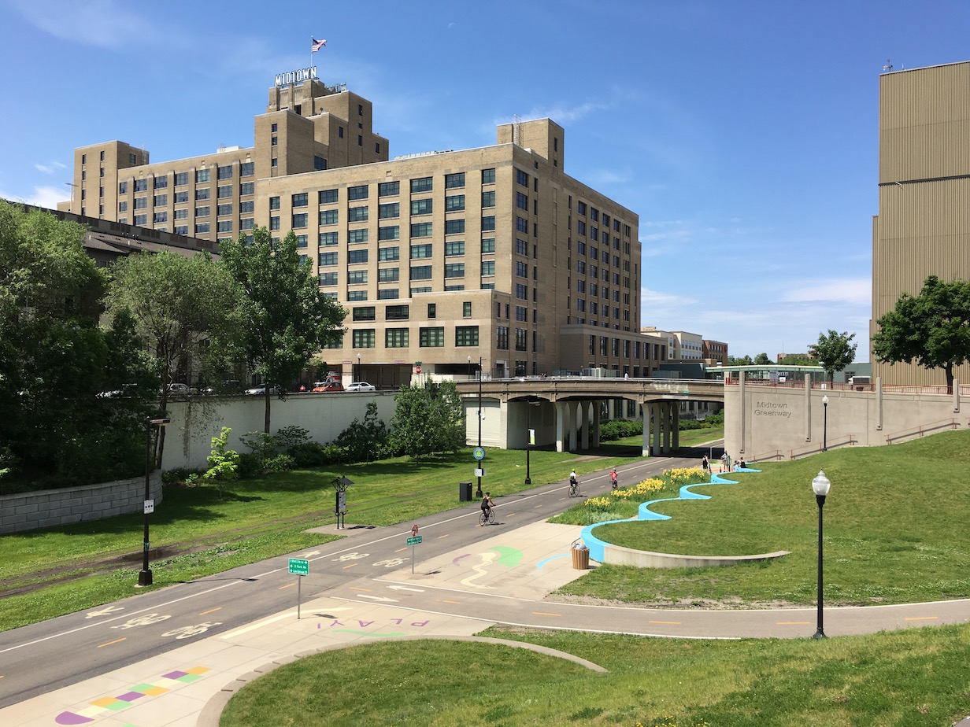
Midtown Exchange Building
1.3 million square foot complex (120,000 square meters).
750-employee Hospital Corporation
Government Service Center (driving licenses, identification, etc.)
70,000-square-foot (21,000 sq. meter) Marketplace

Slide 21
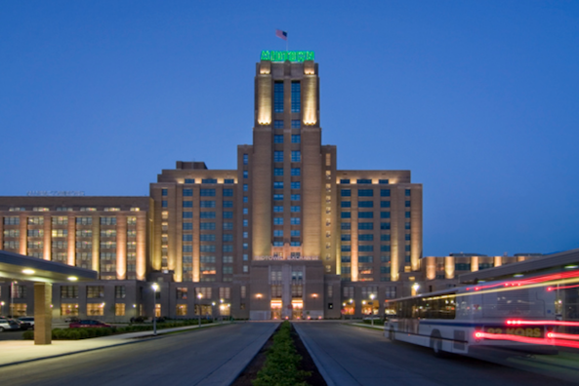
Midtown Exchange Building
280 Rental Apartments; 90 Condominiums; Almost 1,000 residents represent a wide mix of ethnicities

Slide 22
Midtown Global Market
Year-round, indoor marketplace
50 businesses operated by entrepreneurs who originate from 16 countries.

Slide 23
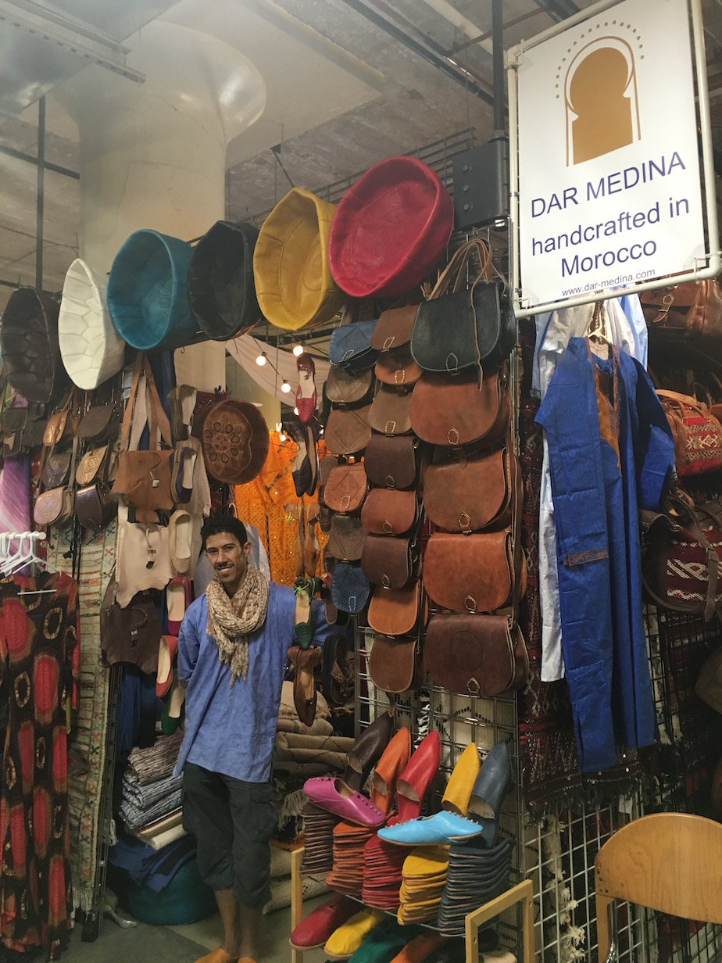
Global Entrepreneurs
Steady growth in visitors and business activity
Average yearly sales (2015) more than $6 million US

Slide 24
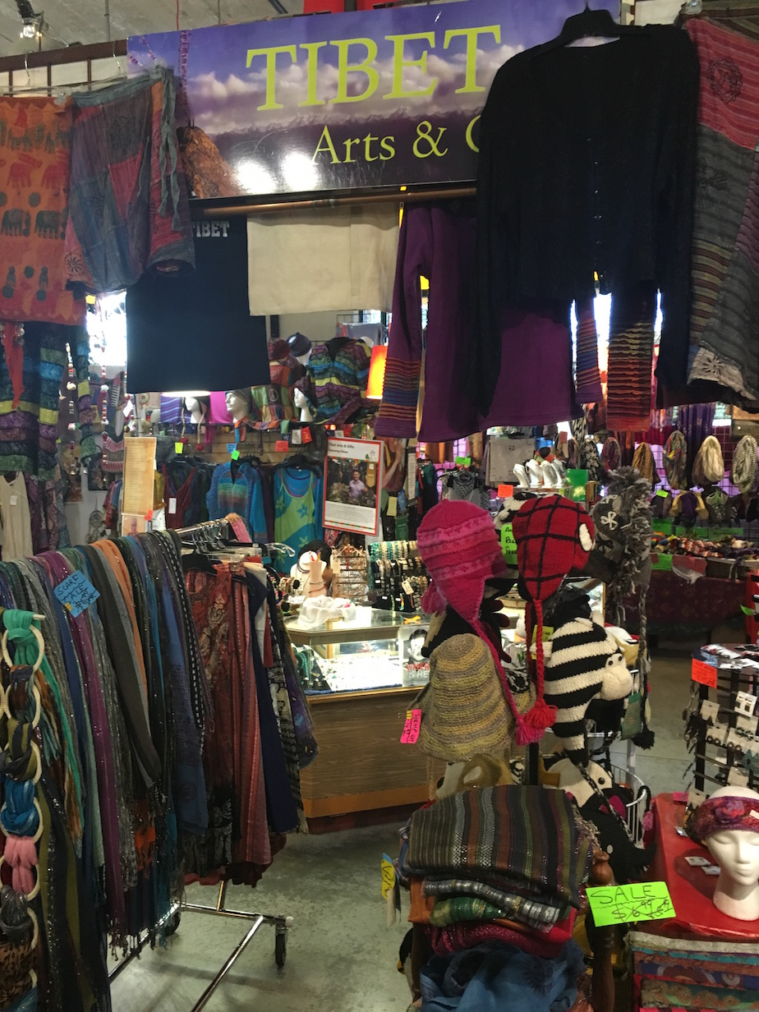
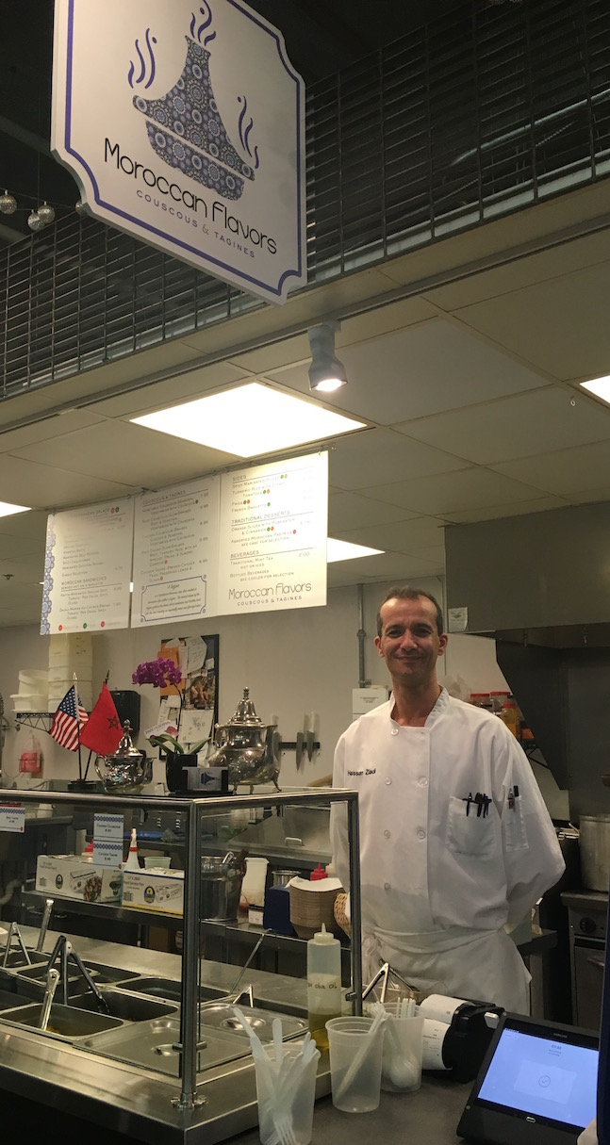
Midtown Global Market
Ethnic foods, local vegetables, fruits, meat, dairy, and other handmade items and foods

Slide 25
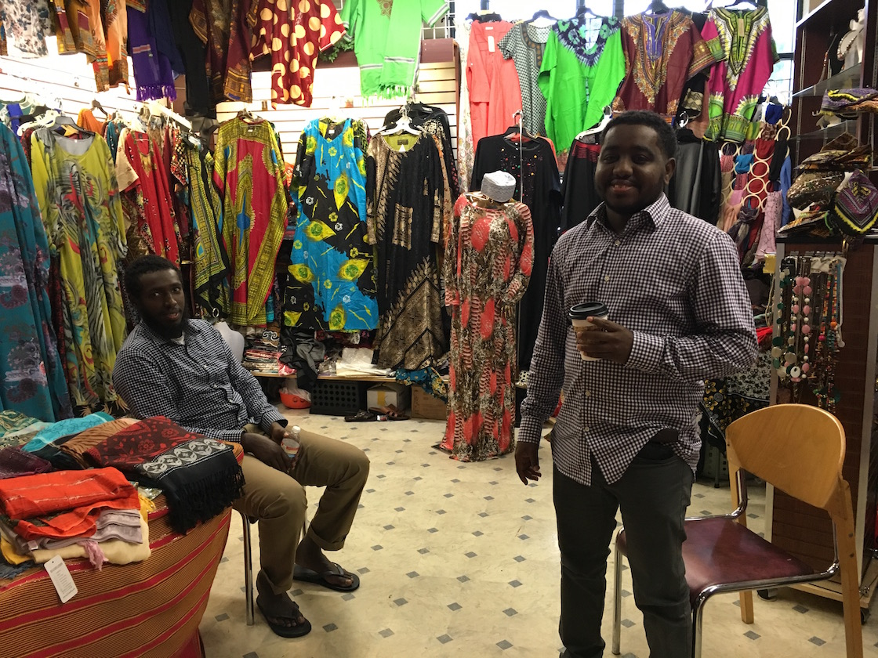
Midtown Global Market
Draws over 1.5 million visitors each year

Slide 26
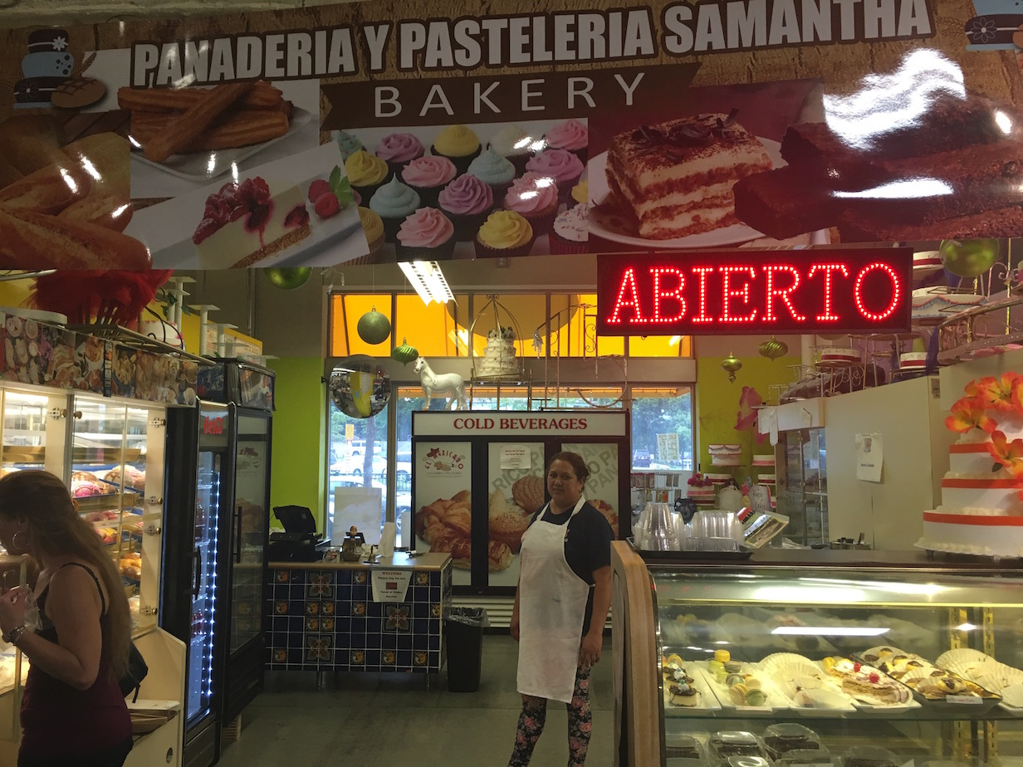
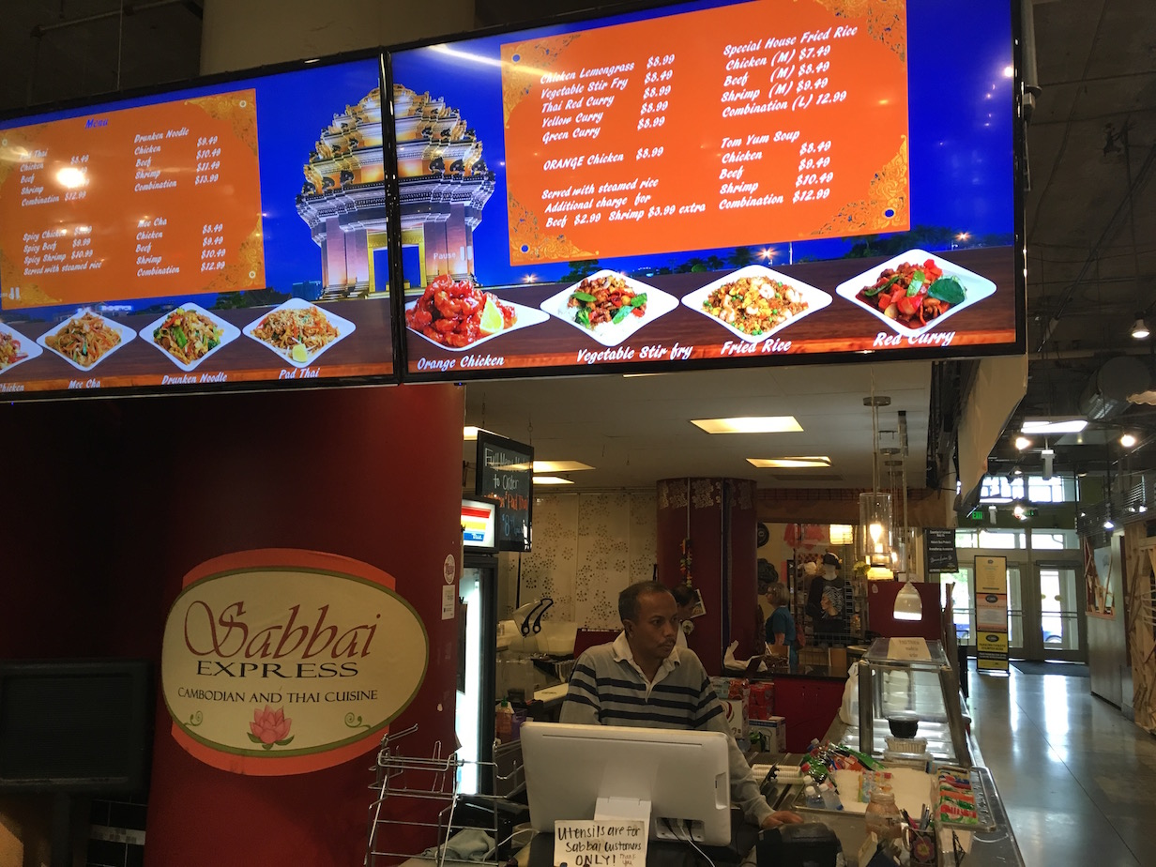
Midtown Global Market
More than 475 jobs created

Slide 27
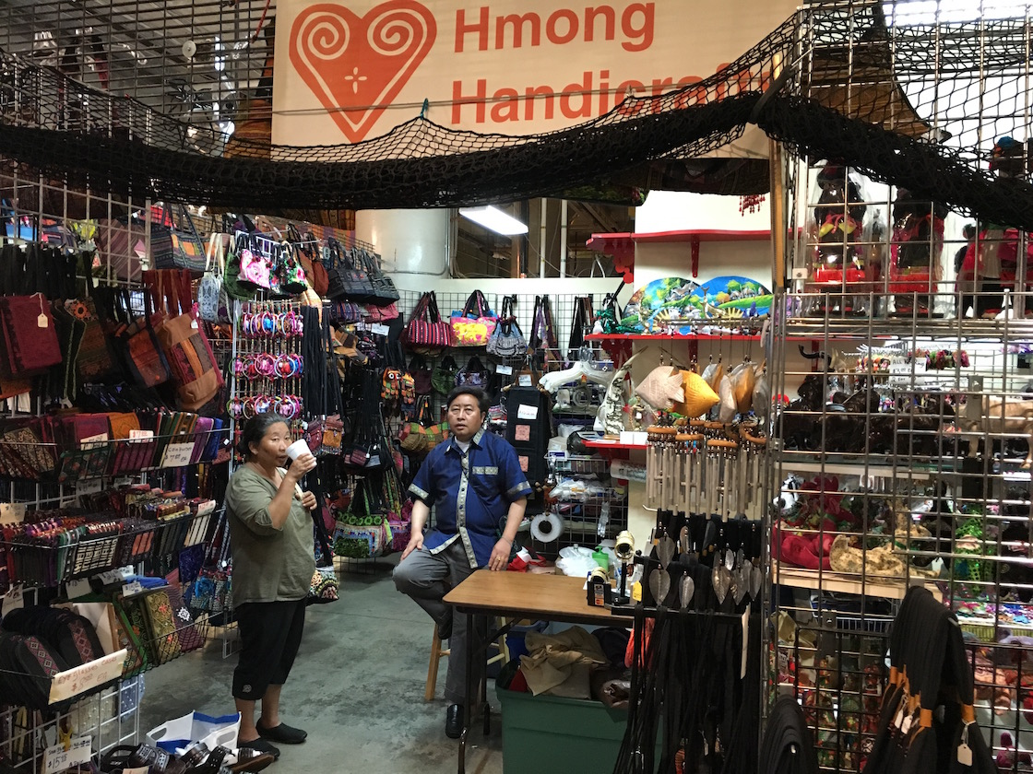
Midtown Global Market
Imported products from dozens of countries in Asia, Latin America, Africa, the Middle East, and Scandinavia stimulate trade and cultural exchange

Slide 28
Midtown Global Market
25 Per Cent reduction in crime in surrounding areas

Slide 29
A Neighborhood Icon

Slide 30
Building Social Capital
Research in an ethnically diverse and therefore “stigmatized” neighbourhood, she found:
“Territorial stigmatization is expected to have negative consequences for social networks, activities, levels of trust and social cohesion in a neighbourhood, but surprisingly this effect is not seen in Sydhavnen, where social cohesion and mutual trust are high.
Helene Lindskov Kjær
Utrecht University, 2016

Slide 31
Spaces Where People Meet
“Meeting opportunities in the public space between the different groups of residents, even though they did not evolve into lasting relations, are found to enhance the mutual trust and social cohesion in the neighbourhood.”
Helene Lindskov Kjær
Utrecht University, 2016

Slide 32
Building Social Capital
Exhibits of local artists, live music 3 to 5 days per week
over 25 large-scale events each year celebrate the eclectic cultures that are part of the market and surrounding neighborhoods

Slide 33
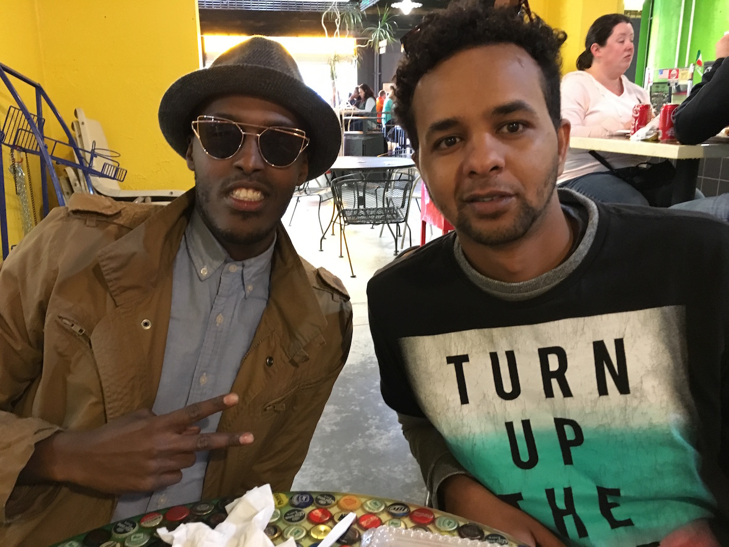
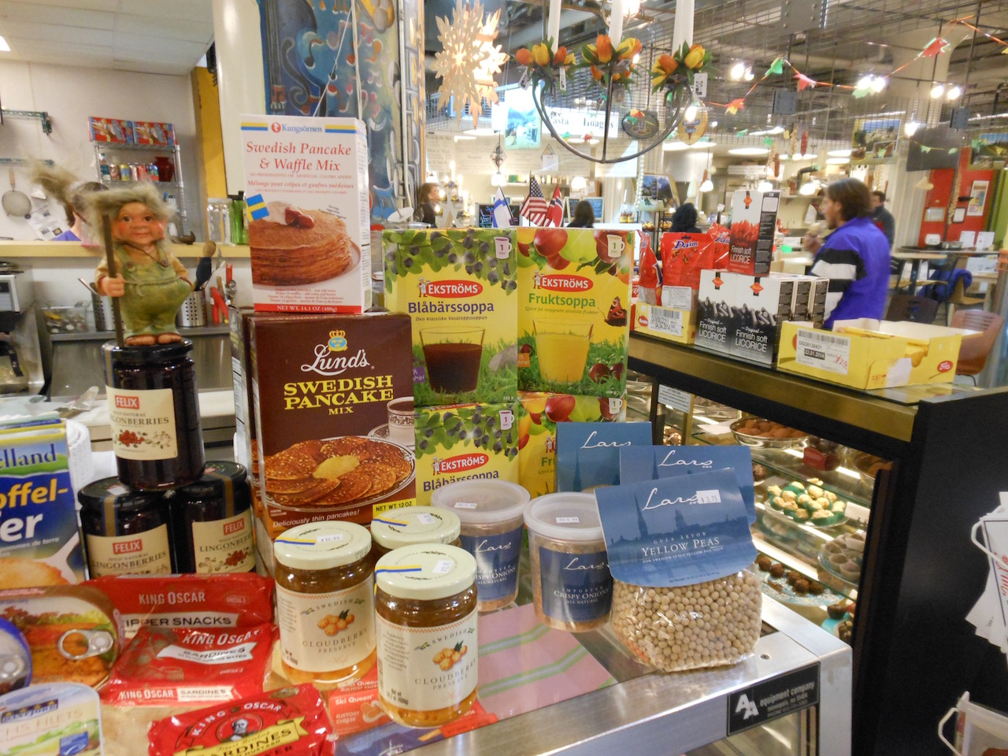
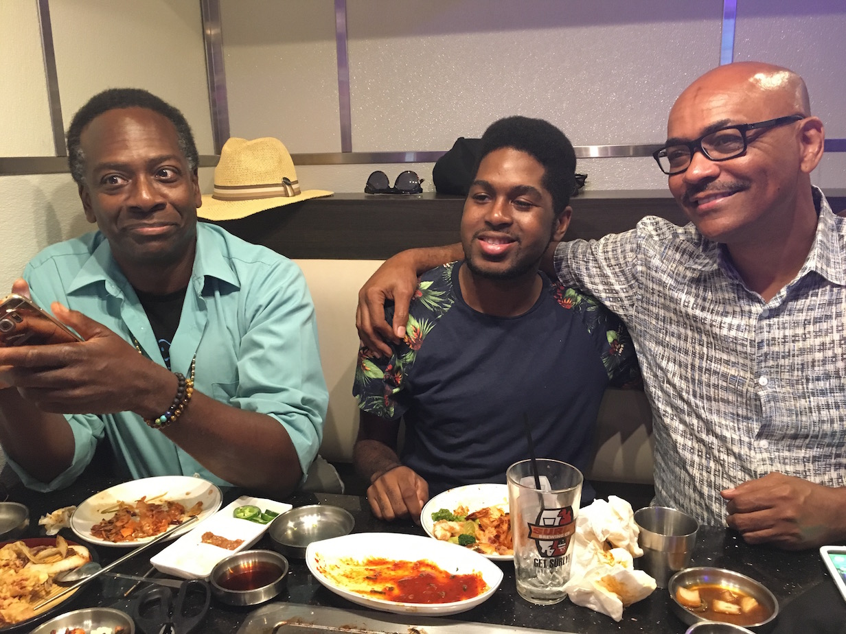
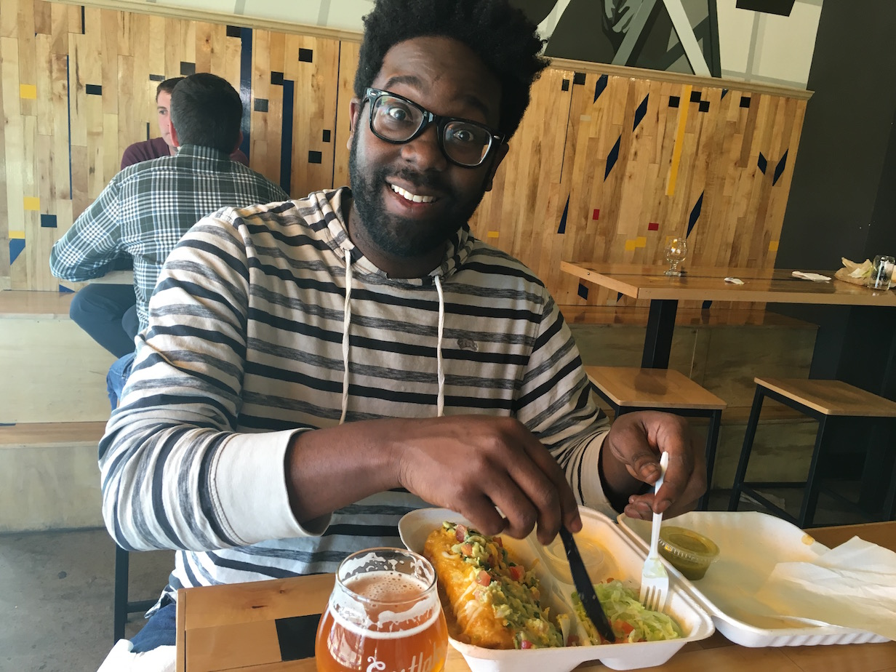
Building Social Capital: Food Connects People

Slide 34
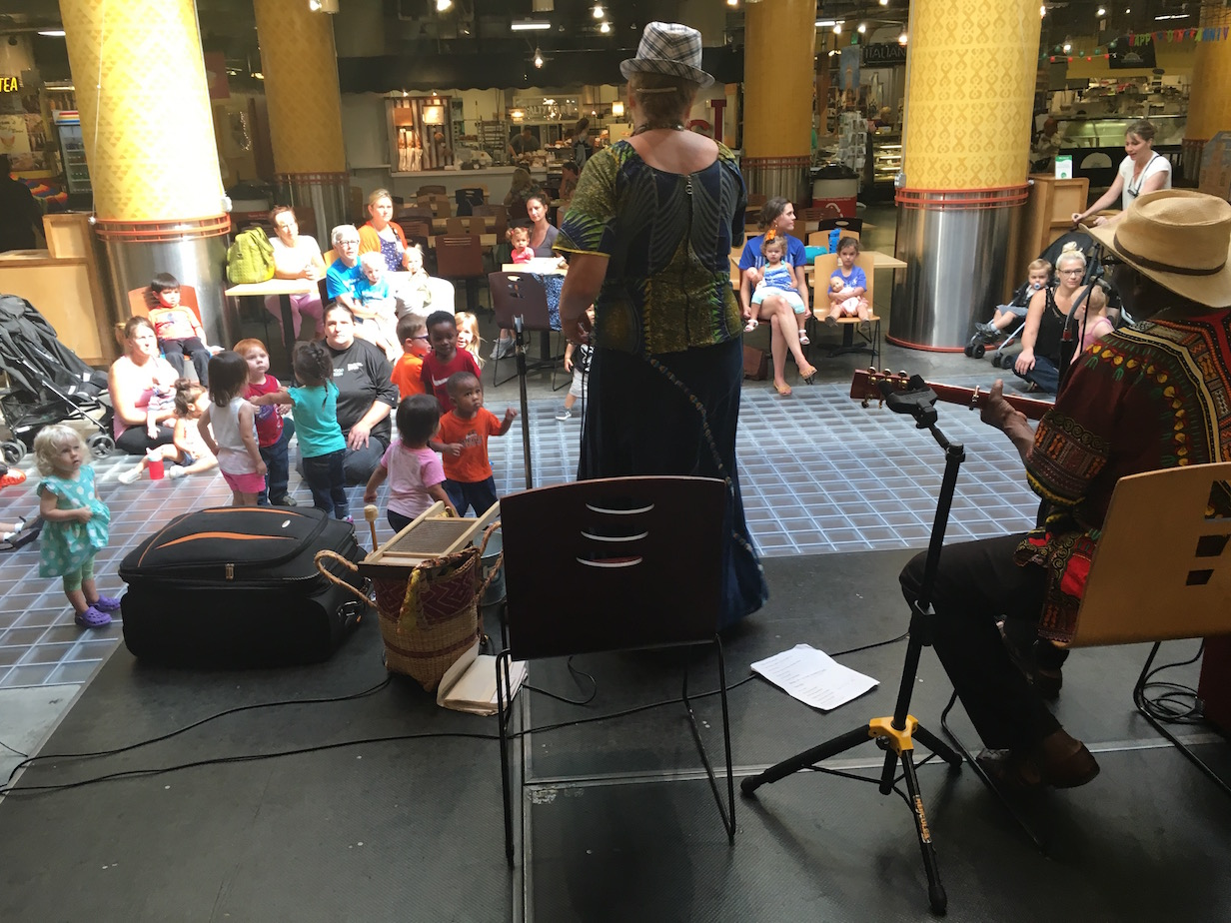
Building Social Capital: Music & Children
Twice weekly events – music & children

Slide 35
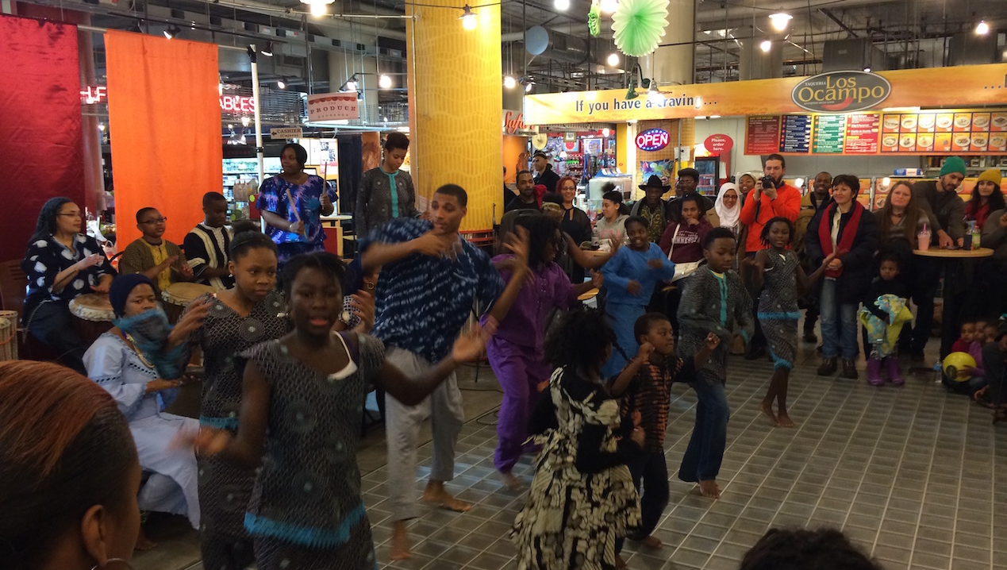
Midtown Global Market
Daily traffic exceeds 4,000 people
Major shift in image of neighborhoods

Slide 36
Rooftop Social Space
Educators from Mexico visit and meet with peers

Slide 37
A Rooftop Social Space
Educators from Mexico visit and meet with peers

Slide 38
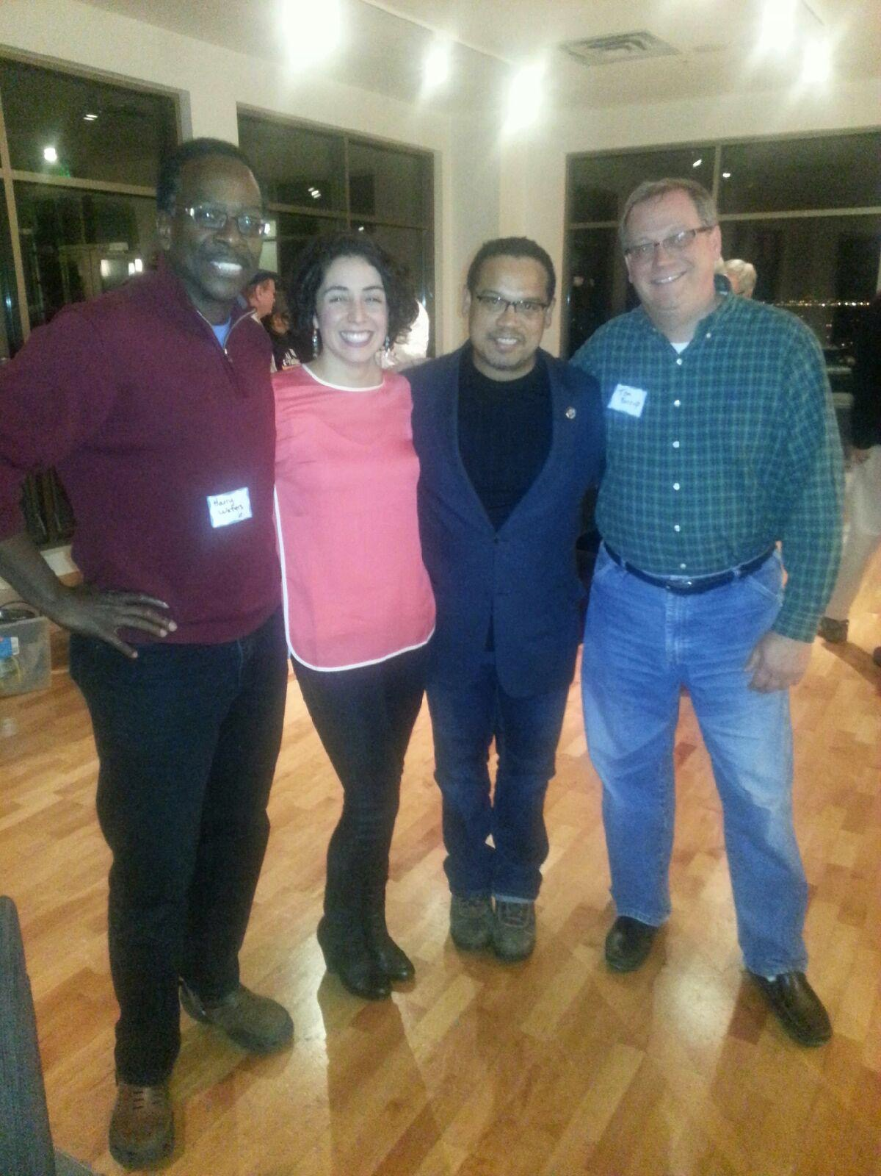
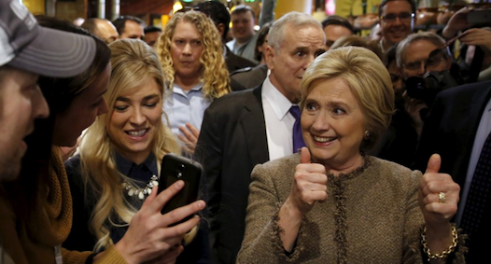
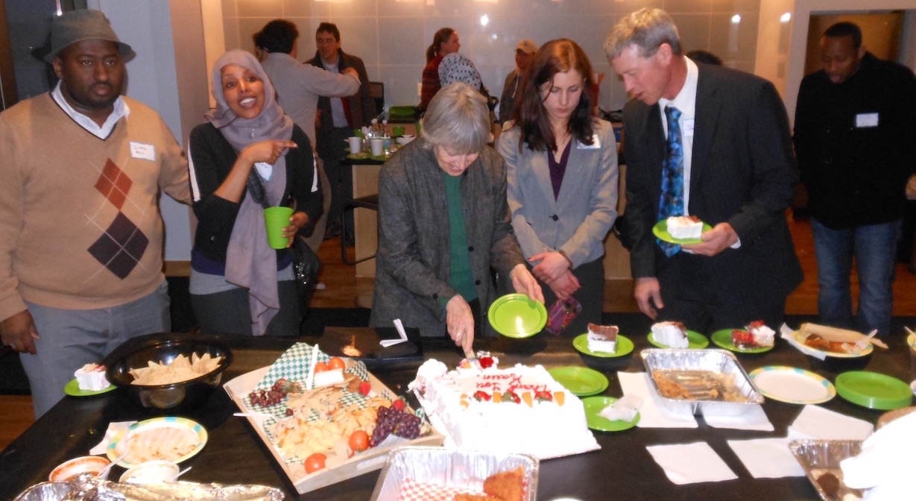
Politicians Campaign

Slide 39
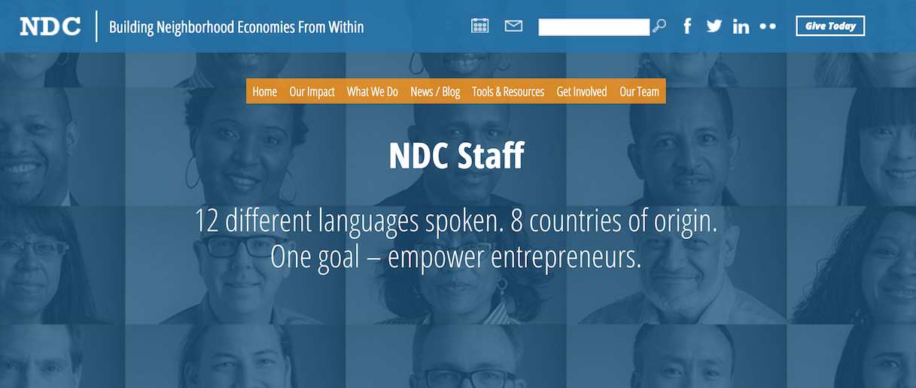
Neighborhood Development Center (NDC)
NGO dedicated to identifying and training local entrepreneurs who can transform their neighborhoods by starting and operating successful businesses.

Slide 40
Neighborhood Development Center (NDC)

Slide 41
Newest Entrepreneurs

Slide 42
Newest Entrepreneurs

Slide 43
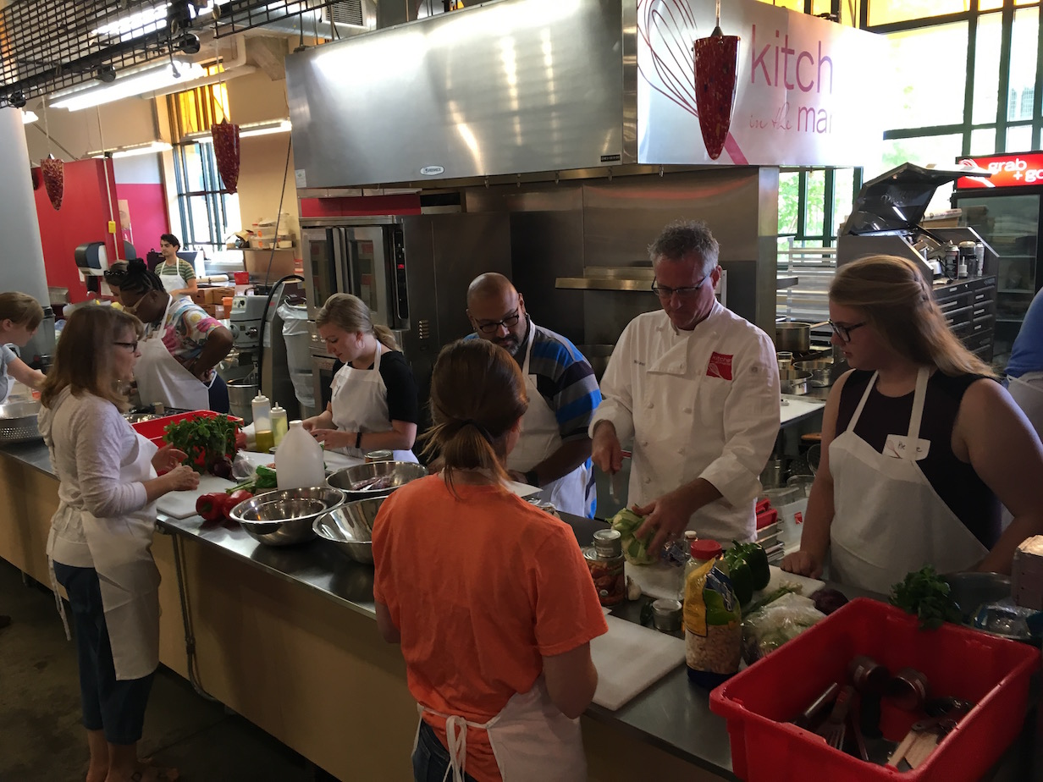
Commercial Kitchen
Food preparation for 25 caterers, food trucks, and craft food producers
Cooking classes

Slide 44
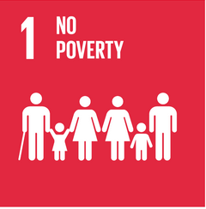
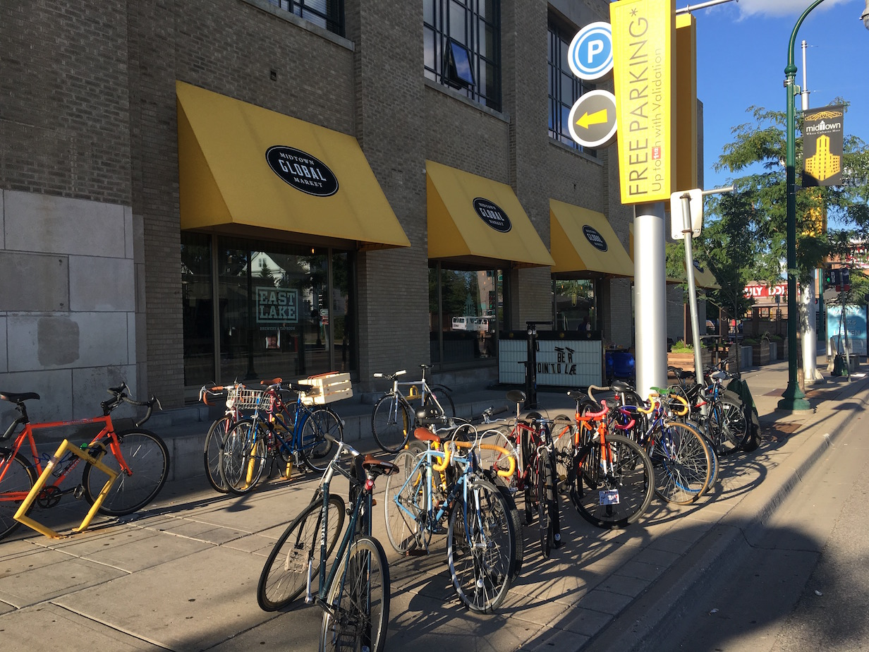
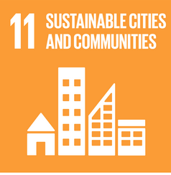
UNESCO Sustainable Development

Slide 45
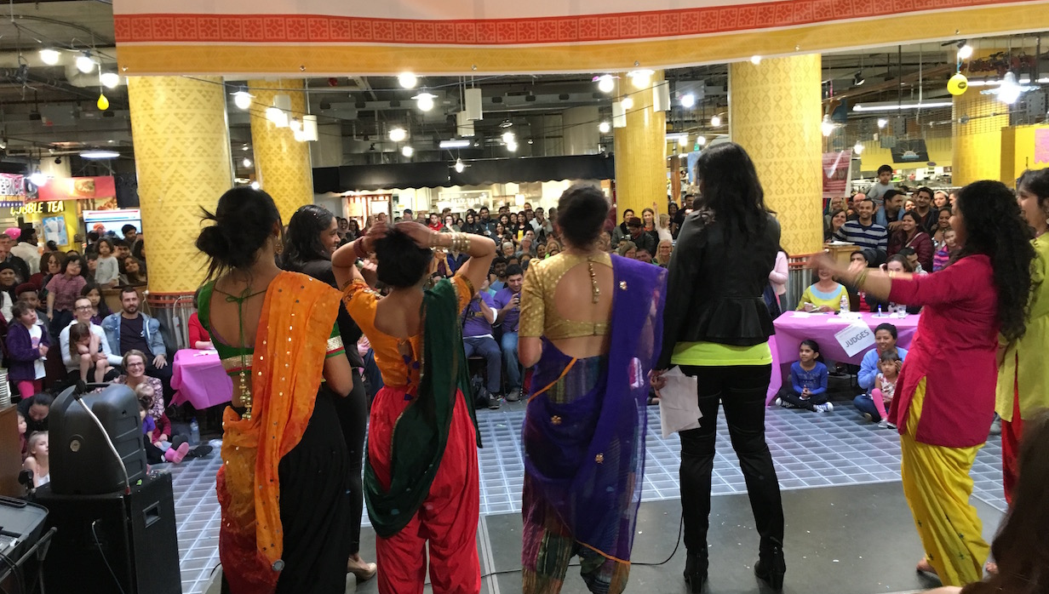
UNESCO Sustainable Development
“Placing culture at the heart of development policies constitutes an essential investment in the world's future and a pre-condition to successful globalization processes that take into account the principle of cultural diversity.”

Slide 46
My Neighborhood

Slide 47
Midtown Global Market: Growing Immigrant Enterprises & New Communities
Conference on Human Dignity and Humiliation Studies – Dubrovnik, Croatia – September 2016
Dr. Tom Borrup
University of Minnesota

