Slide 1
Summary of a Human Rights Based
Child Protection Prevention and Early Intervention Program
Empowering Children, Parents and Schools to Be Safe, Strong and Free
Philip M. Brown, PhD
President, ICAP, Inc.
philipmbrown@gmail.com

Slide 2
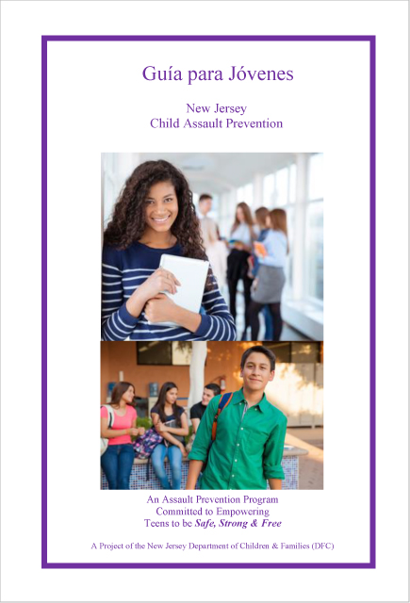
Mission of ICAP
The mission of the International Center for Assault Prevention (ICAP) shall be to improve the quality of life for all children worldwide by reducing the level of interpersonal violence against them through the use of primary prevention education and specifically the use of the Child Assault Prevention (CAP) program in their community.
Notes:
Emphasize – can be tweaked by Advisory Board going forward

Slide 3
History of ICAP
The International Center for Assault Prevention (ICAP), is a 40-year-old organization which has founded prevention programs in 9 U.S. states and 12 additional countries.
ICAP works with local advocates who desire to protect children and strengthen families by starting a Child Assault Prevention (CAP) Project in their community. CAP Projects work to keep children free from abuse, neglect and bullying by utilizing the CAP curricula© in their schools.
With a foundation based on human rights, CAP provides prevention strategies by reinforcing its motto that "All children deserve to be Safe, Strong and Free.”

Slide 4
ICAP CENTERS
Belgium China Canada (4) Croatia
England Estonia France Japan(2)
Korea Moldova Slovenia Dominica U.S.A. (13)

Slide 5
Children, Teachers and Parents Served 2018-19
 | CAP Workshops Conducted by ICAP Regional Training Centers (number of participants served)
Schools Served | 2,458
Teacher/Staff Workshops | 1,223 (23,707)
Parent Workshops | 1,390 (30,914)
Community Adult Workshops | 613 (17,783)
Student Workshops | 13,838 (300,353)

Slide 7
Evaluation Studies – Two Examples
2004 - VanAlst - Center for Children and Families, Rutgers University-
When compared to controls, CAP elementary school participants had statistically significant
Higher levels of self-esteem
Greater knowledge of how to handle bullying, abuse and assault compared to controls.
Were more willing to report abusive situations to adults than youth who had not received the intervention.
2018- 19 – Feric, Ph.D, Trbus, Juranic, Bandic (University of Zagreb, Croatia)
Pre and posttest of 169 students and parents at four middle schools:
Students gained knowledge of safety rights, power and control in peer and dating relationships and willingness to report violence to self and others as a result of participating in TeenCAP program.

Slide 8
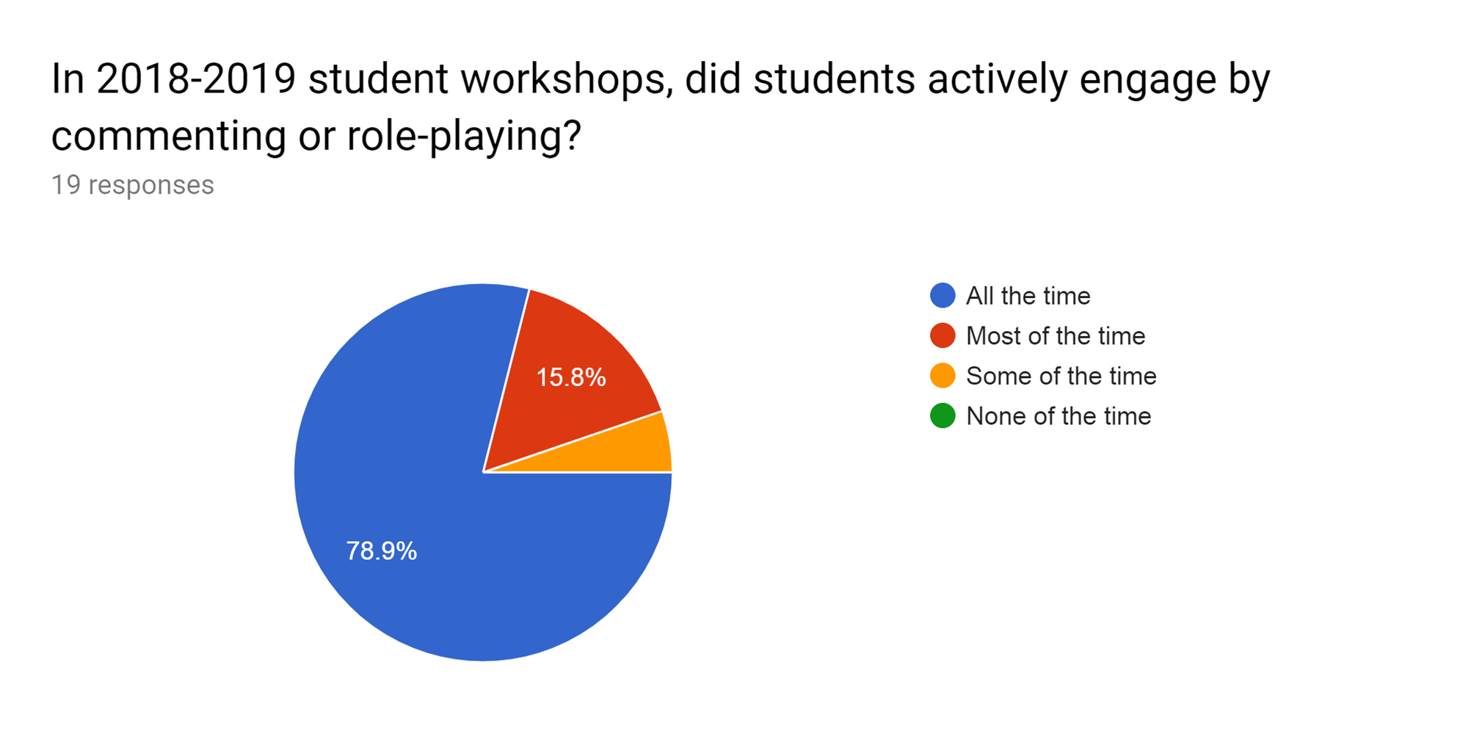

Slide 9
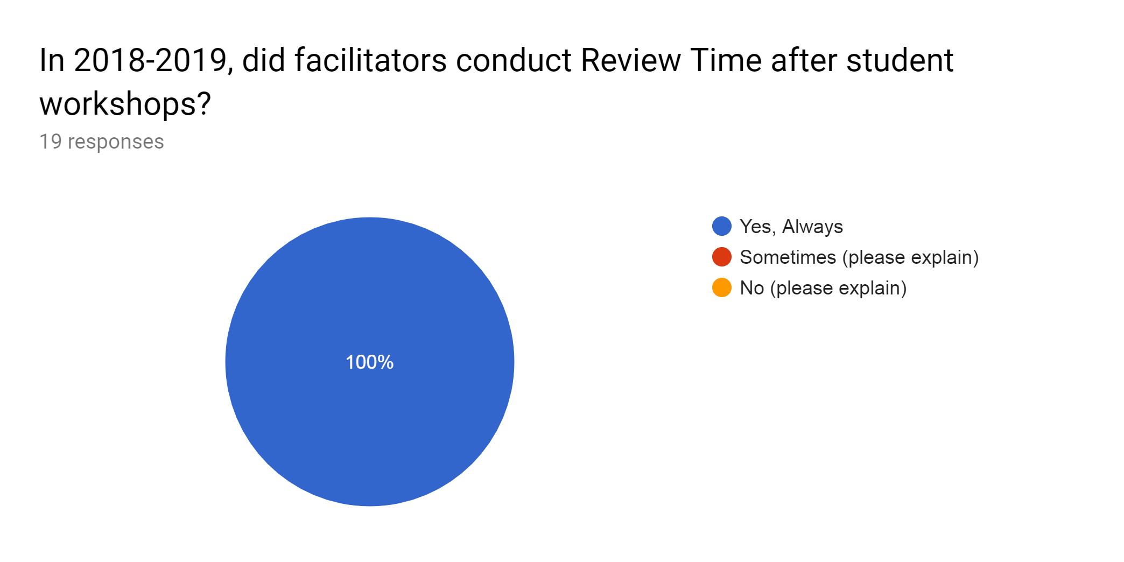

Slide 10
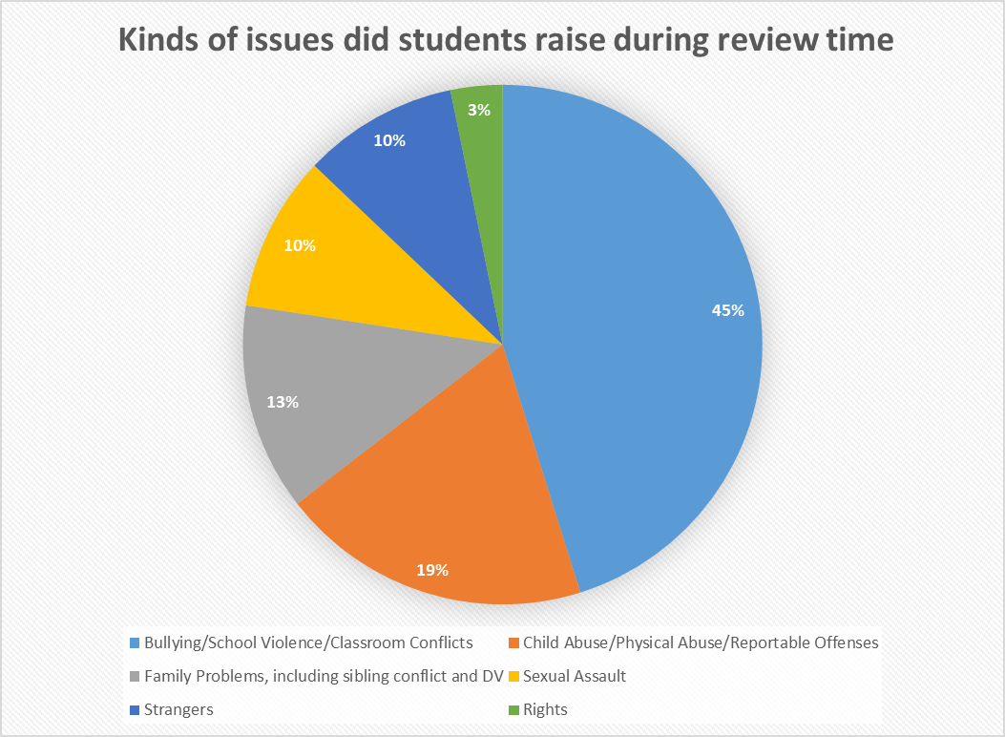

Slide 11
RTC Response/Referral When Children Reported Abuse or Neglect
Provide emotional support 12%
Refer child for emotional support 12%
Report to school personnel 76%
Report to CPS or comparable agency 47%
(Some Respondents reported more than one approach)

Slide 12
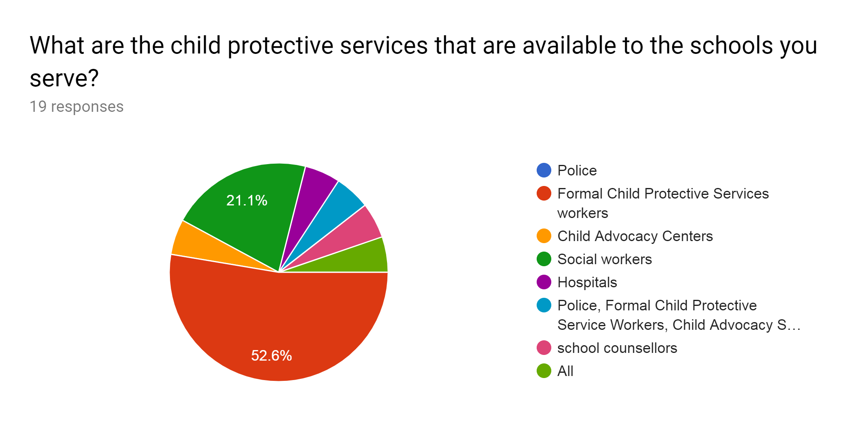

Slide 13
CROATIA CAP – Case example
An eight-year-old girl came to the Zagreb Clinic, accompanied by her mother. We found out that after experiencing a CAP workshop, this girl opened up to a CAP Facilitator and told her about the inappropriate sexual behavior she had experienced from her older cousin. As a result, her mother was notified, and the child and mother referred to the clinic where an investigation determined that the child had been carrying the secret of abuse for a long time. She and the family underwent regular counseling to deal with the trauma and recovery. This child finally got the help she needed to stop the sexual abuse she had been enduring. We credit it largely to the CAP Project in her school. – Child Psychologist, Zegreb Clinic – submitted by Parents Association Step by Step, Zagreb, Croatia

Slide 14
KOREA CAP – Case example
–A fourth grade boy was being bullied by other kids because of the way he looked. He never told anyone until CAP came to his classroom and told him he had rights to be safe. After the workshop he disclosed and the CAP Specialists problem solved with him as well as reported it to the school contact. The school confronted the situation and the other children no longer bully him and he feels empowered

Slide 15
Current interest from other countries
Africa: Kenya; South Africa
Australia
Caribbean - St Vincent; Puerto Rico
Europe – Macedonia
South America – Columbia
More interest from Latin American countries is welcome!

Slide 16
All children have the right to be:
SAFE,
STRONG, And
FREE!!!
https://internationalcap.org/

