Slide 1
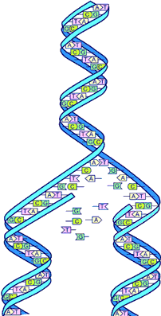
q
Prosocial Development
Moral Sensibility Strand
Social Sensibility Strand
Empathy
Fairness
Self-Regulation
Obligations to Others

