Slide 1
Confronting Narratives of Hate with Stories of Dignity
Claudia E. Cohen, Ph.D. H.D.H.S. Conference, Dec 2018

Slide 2
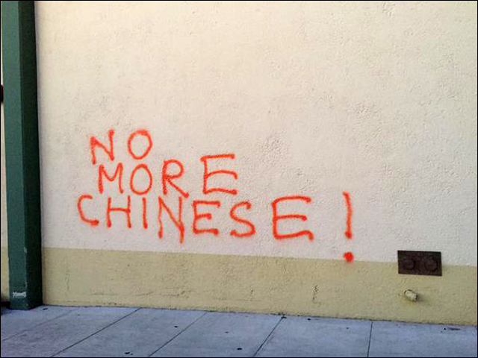
When GRAFFITI is a Narrative of Hate

Slide 3
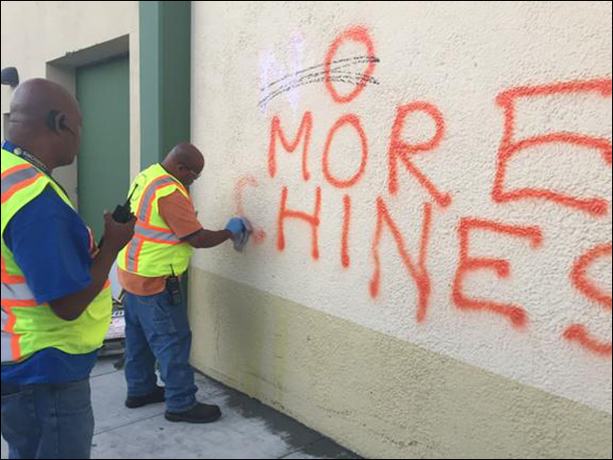
What to do? Erase the words?

Slide 4
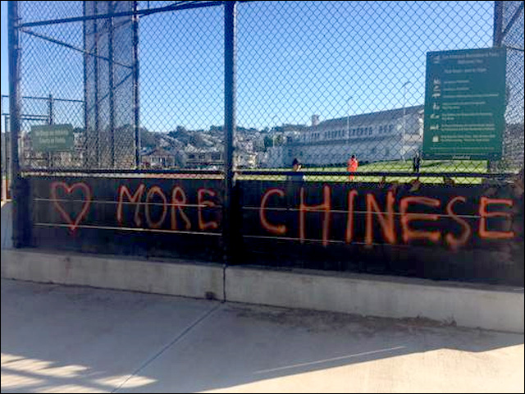
Edit it ?

Slide 5
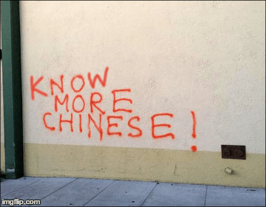
Or replace with a story of dignity….

Slide 6
Reflections on Graffiti, etc.
Hate “speech” as an opportunity for learning
Restorative acts of dignity
Can we separate the message from the messenger?
Challenge: acknowledging the humanity of those who speak hate

