Slide 1
Welcome to the 2017 Human DHS Workshop on Transforming Humiliation
and Violent Conflict December 7-8, 2017
Convened by the Morton Deutsch International Center for Cooperation and Conflict Resolution (MD-ICCCR) at Teachers College and the Advanced Consortium on Cooperation, Conflict and Complexity (AC4), Earth Institute, Columbia University

Slide 2
2017 Workshop on Transforming Humiliation and Violent Conflict
This year’s theme:
"The Nature of Dignity – the Dignity of Nature"
Convened by the Morton Deutsch International Center for Cooperation and Conflict Resolution (MD-ICCCR) at Teachers College and the Advanced Consortium on Cooperation, Conflict and Complexity (AC4), Earth Institute, Columbia University

Slide 3
Morton Deutsch’s Ongoing Legacy
It is hard to overstate Mort's impact on the fields of psychology, conflict resolution, and peace and justice, and his loss is felt deeply by so many of us within the TC and Columbia communities and well beyond. In honor of his influence as a scholar, teacher, mentor, and friend, we helped organize several events, presentations, commemorations and reflections on his legacy:
• Memorial event at Teachers College with reflections from his former
students, colleagues, and members of his family. Video and photos: http://icccr.tc.columbia.edu/morton-deutschmemorial/
• Established the Morton Deutsch Endowed Fellowship through crowd-funded support from alumni, family and friends. The fellowship will support students in TC's Social and Organizational Psychology program who are studying conflict resolution.
• We have two written commemorations in the works for Mort. Peter Coleman wrote one for the American Psychologist, which will come out in 2018. There will also be a special section of the January 2018 edition of Negotiation Journal offering a tribute to Mort that Peter edited with contributions from Dean Pruitt, Dan Druckman, David and Roger Johnson, Susan Opotow and Peter.

Slide 4
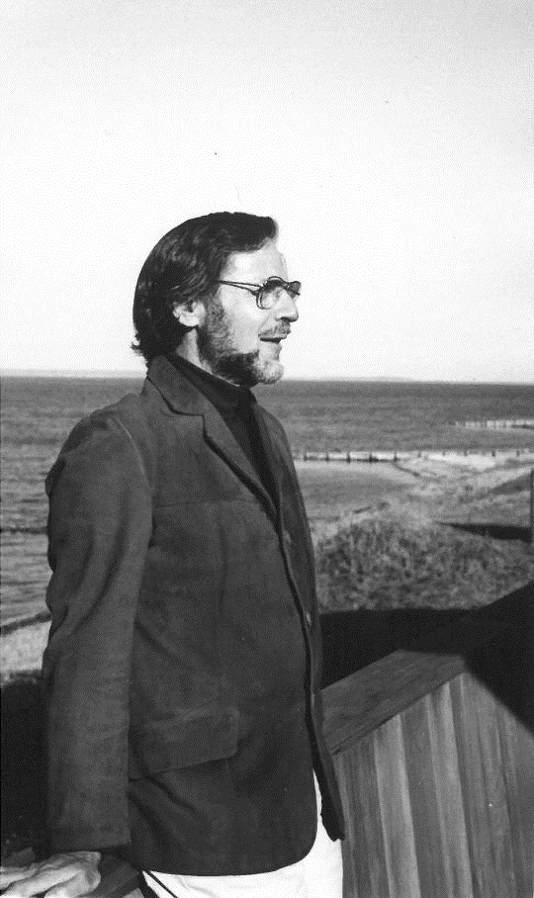
Morton Deutsch’s Ongoing Legacy
Peter authored a reflection in the School for Conflict Analysis and Resolution newsletter at George Mason.
Peter published a series of 10 blog posts on Mort's contributions that ran on Psychology Today, HuffingtonPost, and which are continuing to run on Mediate.com. You can find links to all of these at: http://icccr.tc.columbia.edu/10-big-ideas-on-peace-and-justice/
• We hosted a novel session on Mort's legacy at this year's International Association for Conflict Management conference, including presentations from four of his former students and colleagues who are current leaders in the field of conflict management. Susan Opotow and Michelle Fine hosted a similar event at APA last summer.

Slide 5
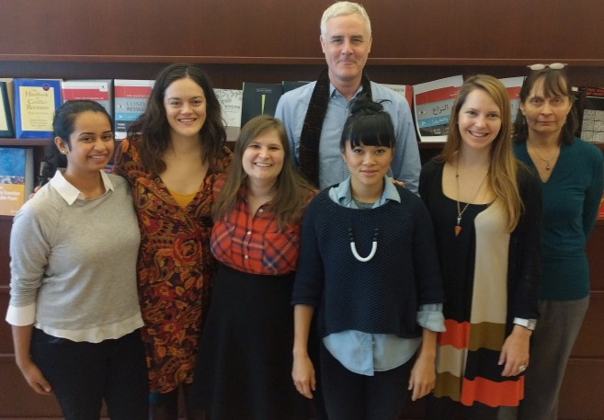
Morton Deutsch Center for Cooperation and Conflict Resolution (MD-ICCCR)
Director: Dr. Peter Coleman
Vigorous, leading-edge dynamical systems research program (intractable conflict; culture & conflict; power & conflict; justice and conflict; environmental conflict; mediation and sustainable peace)
Advanced Certificate Program in Conflict Resolution with ~300 graduates
Projects linking theory & research and
practice applications (e.g., PAR project with Fortune Society; World Bank consulting)

Slide 6
Current Research Areas

Slide 7
MD-ICCCR & Human Dignity and Humiliation Studies
Human Dignity and Humiliation Studies embodies MD-ICCCR’s commitment to social justice
Highlights link between moral emotions, conflict escalation & intractability
Dignity is essential for sustainable peace

Slide 8
Conflict Resolution at Columbia University
AC4 = Advanced Consortium on Cooperation, Conflict and Complexity
Brings together people and institutions from various disciplines at Columbia to tackle complex problems with integrated solutions, understandings and methodologies
Some AC4 Participant Organizations:
MD-ICCCR
Center for Intl Conflict Resolution – at School of Intl. and Public Affairs
NECR - M.S. Program on Negotiation and Conflict Resolution at Columbia’s School of Continuing Education
Mediation Clinic at Columbia Law School

Slide 9
Conflict Resolution at Columbia University
AC4 :
Director: Dr. Josh Fisher
Housed at the Earth Institute
Committed to advancing knowledge and best practices in the areas of conflict, violence prevention, sustainable peace and development
www.ac4.ei.columbia.edu/
AC4 Link connects user to programs, departments and individual conflict scholars
Offers grants and fellowships to graduate students, post-docs and faculty; IACM graduate student fellowships

Slide 10
A Powerful Partnership: Human Dignity and Humiliation Studies (HumanDHS) and Conflict Resolution at Columbia (AC4)
Annual Workshop - Human DHS Transforming Humiliation and Violent Conflict
A Learning Community gathers to reflect on conflict and emotion and the role of dignity and humiliation
AC4 is built upon trans-disciplinary learning and collaboration

