Slide 1
Imperial Dispossession of ‘Others’ by Falsification of Dignity
Fonkem Achankeng I, PhD
University of Wisconsin Oshkosh
30th Annual HumanDHS Conference and the Twelfth Workshop on Transforming Humiliation and Violent Conflict
Teachers College, Columbia University, New York City
December 7 -8, 2017 Theme: The Nature of Dignity and the Dignity of Nature

Slide 2
Invitation to Reflection
“In pre-modern European discourses, non-Western peoples tend to be characterized not in any anthropologically specific terms, but as a lack or poorer form of the values of the centre. From this perspective, discussion of representations of ‘the Other’ is almost misleading insofar as it implies recognition of a distinctive type.”
Nicholas Thomas, p. 1994,71

Slide 3
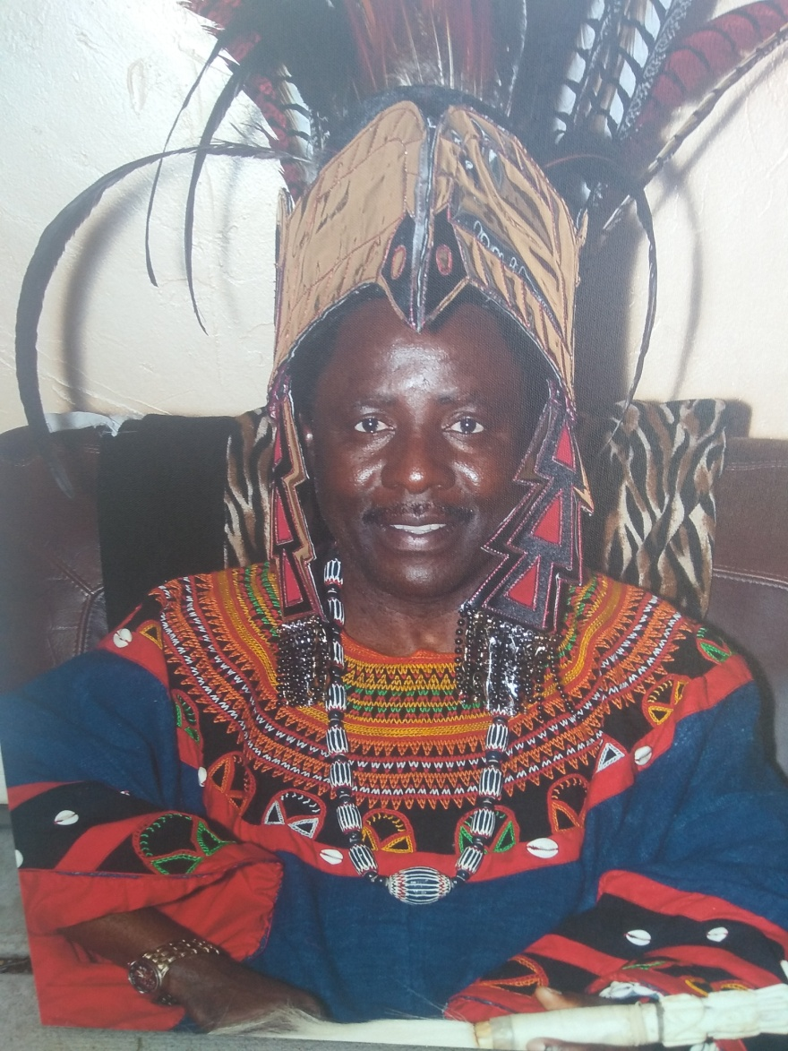
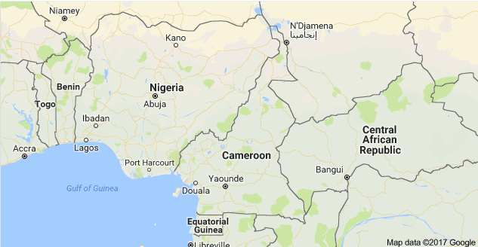
Intro

Slide 4
Situation of My Origins
Situation of my origins
Independence struggle
https://www.youtube.com/watch?v=QKe6htZ8FZ4
Why place a people in this situation?

Slide 5
Argument & Basis
On the basis of colonial and postcolonial theories, I argue that the imperial dispossession of others is sustained in the process by the portrayal of ‘Others’ as incomplete or imperfect rather than as humans of different ‘races’ and ‘cultures.’

Slide 6
Reality
Claim, in agreement with Nicholas Thomas (1994, p. 71), that the underlying epistemic operation of partitioning the human species by situating some “just above apes, and others as immature civilizations” is not only humiliating, but enhances their dispossession by some.

Slide 7
Two Important Points
To enhance imperialist policies of global domination for cheap natural resources the dignity of ‘some’ is falsified.
For the dignity of nature to thrive, we must understand and accept a global world of humans in the plurality of different ‘races’ and ‘cultures’.

Slide 8
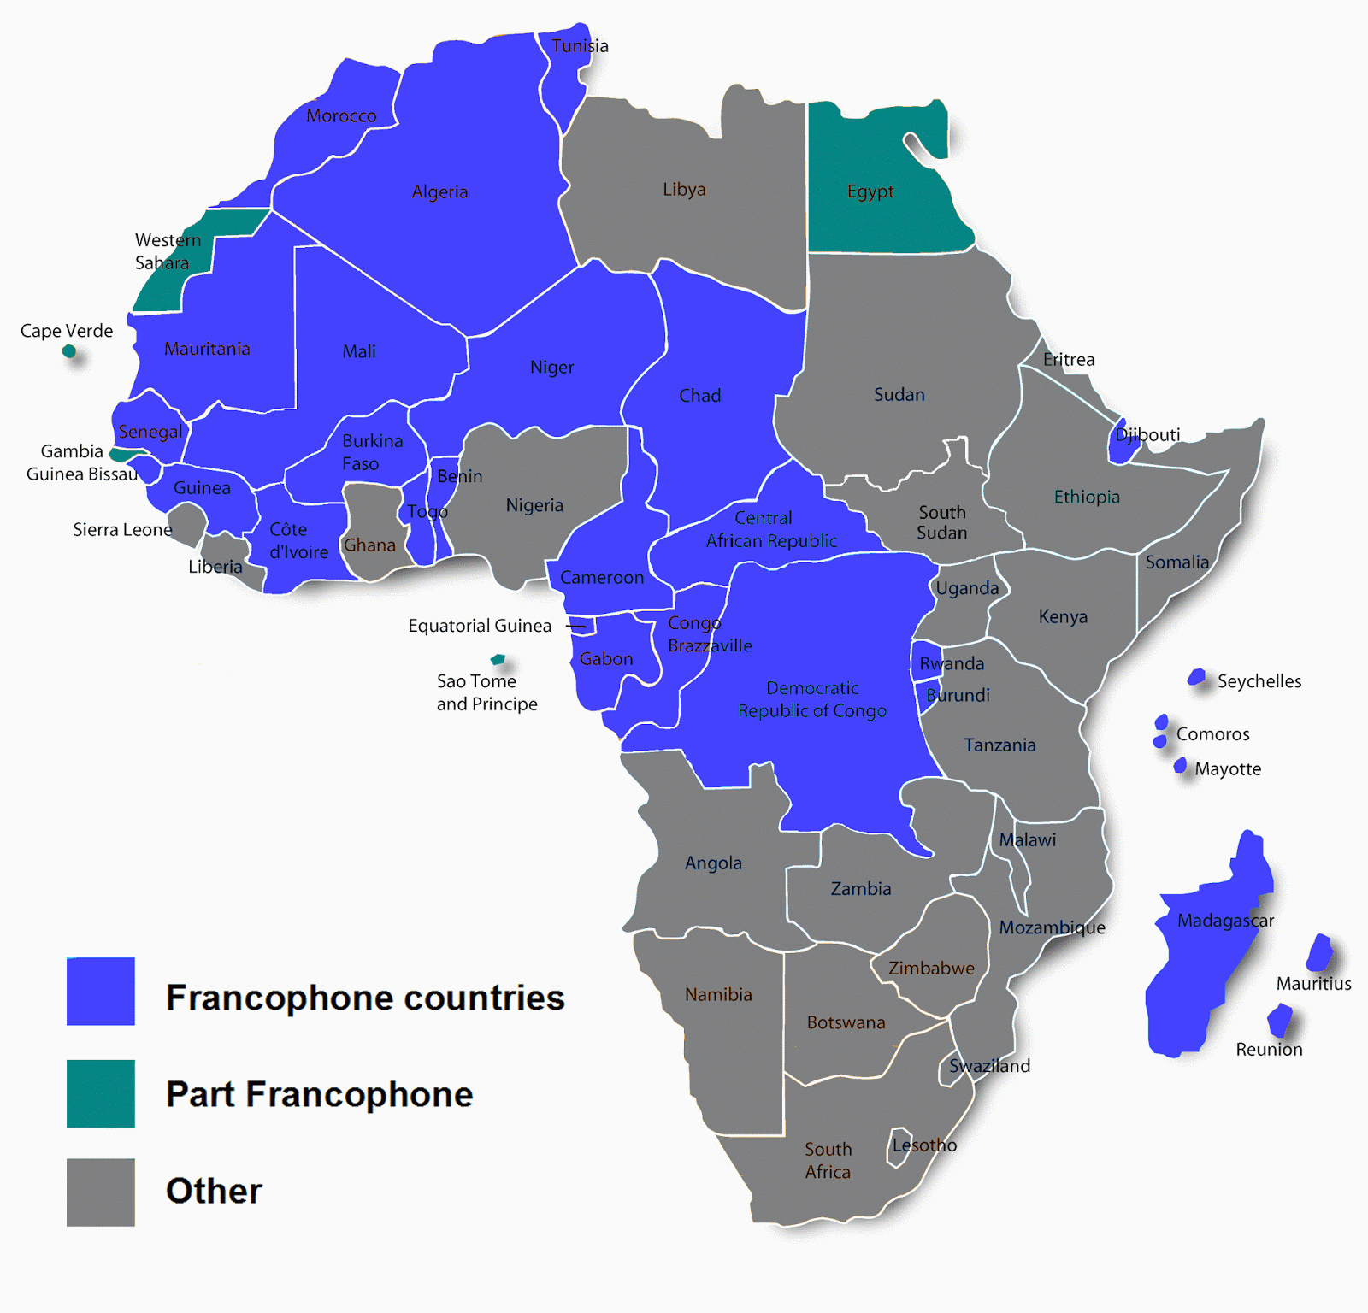
Most of Africa is Not Free
A close study of colonial and postcolonial exploits, existence of military bases and interventions in different regions of the world and ‘cooperation agreements’ reveals patterns of economic design and investment practices of imperial powers.

Slide 9
One Example Cooperation Agreement Btw France & RC
Dec 26, 1959 Eve of Independence on Jan 1, 1960 by General DeGaulle & Ahmadou Ahidjo
Art 6:
1)France shall determine RCs political, economic & sociocultural orientations
2)France shall manufacture money for RC, the XAF
3) France shall guide the determination of RCs educational programs at all levels
4) French treasury shall have an operational account to cover 100% of RCs foreign exchange
5) France shall have priority to exploit RC’s strategic raw materials. Where France is not interested, RC may seek other partners
Etc.

Slide 10
Some Questions From the Dignity Framework
Are global actors interested in working for the dignity of humankind?
Does the global community ever think of recognizing the reality and power of our connectedness?
In the quest for a dignified world, shall we, as actors for peace in dignity become interested in human suffering and humiliation everywhere?

Slide 11
Conclusions
Solution can be found in the notions of dignity and justice.
If dignity & justice principles were applied/implemented across the board, they would influence all and enhance nature of humankind.
How can a people who feel cheated by an unjust system imagine peace & the bigger picture? In order to achieve the kind of transformation that will help "the entirety of humankind to flourish," everyone needs to be making a contribution.
Those deprived of their own humanity by colonizing arrangements who continue to harbor grievances are in no position to make their own contribution.
We cannot continue to leave some people behind and invisible, and expect the "entirety of humankind to flourish."
Current situation is like thinking of a first class group of students in a classroom when a few remain invisible and uncounted.
What can make the difference in the world is dignity and justice for all.

Slide 12
References
Lindner, E. (2017). Honor, humiliation, and terror: An explosive mix and how we can defuse it with dignity. Dignity Press
Thomas, N. (1994). Colonialism’s culture: Anthropology, travel & government. Princeton, NJ: Princeton University Press

