Slide 1
---
-- beyond Homo Sapiens:
Indian Horizons for Dignity Research
D.Raja Ganesan Ph.D
Former Professor
University of Madras

Slide 2
I.THE BACKGROUND

Slide 3
Living in Harmony with Flora and Fauna
-a scene from the Sanskrit epic
Sakunthlam

Slide 4
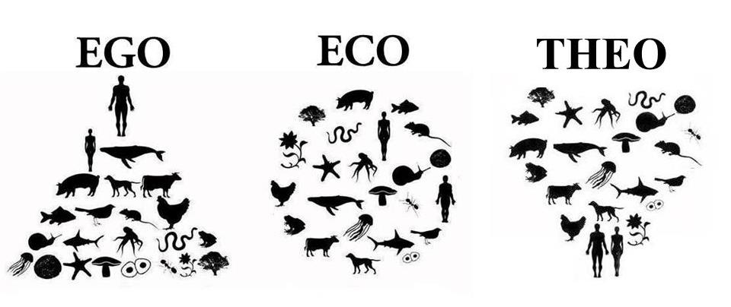
European Renaissance
European Renaissance made for a transition
from a theocentric worldview to a, yes, humanistic worldview.
Humanism is but phylogenetic egocentrism
The challenge before us is to make it
Ecocentric i.e., encompass our flora and fauna

Slide 5
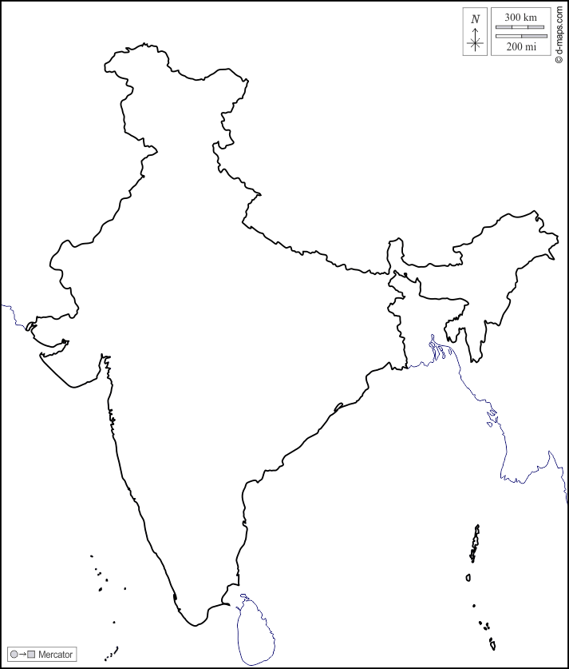
Ancient Indian Philosophical Traditions
Are a promising source of Inspiring ideas
for according
Dignity to our Flora and Fauna

Slide 6
In Indian mythology
Vishnu, the protecting god,
Takes ten avatars.
In other words, even fish,
tortoise and boar—
subhuman species,
are accorded the dignity
of divinity
1.Matsya - fish
2.Kurma - tortoise
3.Varaha - boar
4.Narasimha –hybrid: lion-man.
5.Vamana - dwarf.
6.Parashurama-Brahmin-Warrior
7.Lord Rama- role model
8.Lord Balarama.
9.Krishna
Kalki [yet to appear}
•

Slide 7
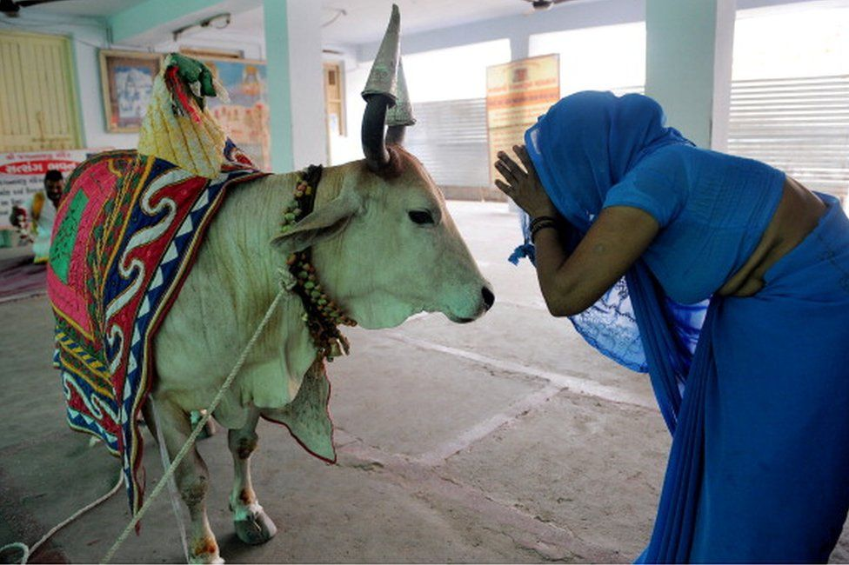
From time immemorial
Hindus worship the cow as god

Slide 8
Hindus in rural India celebrate
Every year ‘mattu [cattle feed] pongal’,
as a part of the Annual
Thanks Giving Pongal Festival

Slide 9
Jainism, a heterodox ANCIENT Indian religious tradition,
is an example par excellence
For concern even for microorganisms:
it is mandatory for Jain monks to wear
a mukha patti- [nostril filter] designed
To prevent inadvertently inhaling airborne insects

Slide 10
Bharathiyar, a well known Tamil poet[1882-1921],
proclaimed the spirit of Advaita philosophy thus:
“The crow and the sparrow are my caste;
The sea and the mountain are my kin;
Wherever I turn there is none but my Self
And celebration of rapturous joy”

Slide 11
The Tamil savant Vallalar’s
[1823-1874] compassion
explicitly encompassed
the horizon of flora too:
“I languished
whenever I saw wilting
plants;….
“My heart pounded in anguish
when I saw people
Falling asleep on empty stomach”.
… … … … …

Slide 12
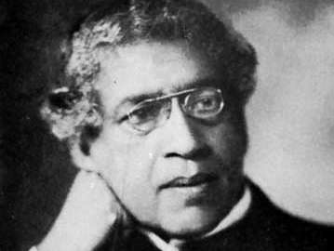
Vallalar’s spontaneous emotional resonance
to the state of flora around him was intuitive:
The Indian scientist J.C.Bose 1958-1927
went one better: Bose demonstrated through
scientific laboratory experiments
“that plants react to the attitude
of those with whom they interact”.

Slide 13
In 1962, Dr. T. C. Singh, Professor of Botany D Annamalai University, India, experimented with the effect of sounds on plant growth.
He discovered on balsa plants, that the rhythm of growth accelerated with 20% for height and 72% for biomass, when exposed to music

Slide 14
The Indian tradition thus calls for
not merely solicitude for survival
of our fellow living species ,
but also for according them dignity—
A universal transformation of our attitude

Slide 15
2. A GLOBAL AGENDA FOR R&D
for HDHS
2021

Slide 16
1.What is the right attitude for man towards his
flora and fauna?
Specifically, how do we distinguish among mere solicitude for their survival on the one hand and according dignity to flora and fauna?
2. What are the sources and the resources for articulating such an attitude?
3. Is it possible to inculcate such an attitude across cultures?
4. If not how to inculcate such attitude in a culture-fare manner?
[Of course, it is presumed that any and every surviving culture will be receptive to the idea of according dignity to our fellow inhabitants on the earth]

Slide 17
Stibbe’s critical discourse analysis
To a range of texts
in major Indian religious scriptures and
ancient Indian literary classics
offers a promising lead
to identifying and integrating the distilled wisdom of
Indian ethos as found in its profound classics
for recreating ambience for flora and fauna
Towards a New Global Solidarity of all living beings
through Dignity Research
,

Slide 18
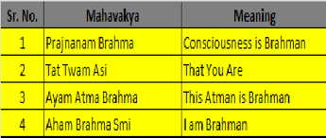
Four Mahavakhyas are deemed the Essence of Indian Wisdom

Slide 19
--Chandogya Upanishad
Thou Art That

Slide 20
Thank You
drajaganesan@gmail.com

