Slide 1
The Dust Never Settles
Finding healthy spaces so you can walk freely with your trauma

Slide 2
People say: Move on- Let it go- You’re better off- Try to forget it- It will pass-

Slide 3
Create a healthy space for healing
D i v o r c e
R a p e
H u m i l I a t I o n

Slide 4
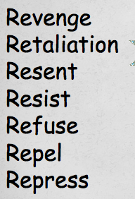
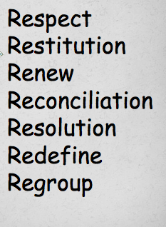

Slide 5
Create enough space to heal. The dust never settles, just eventually disperses enough allowing you freedom to ‘be the arrow’ in the healing process.
D I V O R C E
>>>>>>>>>> BE THE ARROW >>>>>>>>>>>>
D RESPECT >> I RESTITUTION>> V

