Slide 1
KILLING HISTORY AND WORLD HERITAGE; URBAN TRAGEDIES OF SYRIA.
CITIES AT RISK.
DUBROVNIK 2016
Marie Ingand

Slide 2
The seal of Aleppo city.

Slide 3
Map of Aleppo.

Slide 5
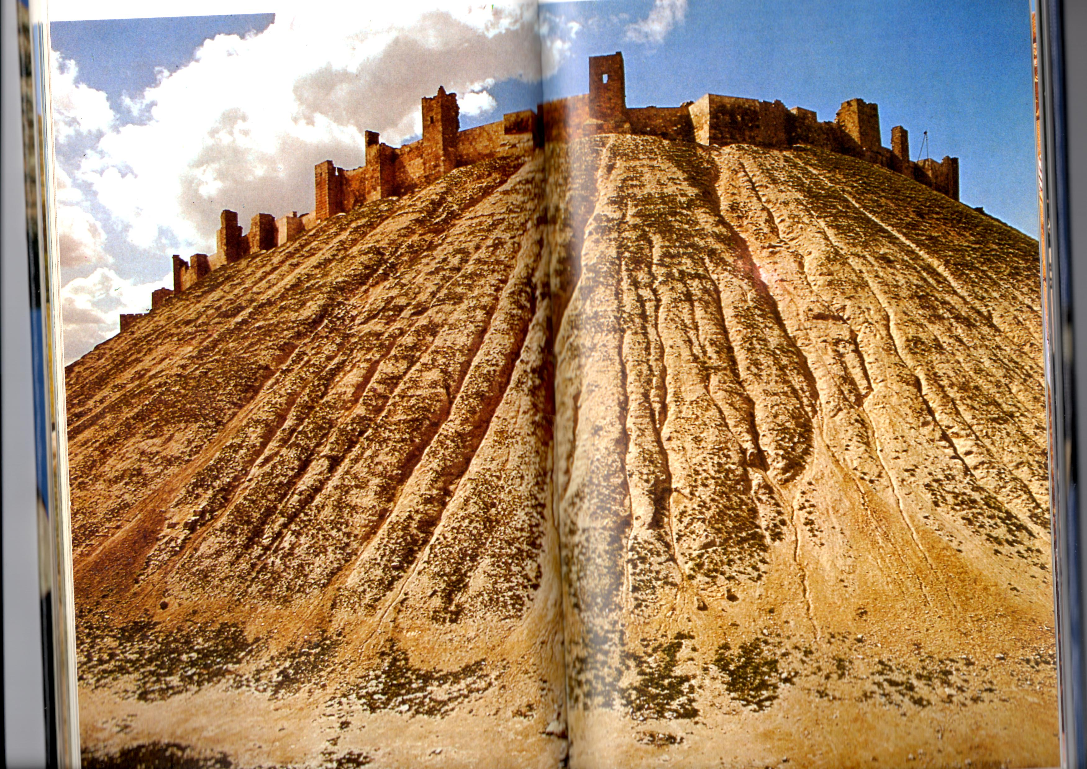
Abraham is said to have camped here on this acropolis which long before his time served as a foundation for a fortress.

Slide 6
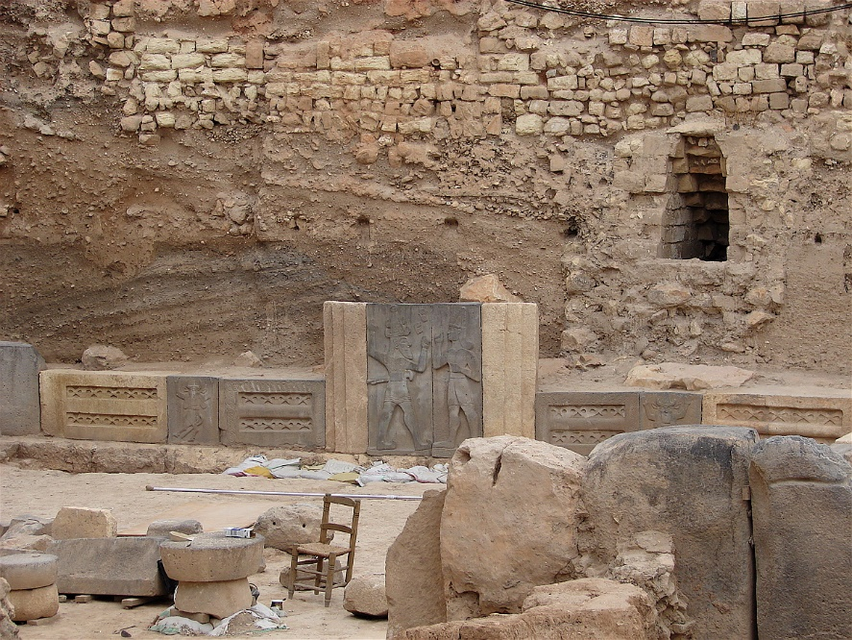
Hadad temple inside Aleppo Citadel.

Slide 7
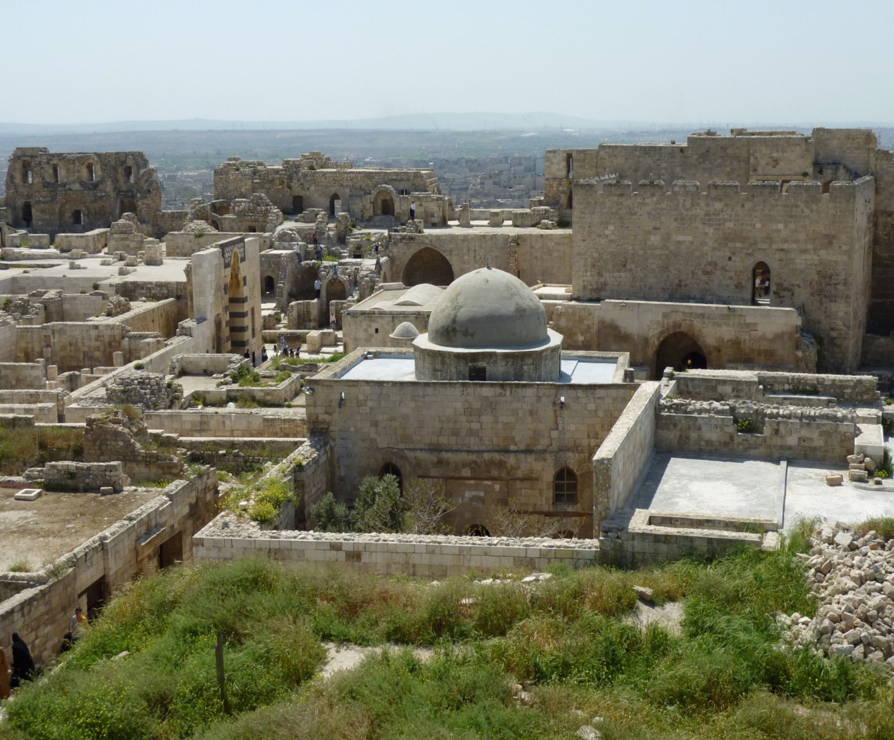
The mosque of Abraham in the Citadel of Aleppo,
Originally built by the Byzantines as a church.

Slide 8
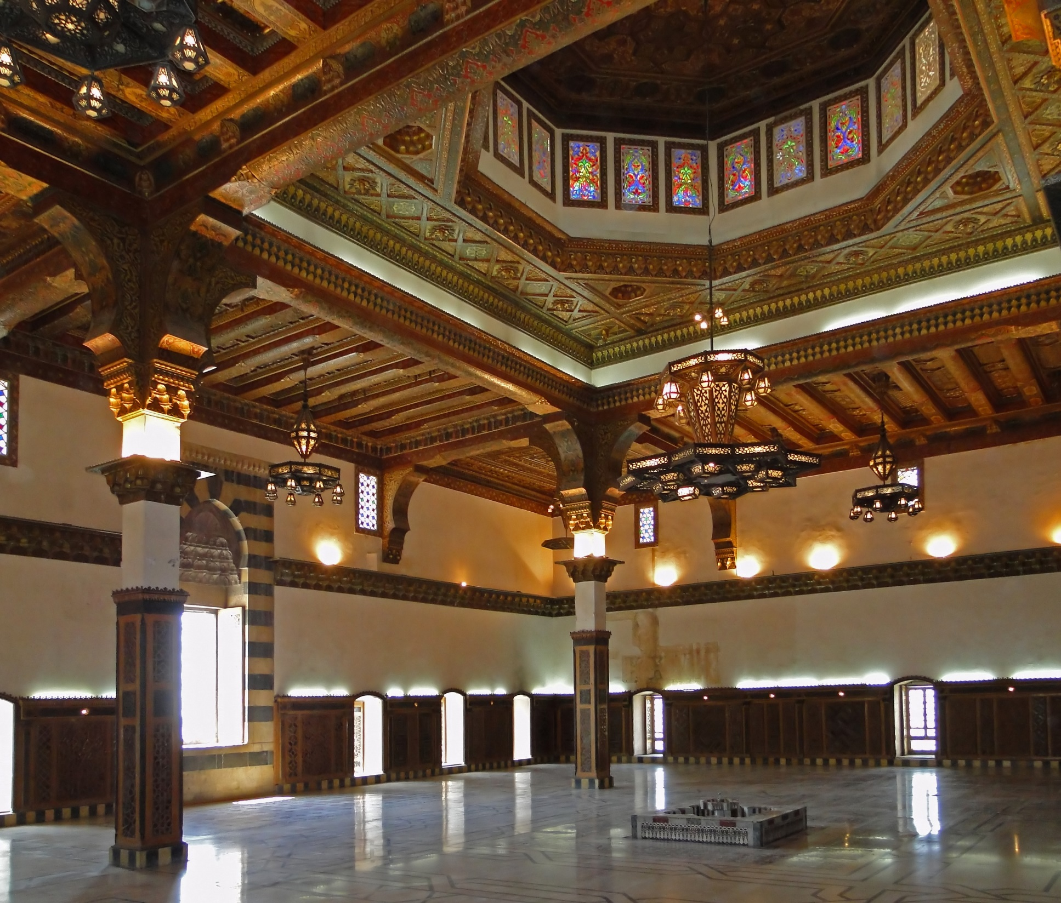
The throne hall of the Citadel restored during the Mamluk periode.

Slide 9
The Otrush- mosque from Mamluk-era.

Slide 10
Souk az-Zirb, where the coins were being struck during the Mamluk-period.

Slide 11
Aleppo textile and carpet market.

Slide 12
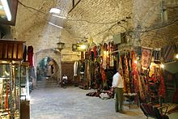
Hammam Al-Nahhasin, the oldest hamam in Aleppo, still in use.

Slide 13
Khusruwiyah-mosque from Ottoman period.

Slide 14
Rue de France.

Slide 15
The street around the Citadel.

Slide 16
The entrance to the madina Souq.

Slide 17
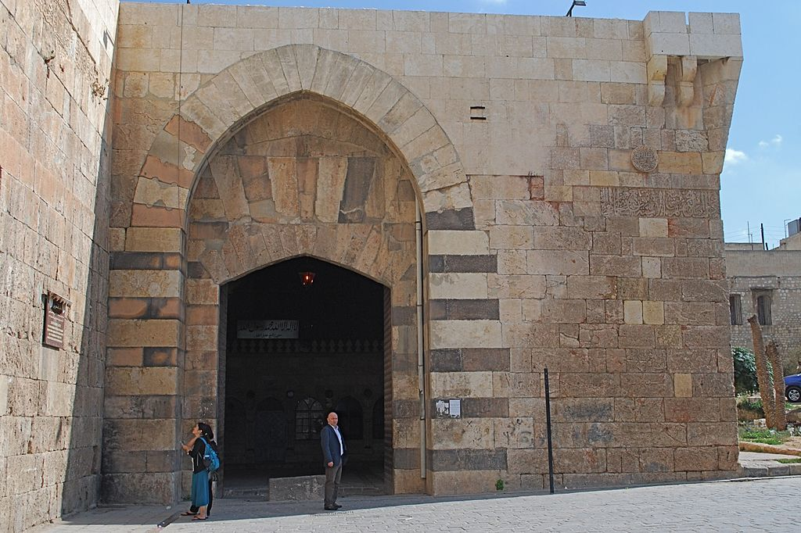
The old walls of Aleppo and the gate of Quinnasrin restored 1256 by Nasir Yusuf.

Slide 18
Department for Art and Humanoria, Univ. of Aleppo.

Slide 20
Queik river by night.

Slide 21
The old city of Aleppo seen from the Citadel.

Slide 22
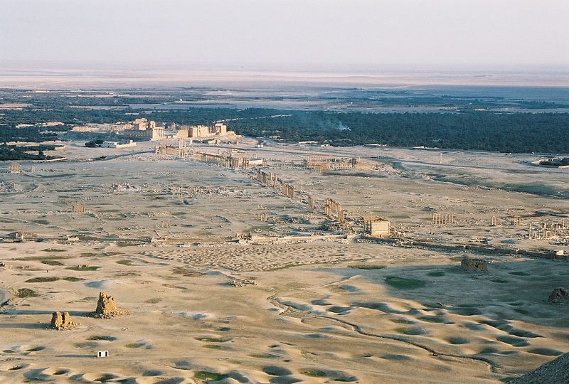
View over Palmyra.

Slide 23
The city of Palmyra.

Slide 24
The Great Colonnade.

Slide 25
The Tempel of Bel.

Slide 26
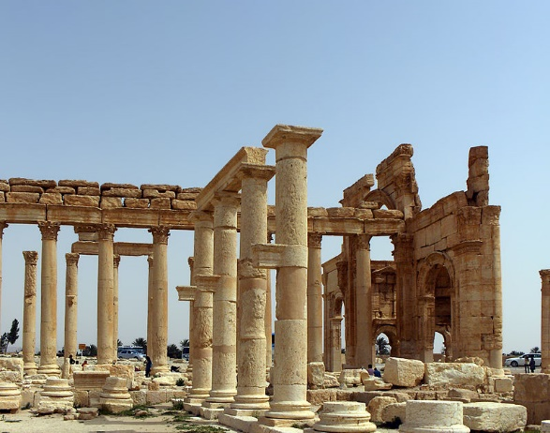
The Tempel of Naba.

Slide 27
The ancient Roman Theater.

Slide 28
The Tetrapylon.

Slide 30
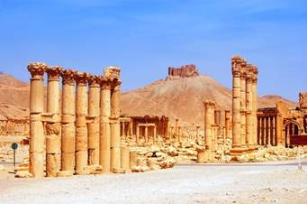
The arab casr on the top of the mountain.

Slide 31
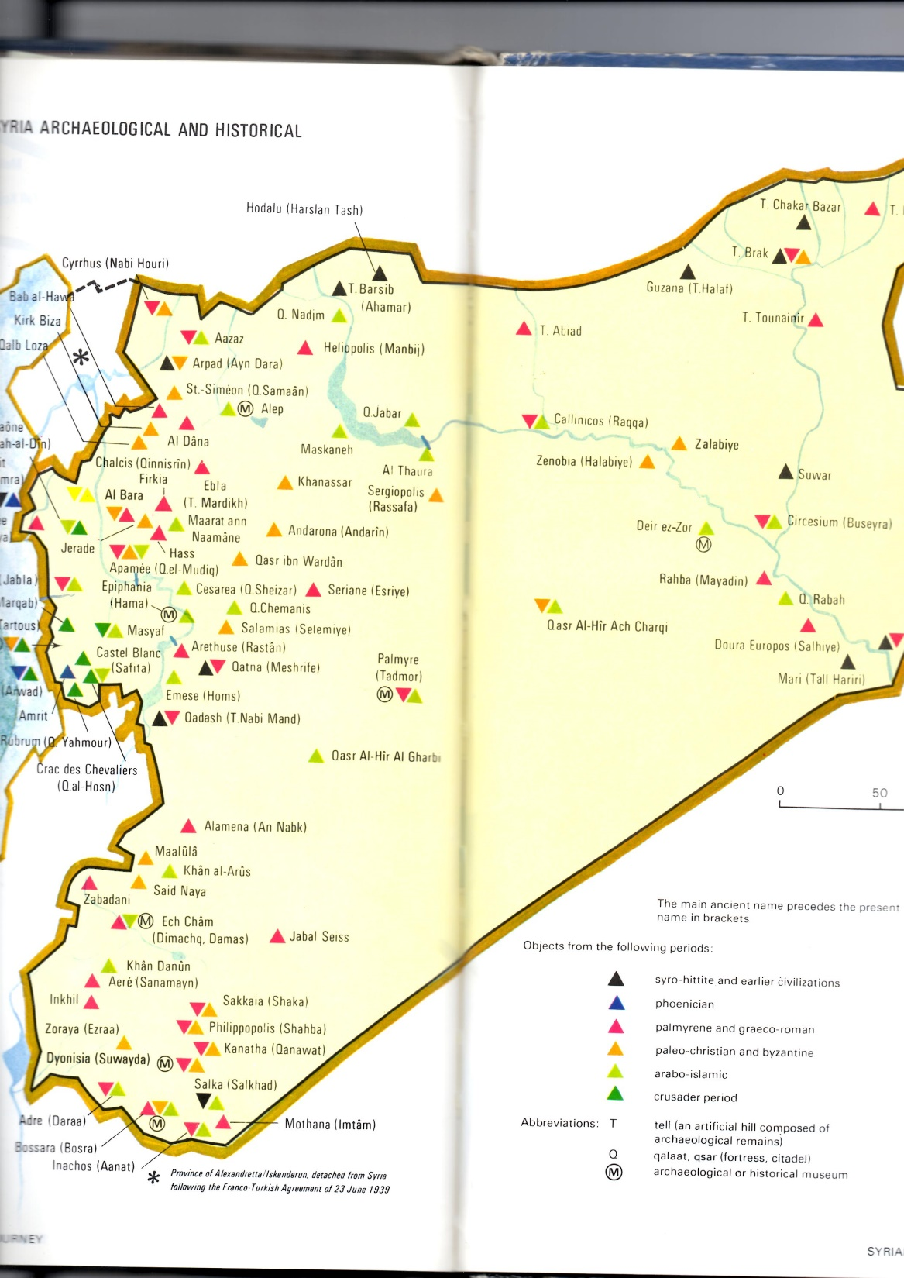
Archaeological
and historical
map over Syria.

