Slide 1
Childhood as the Last Colony
Childhood, Humiliation and Conflict
Can a Changed Understanding of the Place of Childhood Break the Cycle of Violence?
Lucien X. Lombardo
Professor Emeritus
Old Dominion University
Norfolk, VA 23508

Slide 2
Sources of Human Dignity*: Supports and Violations
A Young Girl, a Mother, a Grandfather and a Boat: A Story of Human Dignity
INTERNAL – HOW WE SEE OURSELVES
SELF EVALUATIONS
Self Pride
Self Worth
Self Esteem
Self Respect
Self Value
AUTHENTICITY
Pride in Own Abilities
Who and What You Are
Being Able to be Myself
Being Comfortable with What and Who I Am
INTERACTIONAL – IN RELATIONSHIPS WITH OTHERS
POWER AND CONTROL
Involved in Decisions
Freedom over Body, Opinions, feelings
TREATED WITH
Respect, Expressions of Kindness, Fairness, Not Controlled
CONTRIBUTING
Opportunities to help others
*Derived from Undergraduate Student responses to the following questions: How would you define human dignity? Describe two examples of when you felt your human dignity was supported as a child? Describe to examples where you felt your human dignity was violated as a child? (Course: “Violence in the World of Children”)
Notes:
IN response to a question about experiences with human dignity as a child, A 48 year old women student in my “Violence in the World of Children” class related the following story:
When I was young our family used to rent a cottage on a near-by river in the summers. I remember it was a beautiful, peaceful spot. It was great except tat for some reason I was very afraid of the water. I was 5 or 6 at the time. My mother used to force me to go with her in the little boat we had. I was deathly afraid. I used to cry and cry and tell her I didn’t want to go. She would yell at me, say I was a little baby, She would say, “I am your mother and you will listen to me and learn!!” Sometimes she would hit me, often in front of my siblings who would laugh at me. She forced me into the boat and I would cry the whole time until we got back on land.
I did get over this, however. But not because of my mother. It was my grandfather who visited us for a few days. He saw how my mother treated me and one day he came up to me when the others were away and asked, “Would you like to go out in the boat? You don’t have to go, you can sit on the dock, but I am going to go out for a little bit, just to float around.” I said, “Maybe” and walked with him to the dock. He got in the boat and asked me again “Do you want to come? I t will be OK. It’s up to you! I said “OK” and he helped the trembling little girl into the boat. I hung on to him as we moved away from the dock. After a few minutes I relaxed. He took my hand and put it on the tiller , put his had over mine and let me steer. I never felt so empowered, as if I what I thought and felt mattered to someone. It changed my life!

Slide 3
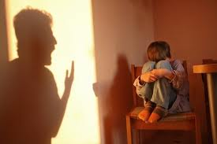
Colonial* Relationships Between Groups:
Socially Destructive**
ADULT AS COLONIZER: the group who has the power and can impose their will and create others in his image.
CHILDHOOD AS COLONIZED: the group whose identity is submerged and whose authenticity is eliminated and who is placed in the service of the colonizer through the force, threat of force by the colonizer.
*Drawing on Albert Memmi, THE COLONIZER AND THE COLONIZED; Franz Fanon, BLACK SKINS, WHITE MASKS; Paulo Friere, PEDAGOGY OF THE OPPRESSED; Alice Miller, FOR YOUR OWN GOOD.; **Comstock and Sanford, SANCTIONS FOR EVIL.: SOURCES OF SOCIAL DESTRUCTIVENESS.
Notes:
At an international conference focusing on children, I was providing a summary of a discussion of a number of panels dealing with children’s rights in relation to the UN Convention on the Rights of the Child. I pointed out how the CRC was in the view of many a ‘relationship” changing document. It changed the relationship between the adult world and the world of children. It saw children as active agents creating meaning and judgments in their lives in relation to the environments and experiences they encountered. If saw the importance of valuing the experiences and voices of children in shaping decisions that affected their lives. Here, many in the audience began to react. “What do children know?” “Children do not understanding the complexities of the world.” Looking around the room, I asked, “There are many people of color from former colonized nations in the room, 30 years ago you would not have been in this room because the questions you ask about children would have been asked about you. The same holds true for women. Now you are making the same assumptions about children. It seems that children and childhood is the last colony!”
From Albert Memmi, THE COLONIZER and the COLONIZED applied to the Colonization of Childhood.
COLONIZATION OF CHILDHOOD:
For example: (see pages 96-97) Memmi (1965) writes about what we can see as “social destructiveness” involved in hate violence:
The colonized (child): enjoys none of the attributes of citizenship; neither his own, which is dependent, contested and smothered, nor that of the colonizer (adult). He can hardly adhere to one and claim the other. Not having his just place in the community, not enjoying the rights of a modern citizen, not being subject to his normal duties, not voting, not bearing the burden of community affairs, he cannot feel like a true citizen (empowered). As a result of colonization, the colonized, never experiences nationality and citizenship, except privately. Nationally and civically he is only what the colonizer is not.
REPRESSION AND OPPRESSION OF CHILDHOOD
Think of Alice Miller’s poisonous pedagogy and the impacts of violence on the situation of women and Bierce’s definition of homicide when you read the following:
Let us even put aside the problem of the initial responsibility for colonization. In the final analysis all that is not important. What does count is the present reality of colonization and the colonized (Bierce – it is the suffering of the victim that matters in defining violence). We have no idea what the colonized would have been without colonization (This is what Alice Miller says in regard to ‘Poisonous Pedagogy: what would the child have become without the harsh treatment?), but we certainly see what has happened as a result of it. To subdue and exploit, the colonizer pushed the colonized out of the historical and social, cultural and technical current. What is real and verifiable is that the colonized’s culture; society and technology are seriously damaged (the historical place of children).
Albert Memmi (1965) The Colonizer and the Colonized. Boston: Beacon Press, pp.114-115.

Slide 4
Colonial / Adultism - Child Centeredness and
Human Dignity: Reflected in Culture and Experience
Principles of Adultism (Promotes Child Maltreatment at all levels)
Principles of Child Centeredness (Supports Children at All Levels)
Children are inferior to Adults
Children are Rightfully Controlled by Adults
Dignity is not an inherent characteristic of children
Age, gender, class and achievement are markers of human dignity
Others have power to bestow or take away ones human dignity
Those who take away another’s human dignity are rewarded with power
The meanings children attach to their experiences are of little importance
Children and adults share a common humanity and mutuality of status
Children are an oppressed group now
Children, as members of the human family, have dignity and rights
Dignity is inherent in all life, including children
Age, gender, class and achievement are not related to a person’s human dignity
No one can bestow or take away another’s or violate their own human dignity
Those who attempt to take away another’s human dignity violate their own
The meanings children attach to their experiences are of utmost importance
See: Human Dignity and Children - Operationalizing a Key Human Rights Concept
Notes:
Adultism is a system of oppression that permeates relationships. It emphasizes adults differences from children, provides supports adults power over children and the differential access to power and resources between children and adults, and provides support and justifications for child maltreatment in the form of violations of children’s physical and psychological integrity.

Slide 5
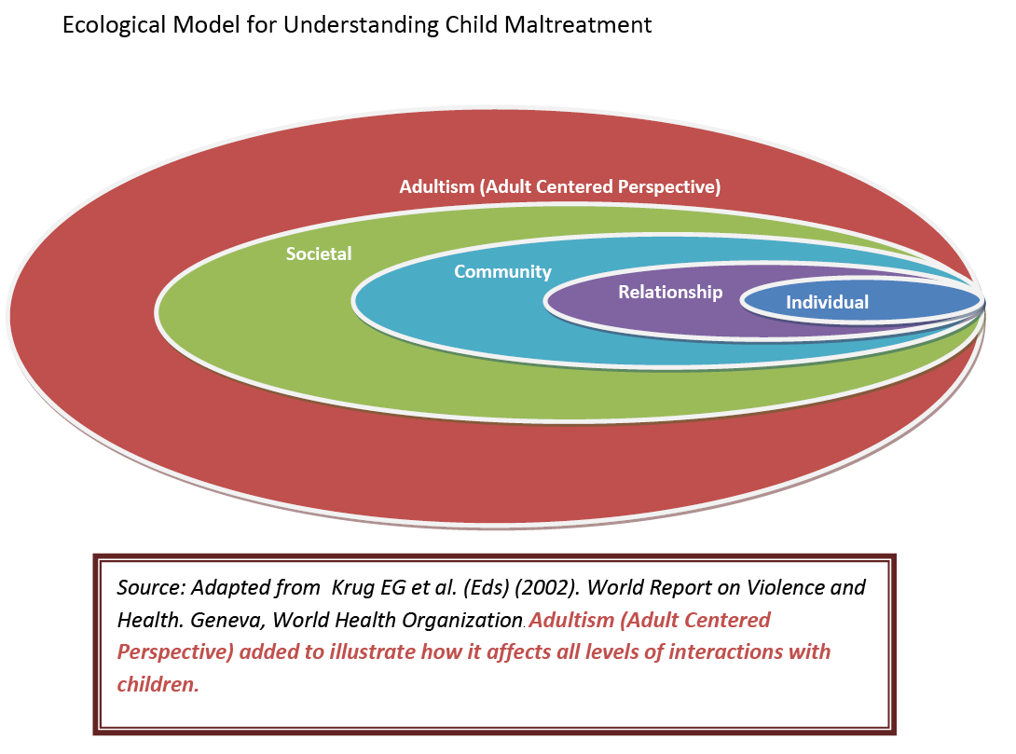
Colonial /Adultism Perspective Dominates
All Contexts of Childhood Maltreatment:
Something Missed in UN Report
Notes:
The model presented in this diagram is adapted from the 2002 World Health Organization Report on Violence and Health. The WHO report recognizes the contributions of individual characteristics, relationship patterns (family), community (economic and political conditions) and societal (economic and cultural) to child maltreatment. While it is clear that social-ecological perspectives integrating multi-level characteristics are important, what this report missed is the over-arching structural context of Adultism / colonialism that shapes children’s relationships with each of the other contexts.
However, what it fails to do is to recognize and portray the larger discriminatory, power granting and maltreatment supporting implications of Adultism. This failure of recognizing ADULTISM’s effects is like not recognizing the discriminatory, power granting, and woman maltreatment supporting implications of the male oppression of women; or the effects of racism on the oppression and violence directed at racial and ethnic groups. It is by applying the sociological concepts of ‘class discrimination’ that the recognition of children AS A CLASS emerges and Adultism is recognized.

Slide 6
Cycle of Violence Process :
The HOW of Transformation from Not Violent to Violent*
Making of Perpetrator: Culture and Experience
Experiencing and Surviving Trauma and Culture: Coping**
Language
Other / Enemy Making
Dehumanization: Self / Other
Social Roles
Removing Agency
Shifting Responsibility
Isolation (Perceived – Real)
Social Support (Group Dynamics)
Reduced Saliency of non-violence
Power Differentials
Hyper-arousal / sensitivity to threat
Death Imprint / Shattered Assumptions
Psychic Numbing / reduced empathy
Fake Nurturance
Fight / Flight
Resignation
Denial / Construction / Dissociation
Death Spell
*FORMS OF VIOLENCE: Suicide, Violence against Children, Women, Hate Violence, Institutional Violence, War, Genocide, Omnicide
Robert Jay Lifton, DEATH IN LIFE: SURVIVORS OF HIROSHIMA; Judith Herman, TRAUMA AND SURVIVAL; Viola Bernard, “Dehumanization” in SANCTIONS FOR EVIL, N. Sanford and C. Comstock (Eds).
Notes:
The relationship of the colonial model of childhood fits into the cycle of humiliation and violence by providing a broad culturally supported context within which the violence process is shaped. This “process” model does not seek to identify causes of violence and humiliation, rather it seeks to identify factors which have a variety of cultural and experiential sources that transform individuals from a state of being not violent to a state where they are violent. Important in this processes the mutually reinforcing connections between experiencing cultural and experiential contacts with trauma and lack of support and perpetrating violence and humiliating othes.

Slide 7
Which Is the Longer Period of Life: Childhood or Adulthood?
MOST SAY ADULTHOOD – We can’t see that:
Whatever Impedes Children’s Work in Violence in Children’s Lives
Figure 3
Models of Childhood in the Life-Span:
ADULT CENTERED MODEL: Devalues Childhood experiences
Adulthood Longer (one line broken up into two separate parts):
Childhood Adulthood
Rites of Passage, Reject Past, Not Relevant, Position of power
0 18 life after 18
CHILD CENTERED MODEL: Values childhood experiences throughout life-span
Childhood longer (childhood continues and continually overlaps with adulthood)
Childhood
Adulthood
The Adverse Childhood Experience Study;
Child Trauma Academy (Brain Development)
Life long Effects of Early Childhood Adversity and Toxic Stress (2012 PEDIATRICS)

Slide 8
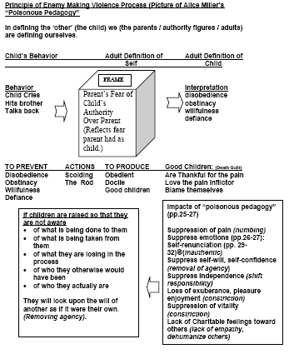
Alice Miller, Poisonous Pedagogy and Reproduction of Adultism
How does
Childhood
Become the
Enemy / Other?
Adultism / Colonial
Adapted from Alice Miller (1990) For Your Own Good: Hidden Cruelty in child-rearing and the roots of violence. NY: Farrar, Straus and Giroux (pp. 3-91)
Notes:
Psychiatrist Alice Miller (1990:9) uses the term ‘poisonous pedagogy’ to describe the techniques used by parents to control, to punish, to teach and “to condition a child at an early age not to become aware of what is really being done to him or her.” This perspective gives us great insights into the perpetuation of adultism and child maltreatment from generation to generation. Poisonous pedagogy normalizes adultism and prevents us from seeing it for what it is: a form of oppression.
As Miller states: “The former practice of physically maiming children, exploiting,, and abusing children seems to have been gradually replaced in modern times by a form of mental cruelty that is masked in the honorific term child-rearing (emphasis in original). Since training in many cultures begins in infancy during the initial symbiotic relationship between mother and child, this early conditioning makes it virtually impossible for the child to discover what is actually happening to him. The child’s dependence on his or her parents’ love also makes it impossible in later years to recognize these traumatizations, which often remain hidden behind the early idealization of the parent’s for the rest of the child’s life.
Here we see the development of the support for adultism and the parents and adults belief in the correctness of child maltreatment, that children support when they become adults.

Slide 9
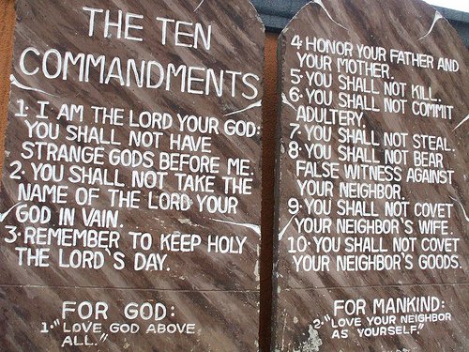
The New 4th Commandment*
PARENTS SHOULD HONOR AND EMPOWER THEIR CHILDREN, SO THAT THEY, THEIR CHILDREN AND THEIR CHILDREN'S CHILDREN WILL LIVE THEIR OWN TRUTHS OVER LONG AND AUTHENTIC LIVES!
UNDERCUT COMPONENTS OF VIOLENCE PROCESS BY CONFRONTING VIOLENCE AND BEING AN ENLIGHTENED WITNESS**
*Written as part of review of Alice Miller’s, THE BODY NEVER LIES
See: Some Observations on THE BODY NEVER LIES.
**Reasserting Humanity in the Face of Violence

