Slide 1
Abantu Eswatini Dignity Institute Indigenous Knowledge Hub
Dignity Through Solidarity: Towards a New Global Normal Presentation by Joy Ndwandwe Founding President

Slide 2
Introduction
Abantu Eswatini Dignity Institute is a Registered NGO N.O. 543 of 2020
Established to Lead the Second Liberation, Knowledge Liberation
Dedicated to Bridging a Gap between Academic, Indigenous People’s Scientific Knowledge and Ancestral Knowledge
Through Integrating Indigenous Knowledge and Modernity

Slide 3
Purpose of AE Dignity Institute
Integrating Indigenous Knowledge and Modernity
Towards Contributing to Knowledge Economy
Towards Contributing to Creative Economy
This AEDI is in accordance with Constitution of the Kingdom of Eswatini 2005
The AEDI is in line with the National Development Strategy 2022

Slide 4
Naming AEDI
A-Abantu is the Spiritual Identity of Southern Africa predominately known as Bantu
AEDI is for Spiritual and Academic Healing, Big Love and Hope Space, Lindner (2020)
Bantu the linguistic identity has been a source of humiliation such as Bantu Education, Bantustans, Bantu Administration
Transforming Bantu Migration into Abantu Migration

Slide 5
Naming AEDI continued
E- the Kingdom renamed by the Patron from Swaziland to Eswatini
Decolonizing the Kingdom from Colonial Legacy embedded with Swaziland
Linguistic Emancipation as Swaziland is Zulu considering SiSwati is recently developed linguistically
EmaSwati have an indigenous context as part of Abantu migration from East and West Africa

Slide 6
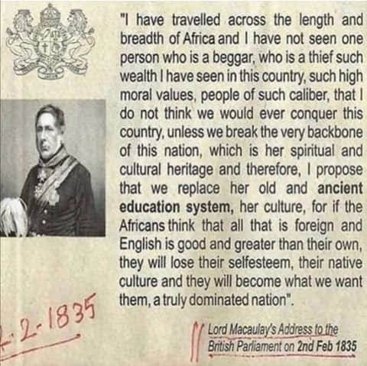
Naming AEDI Continued
DI Dignity Institute: Responding to statement

Slide 7
Naming AEDI Continued
The Above Statement In Formed Global Missionary, Colonial and Apartheid Agenda
Systemically Negating Indigenous Knowledge
In the context of the Kingdom, complicated as Queen LaZidze was Queen Mother and Queen Regent when Missionaries arrived
Her Feminine Power anchored Leadership and Resilience in Preserving Indigenous Knowledge
Missionaries and Colonialist suppressed her voice and negated her leadership and indigenous knowledge in 1800 epoch

Slide 8
AEDI Vision
Abantu ESwatini Dignity Institute, the Indigenous Knowledge Hub, leading a second liberation dedicated to bridging the gap between academic, indigenous people’s scientific and ancestral knowledge through integrating indigenous knowledge and modernity towards contributing to the knowledge and creative economy.

Slide 9
AEDI Mission
Abantu ESwatini Dignity Institute (AEDI) Indigenous Knowledge Hub, provides African Renaissance academic research space to advance the Agenda 2030 UN Sustainable Development Goals towards Agenda 2063 Africa, SADC and Eswatini we want. Moreover, towards achieving Education for Sustainable Development (ESD: 2030) to equip learners with knowledge, skills, values and attitudes needed to contribute to a more inclusive, just, peaceful and sustainable world, through knowledge creation, production, disseminating and use of technology for social innovation.

Slide 10
AEDI Objectives
To advance the Africa we want, SADC we want, ESwatini we want and UN SDGs
To provide academic space in multidisciplinary policy makers and researchers
To provide academic space in interdisciplinary policy makers and researchers
To provide academic space in transdisciplinarity policy makers and researchers
To provide academic space for public policy advocacy and transformation
To provide academic space for indigenous knowledges technological innovation

Slide 11
Motivation and Justification
Abantu ESwatini Dignity Institute (AEDI) Indigenous Knowledge Hub emanates from the founding president’s vision with His Majesty King Mswati III.
Hence, the AEDI seeks to provide leadership in a knowledge liberation, embedded within prehistoric, historical and contemporary imperatives systemically negated by missionaries, colonialism and apartheid, including Africans.

Slide 12
AEDI 3 Logos for Patrons Choice

Slide 13
AEDI Common Heritage Symbols
Sibaya-Kraal Circular Design with 4 Cardinal Points symbolizing Experiential Learning
Transforms into Governance, Wholeness, Sacredness Space and the People’s Parliament
Shield-Symbolizing Sacredness of Cow Hides in Traditional Regalia, War and Peace Regiments
Calabash-Symbolizing Wholeness emanating from Mother Earth as Reservoir of Bottomless Indigenous Knowledge

Slide 14
AEDI/ESD Framework
Five Priority Action Areas Towards Agenda 2030 and African Union Agenda 2063
Advancing Policy
Transforming Learning and Training Environment
Developing Capacity of Educators and Trainers
Mobilizing Youth
Accelerating Sustainable Solutions at Local Level

Slide 15
AEDI/ ESD Specifics & Targets
ESD Specific Attention
Individual Transformation
Societal Transformation
Technological Advances
ESD Target Groups
Policy Makers
Institutional Leaders
Leaners and Parents
Educators
Youth and Communities

Slide 16
Abantu Eswatini Dignity Institute
Community and
International
Schools
Engagement
Peace,
Governance
And Democracy
Studies
Indigenous
Knowledge
Hub
Education, Law;
Abrahamic Religions
Including Bahia
Ecology,
Environment,
Climate Change
Studies
Indigenous
Knowledge
Wholeness and
Sacredness
Rules
Inclusive
Development
Creative Arts
and
Industries
Ethical
Leadership,
Feminine Power

Slide 17
Proposed Partnerships
World Dignity University
University of South Africa
UNESCO Commission in Eswatini
University of Eswatini
Royal Science and Technology Park
Looking for More Partners for Capacity Building: wasegudu@gmail.com

