Slide 1
INTERNATIONAL COUNCIL FOR TRADITIONAL MUSIC, APPLIED ETHNOMUSICOLOGY,
AND URBAN OUTREACH
27th Annual Conference of Human Dignity and Humiliation Studies
'Cities at Risk - From Humiliation to Dignity’
Dubrovnik, Croatia, September 2016
SVANIBOR PETTAN
UNIVERSITY OF LJUBLJANA
SLOVENIA

Slide 2
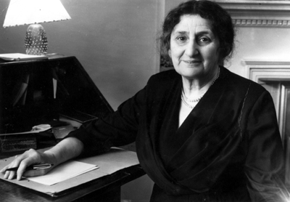
INTERNATIONAL COUNCIL FOR TRADITIONAL MUSIC (est. in London in 1947)
(1) is a scholarly non-governmental organisation in formal consultative relations with UNESCO.
(2) Its aims are to further the study, practice, documentation, preservation and dissemination of traditional music and dance of all countries.
(3) To these ends the Council organises
World Conferences, Study Group Symposia and Colloquia.
(4) By means of its World Network and Study Groups
it is a bond among peoples of different cultures and thus serves the peace of humankind.
MAUD KARPELES
(1885-1976)

Slide 3
PRESIDENT | SECRETARY GENERAL
Ralph Vaughan Williams, UK (1947–1958) Jaap Kunst, The Netherlands (1959–1960) Zoltán Kodály, Hungary (1961–1967) Willard Rhodes, USA (1967–1973) Klaus P. Wachsmann, USA (1973–1977) Poul Rovsing Olsen, Denmark (1977–1982) Erich Stockmann, Germany (1982–1997) Anthony Seeger, USA (1997–1999) Krister Malm, Sweden (1999–2005) Adrienne L. Kaeppler, USA (2005–2013) Salwa El-Shawan Castelo-Branco, Portugal (2013–2017) | Maud Karpeles, London, UK (1947-1968) Graham George, Queen’s University, Kingston, Canada (1969-1980) Dieter Christensen, Columbia University, New York, USA (1981-2001) Anthony Seeger, University of California, Los Angeles, USA (2001-2005) Stephen Wild, Australian National University, Canberra, Australia (2006-2011) Svanibor Pettan, University of Ljubljana, Ljubljana, Slovenia (2011-2017)

Slide 4
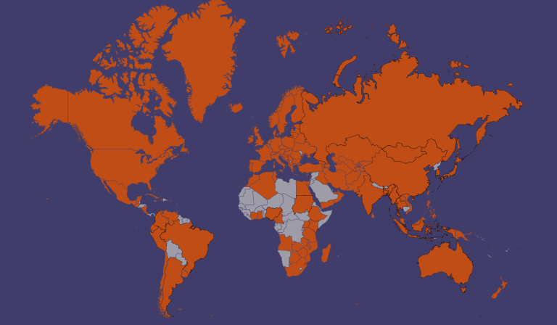
ICTM World Network 2016

Slide 5
ICTM has a grand total of 1450 members and subscribers, constantly growing.
ICTM has official representation in 125 countries and regions on all continents.
From International Folk Music Council (IFMC, 1947-) to International Council for Traditional Music (ICTM, 1969-).
Notes:
A complete list of ICTM National and Regional representatives will be presented later on this meeting, under heading 13.1 of the Agenda.
2) The complete list of new reps follows, sorted in reverse chronological order (of their recognition): Jaime Jones (Ireland), Bjørn Aksdal (Norway), Mohammed Adam Sulaiman Abo-Albashar (Sudan), Jarkko Niemi (Finland), Lisa Urkevich (Kuwait), Zlata Marjanović (Montenegro), Marita Fornaro (Uruguay), Robert Chanunkha (Malawi), María Gabriela López Yánez (Ecuador), Joseph Jordania (Georgia), János Sipos (Hungary),,Efraín Rozas (Peru), Ignazio Macchiarella (Italy), Eva Fock (Denmark), Haruko Komoda (Japan), Olha Kolomyyets (Ukraine), Made Mantle Hood (Indonesia), Danka Lajic-Mijalovic (Serbia), Tsai Tsung-Te (Taiwan), Phạm Minh Hương (Vietnam), Timkehet Teffera (Ethiopia), Katrin Lengwinat (Venezuela), Imani Sanga (Tanzania).

Slide 6
 | COMPARATIVE MUSICOLOGY | FOLK MUSIC RESEARCH | ETHNOMUSICOLOGY
WHEN? | 1885-1950s | From late 18th c. on | From 1950s on
WHAT? | Music of “primitive” peoples’ and “High Oriental cultures’” | Peasant music | People making music
HOW? | “Armchair” | Fieldwork (extensive) | Fieldwork (intensive)
WHO? | Other people | Own people | Any people
WHERE? | Elsewhere | Within own ethnic/national realm | Anywhere
WHY? | Knowledge | National duty | Understanding

Slide 7
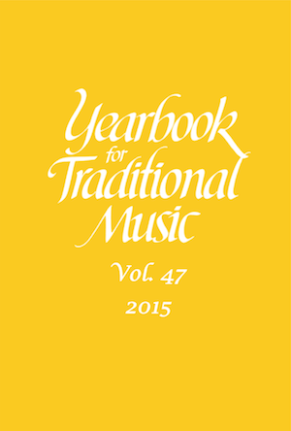
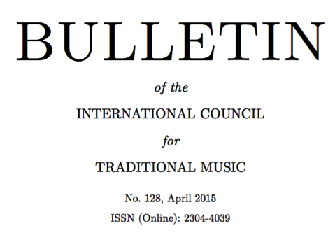
ICTM Publications

Slide 8
ictm world conferences basel (1948), venice (1949), Bloomington (1950), opatija (1951), sinaia and bucharest (1959), …
Canberra (1995), nitra (1997), hiroshima (1999), rio de janeiro (2001), fuzhou (2004), sheffield (2005), vienna (2007), durban (2009), st.john’s (2011), shanghai (2013), astana (2015), limerick (2017)

Slide 9
ICTM Study Group Symposia
Multipart Music: 4-7 July 2016, Singapore
Music and Minorities: 4-10 July 2016, Rennes, France
Ethnochoreology: 9-16 July 2016, Graz, Austria
Music and Gender: 13-16 July 2016, Bern, Switzerland
Performing Arts of Southeast Asia: 31 July-6 August 2016, Penang, Malaysia
Musics of East Asia: 25-27 August 2016, Taipei, Taiwan
Audiovisual Ethnomusicology: 25-27 August 2016, Ljubljana, Slovenia
Applied Ethnomusicology: 5-9 October 2016, Cape Breton, Canada
Musics of the Slavic World: 13-15 October 2016, Ljubljana, Slovenia
Musical Instruments: 5-8 April 2017, Sarajevo, Bosnia and Herzegovina
Mediterranean Music Studies, jointly with International Musicological Society: Naples, Italy, 21-26 June 2016

Slide 10
ICTM Study Group Symposia (cont.)
12. Music and Dance of Oceania: 19-21 May 2016, Guam
13. Iconography of the Performing Arts: 17-20 May 2016, Venice, Italy
14. Music and Dance in Southeastern Europe: 2-8 May 2016, Blagoevgrad, Bulgaria
15. Music of the Turkic-speaking World: 21-23 April 2016, Almaty, Kazakhstan
16. Historical Sources of Traditional Music: 9-13 March 2016, Paris, France
17. African Musics: 30 September-4 October 2015, Durban, South Africa
18. Music Archaeology: 17-23 August 2015, Biskupin, Poland
19. Maqam: December 2014, Ankara, Turkey.
20. Music in the Arab World: December 2014, Ankara, Turkey.
21. Music and Allied Arts of Greater South Asia: 4-6 March 2016, Boston, USA.

Slide 11
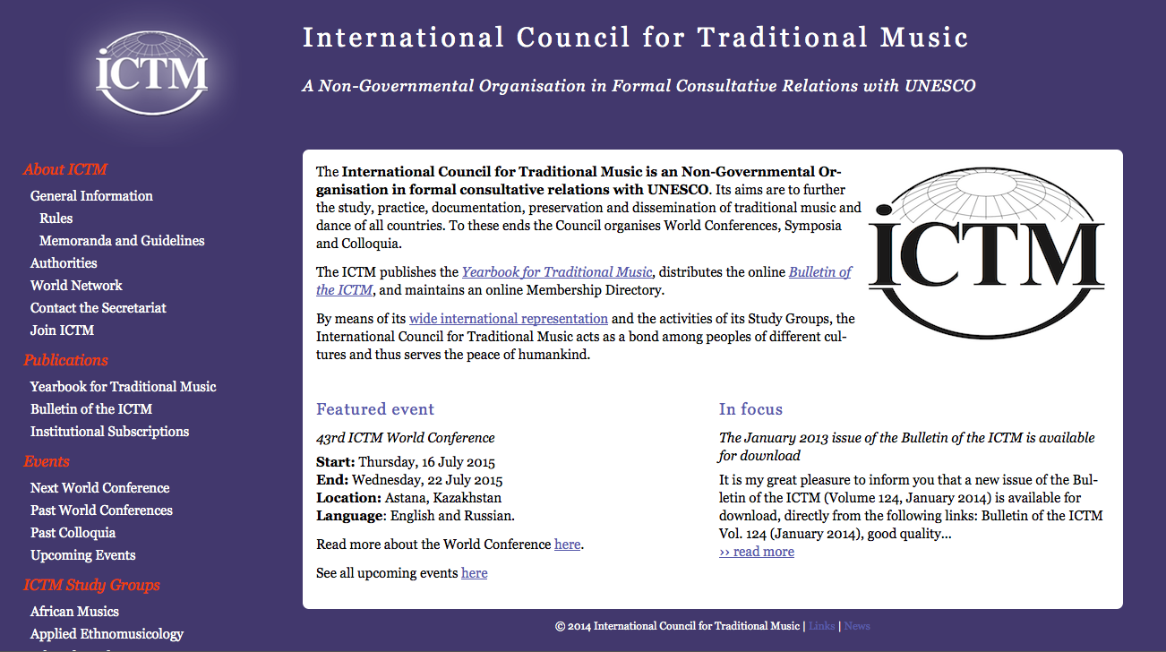
ICTM WEBSITE

Slide 12
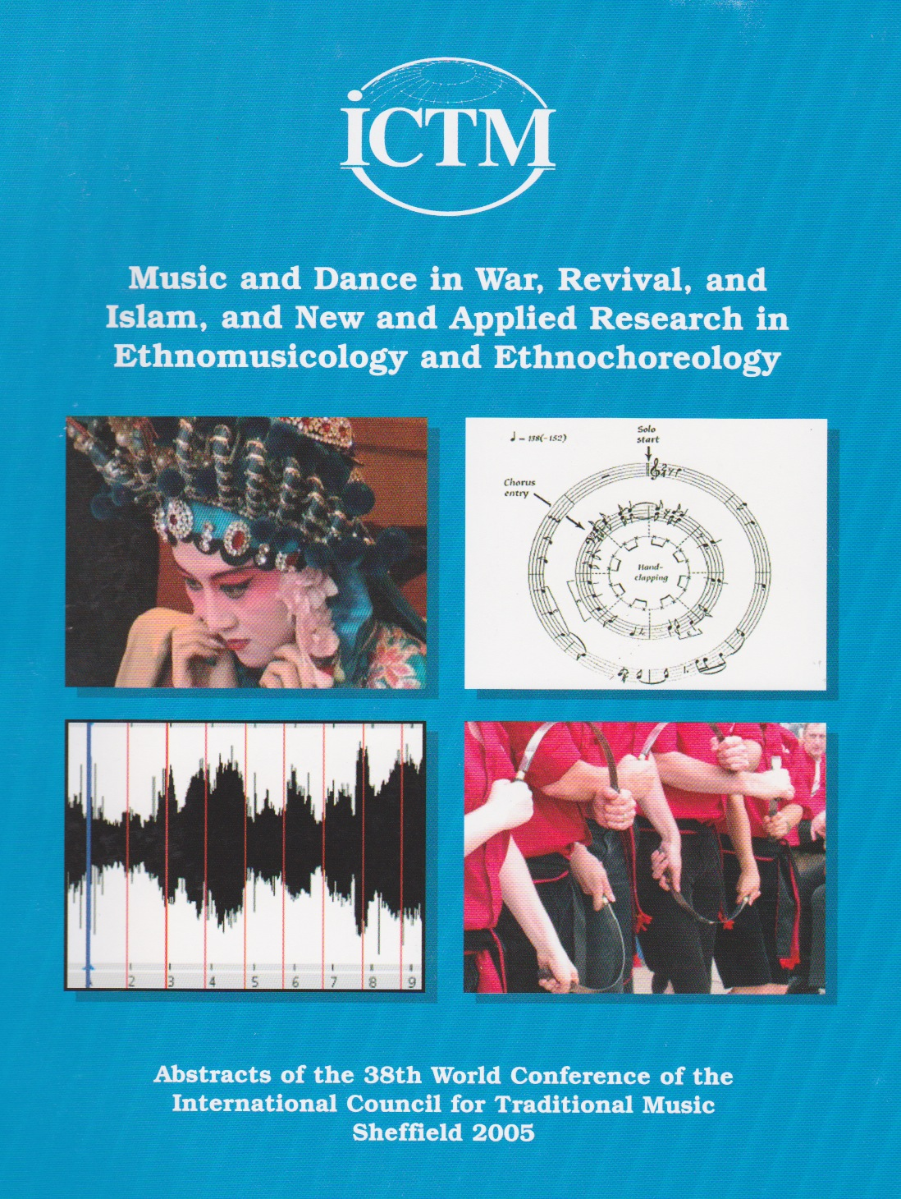

Slide 13
Conference Themes:
1) Music, Dance, and War
2) Reviving, Reconstructing, and Revitalizing Music and Dance
3) Applied Ethnomusicology and Ethnochoreology
4) Music, Dance, Islam
5) New Research
3) Applied Ethnomusicology and Ethnochoreology
The theme emphasizes situations in which scholars put their knowledge and understanding to creative use to stimulate concern and awareness about the people they study. Papers may consider issues of advocacy, canonicity, musical literacy, cultural property rights, cultural imperialism, majority - minority relations, and many others. Contributions on the applications of technologies such as internet and their effects on music and dance also fit in here. Presenters are invited to address both positive and negative cases from world-wide contexts, past and present.

Slide 14
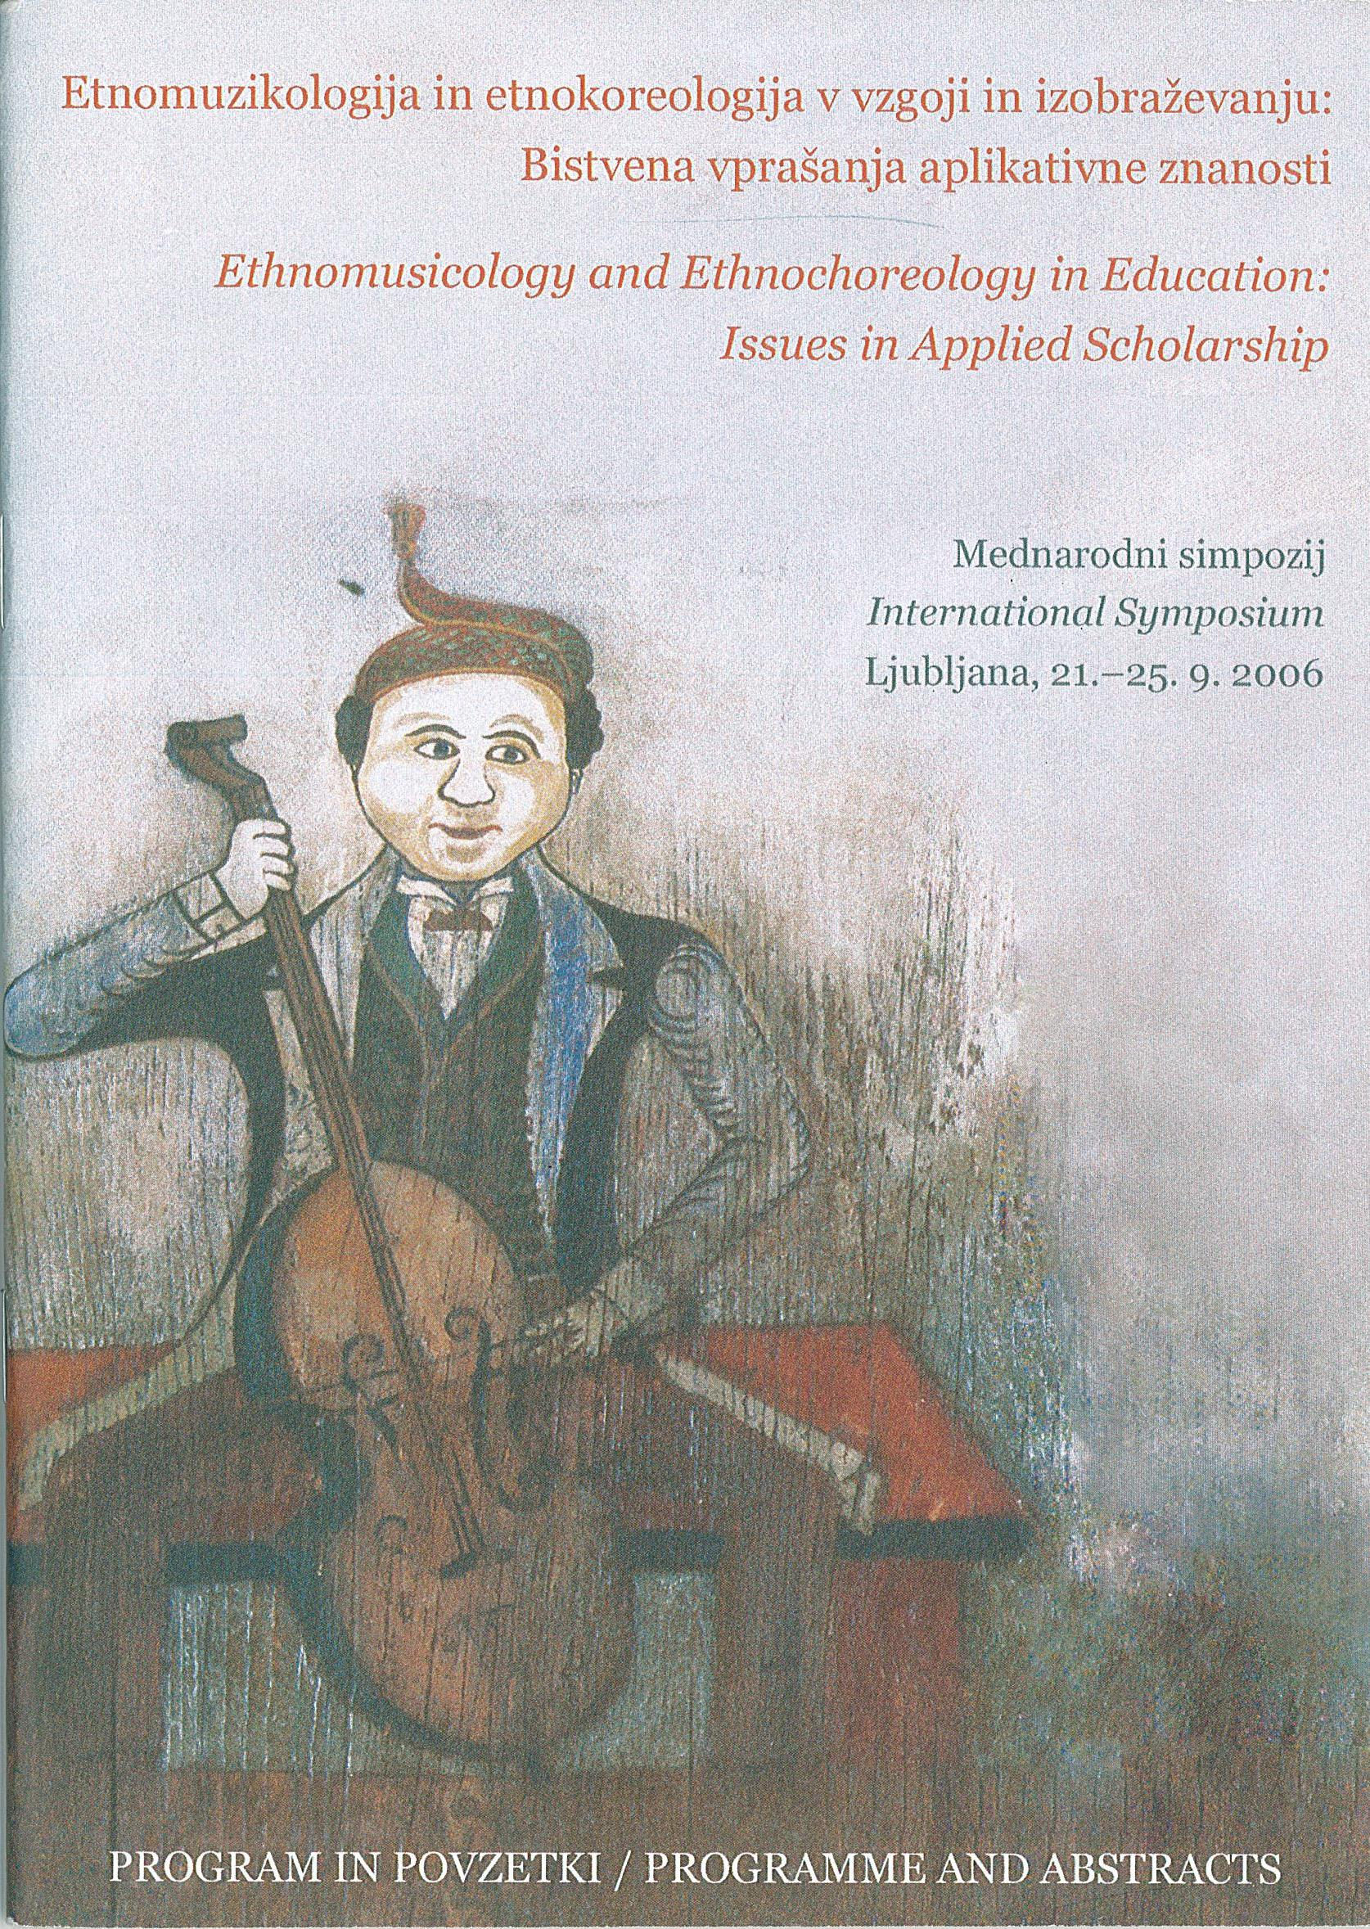

Slide 15
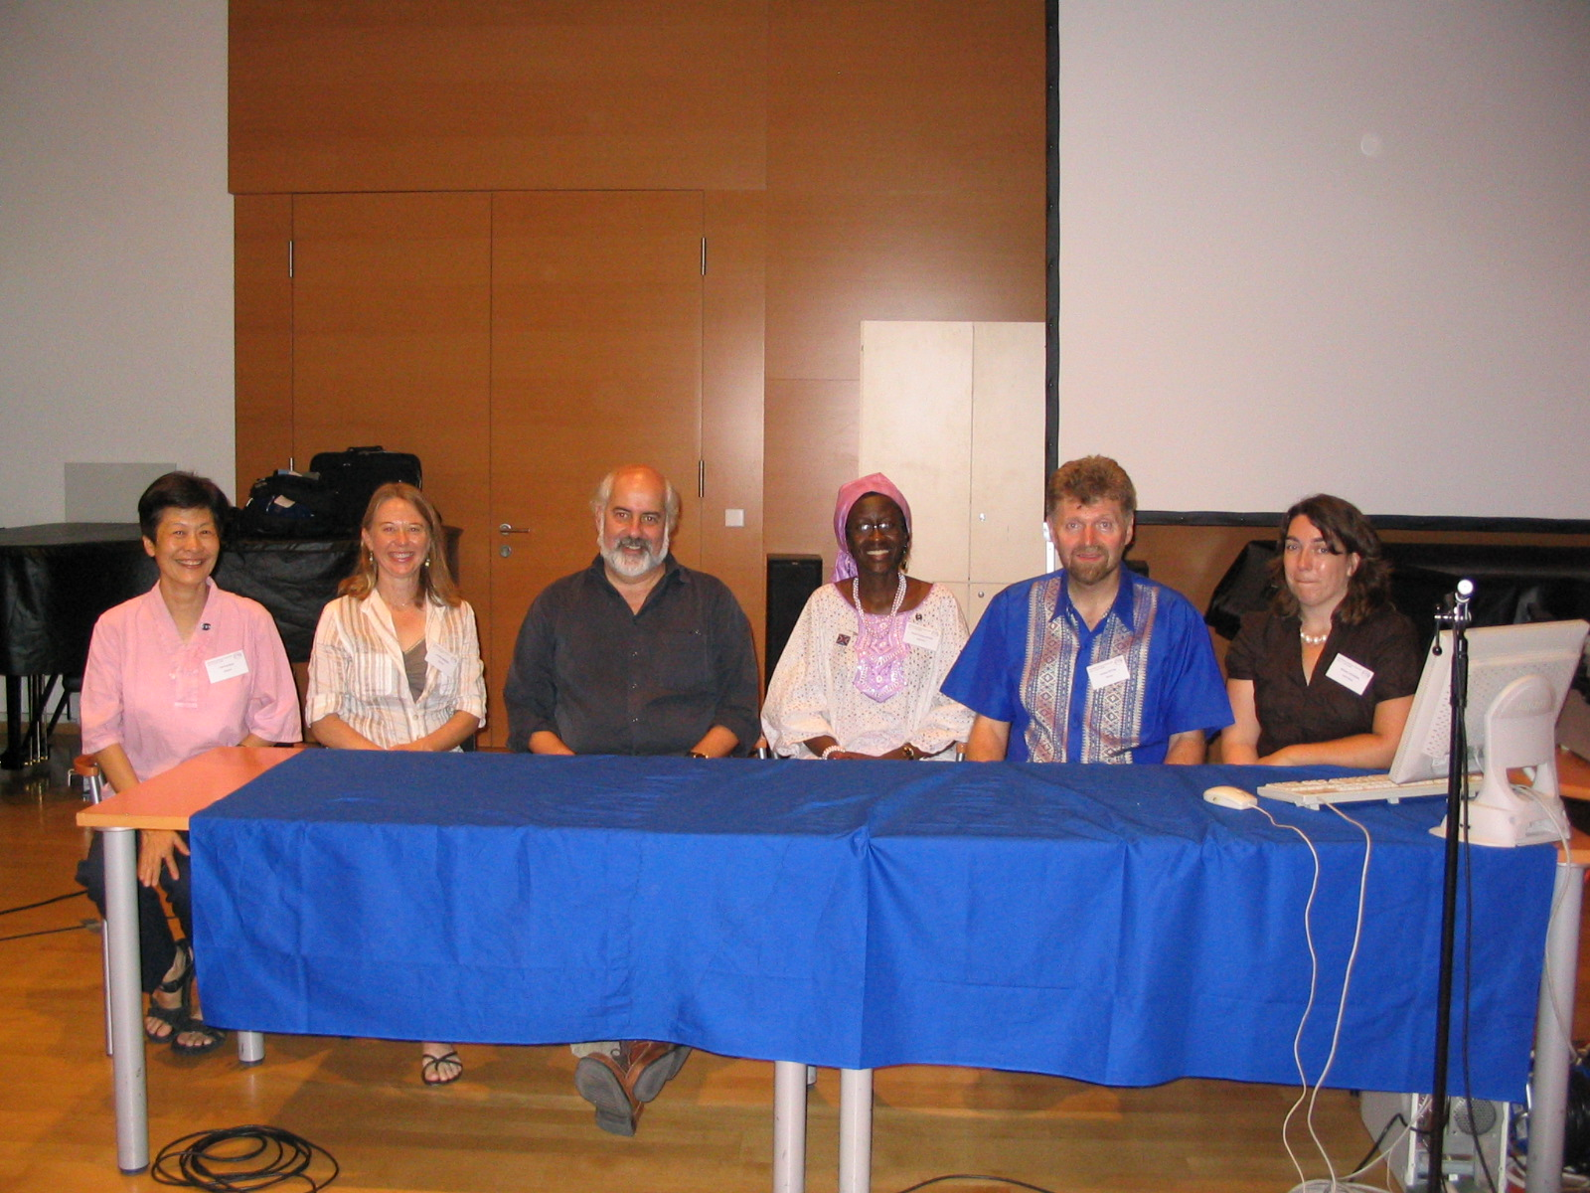
Double panel The Politics of Applied Ethnomusicology: New Perspectives, Vienna 2007:
Tan Sooi Beng (Asia), Jennifer Newsome (Australia), Samuel Araujo (South America), Patricia Opondo (Africa), Svanibor Pettan (Europe), Maureen Laughran (North America).

Slide 16
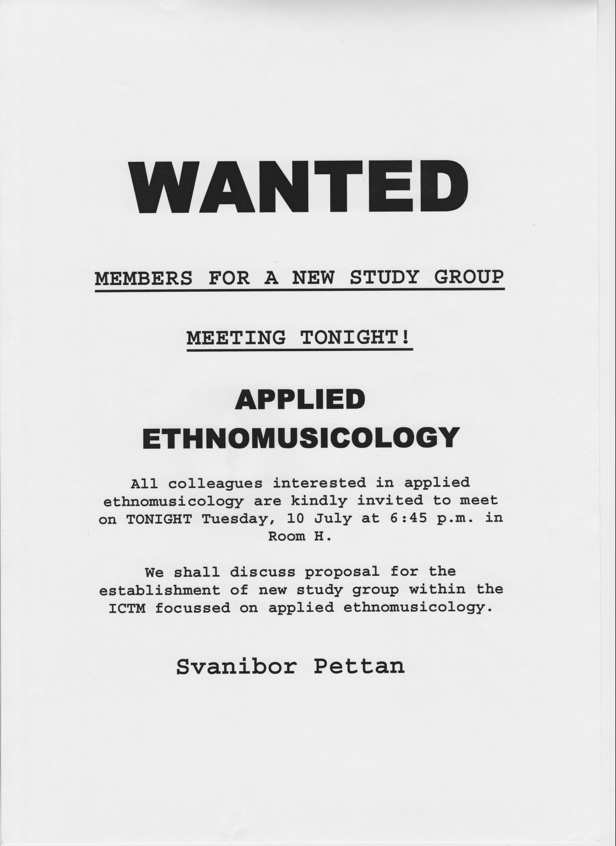

Slide 17
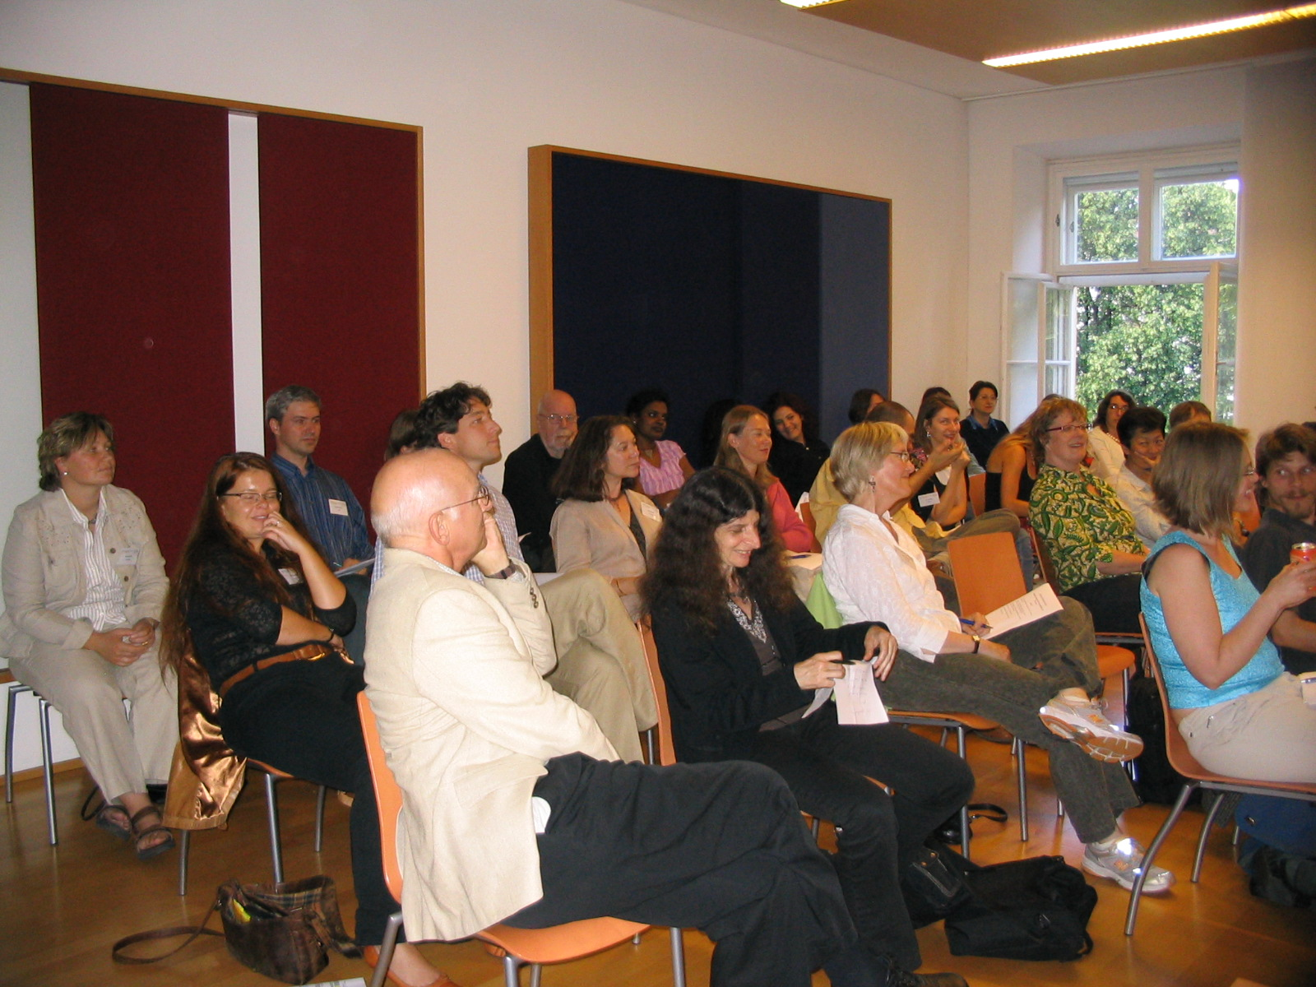
Meeting of ICTM members interested in AE, Vienna 2007

Slide 18
APPLIED ETHNOMUSICOLOGY is the approach guided by principles of social responsibility, which extends the usual academic goal of broadening and deepening knowledge and understanding toward solving concrete problems and toward working both inside and beyond typical academic contexts.
The ICTM STUDY GROUP ON APPLIED ETHNOMUSICOLOGY advocates the use of ethnomusicological knowledge in influencing social interaction and course of cultural change. It serves as a forum for continuous cooperation through scholarly meetings, projects, publications and correspondence.

Slide 19
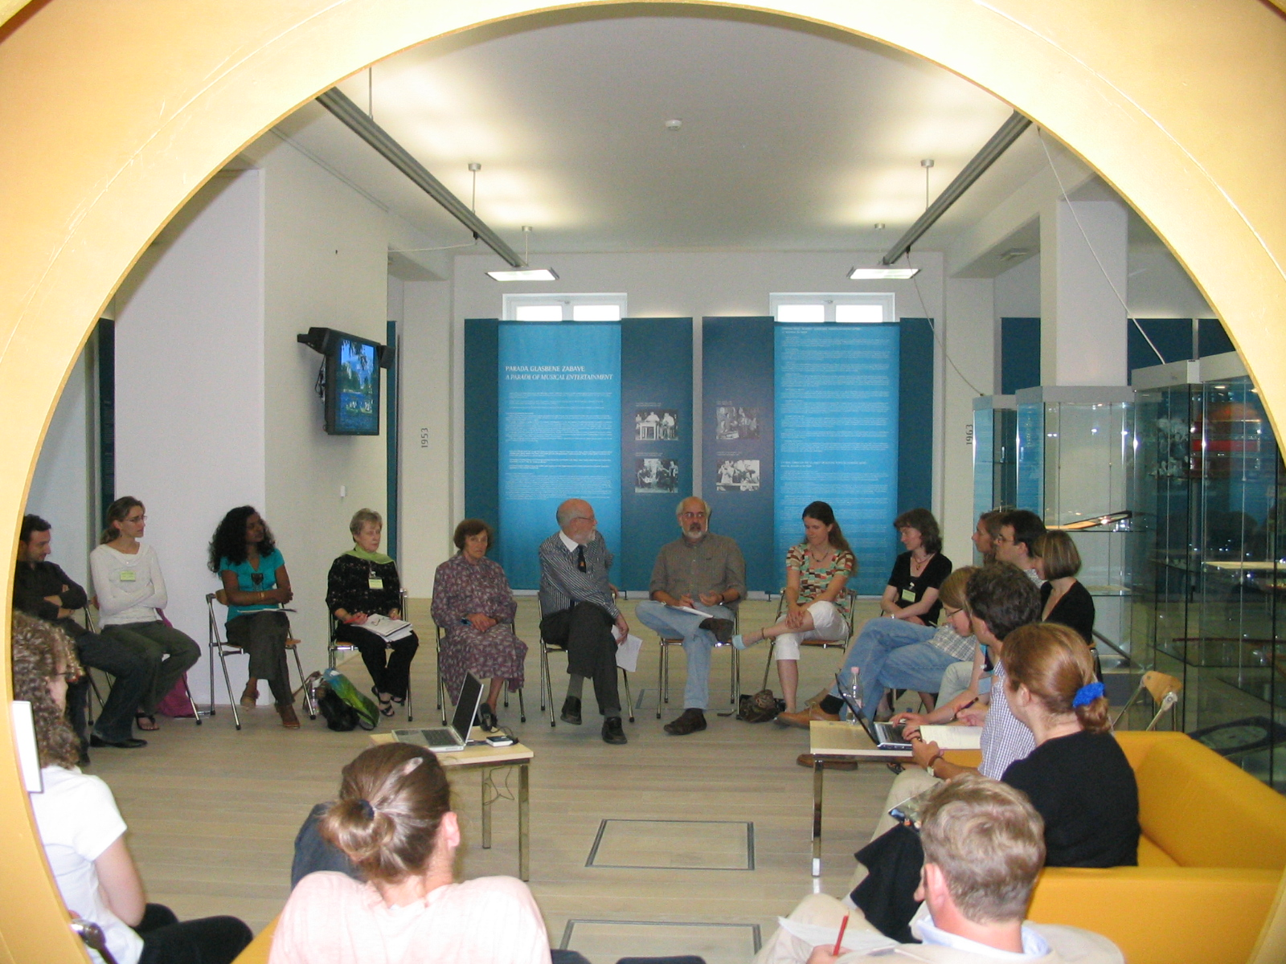
First symposium of the Study Group, Ljubljana 2008.

Slide 20
The 1st symposium of the ICTM Study Group
Applied Ethnomusicology
Ljubljana, Slovenia, 9-13 July 2008
Themes:
History of the Idea and Understanding of Applied Ethnomusicology in World-Wide Contexts
Presentation and Evaluation of Individual Projects – with Emphasis on Theory and Method
Applied Ethnomusicology in Situations of Conflict

Slide 21
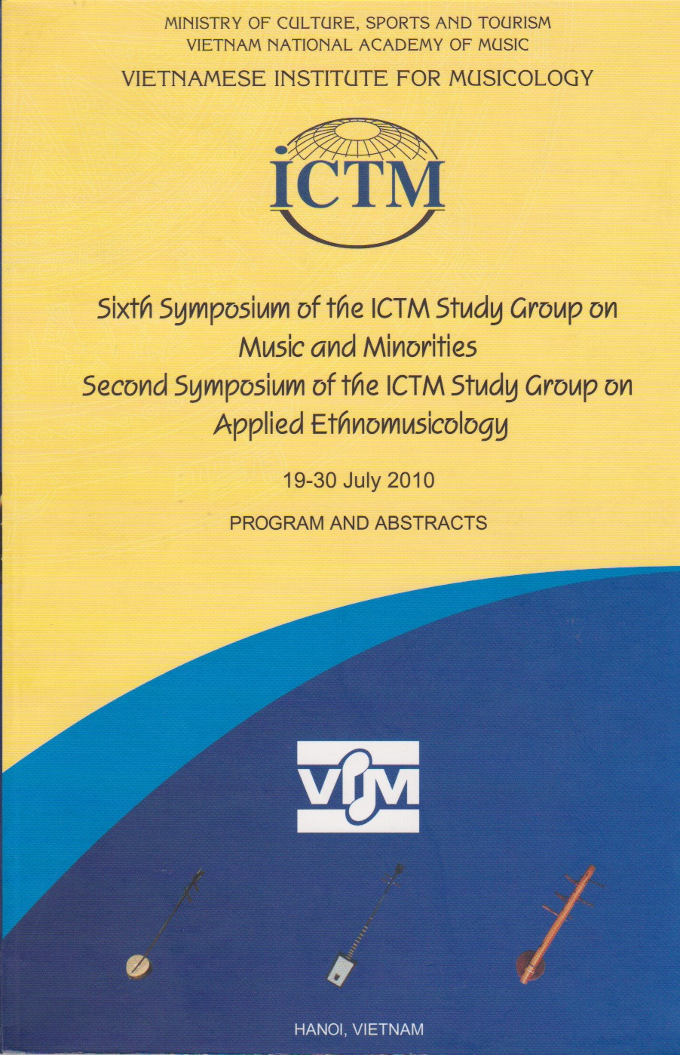

Slide 22
The 2nd symposium of the ICTM Study Group
Applied Ethnomusicology
Hanoi, Vietnam, 19-30 July 2010
Themes:
1. History and Workings of Applied
Ethnomusicology
2. Performing Arts and Ecology
3. Performing Arts in Dialogue, Advocacy,
and Education

Slide 23
The 3rd symposium of the ICTM Study Group
Applied Ethnomusicology
Nicosia, Cyprus, 18-22 April 2012
Themes:
Politics and Practices of Applied Ethnomusicology: Social Activism, Censorship, State Control
Disability and Music
Music and Conflict

Slide 24
The 4th symposium of the ICTM Study Group
Applied Ethnomusicology
East London – Hogsback - Grahamstown,
South Africa, 30 June - 4 July 2014
Themes:
Applied Ethnomusicology and Institutions
Music and Media
New Work in Applied Ethnomusicology

Slide 25
The 5th symposium of the ICTM Study Group
Applied Ethnomusicology
Cape Breton,
Canada, 5 – 9 October 2016
Themes:
Music, Labour, and Exchange
Research Methodologies for the 21st century: Collaboration and Criticality
Intangible Cultural Heritage in Contemporary Societies

Slide 26
Programme Committee
Beverley Diamond, Co-chair
Salwa Castelo Branco, Co-chair
Samuel Araujo
Gage Averill
Jayson Beaster-Jones
Svanibor Pettan
Anne Rasmussen
Tan Sooi Beng
LocaL arrangements Committee
Colin Quigley, Co-chair
Aileen Dillane, Co-chair
Orfhlaith Ní Bhriain
Mats Melin
Niall Keegan
Sandra Joyce
Catherine Foley

Slide 27
The four principal volumes
from the 21st century with focus on
applied ethnomusicology

Slide 28
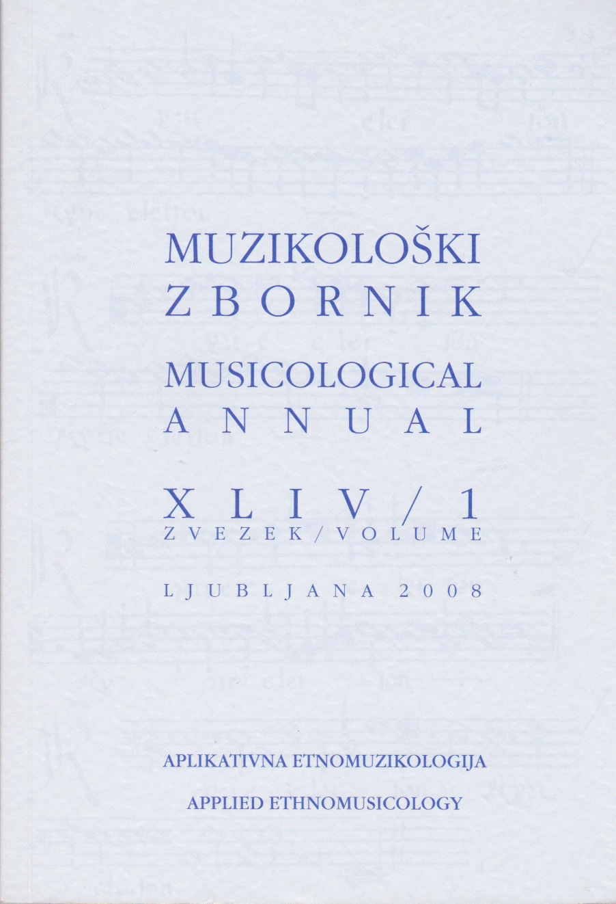
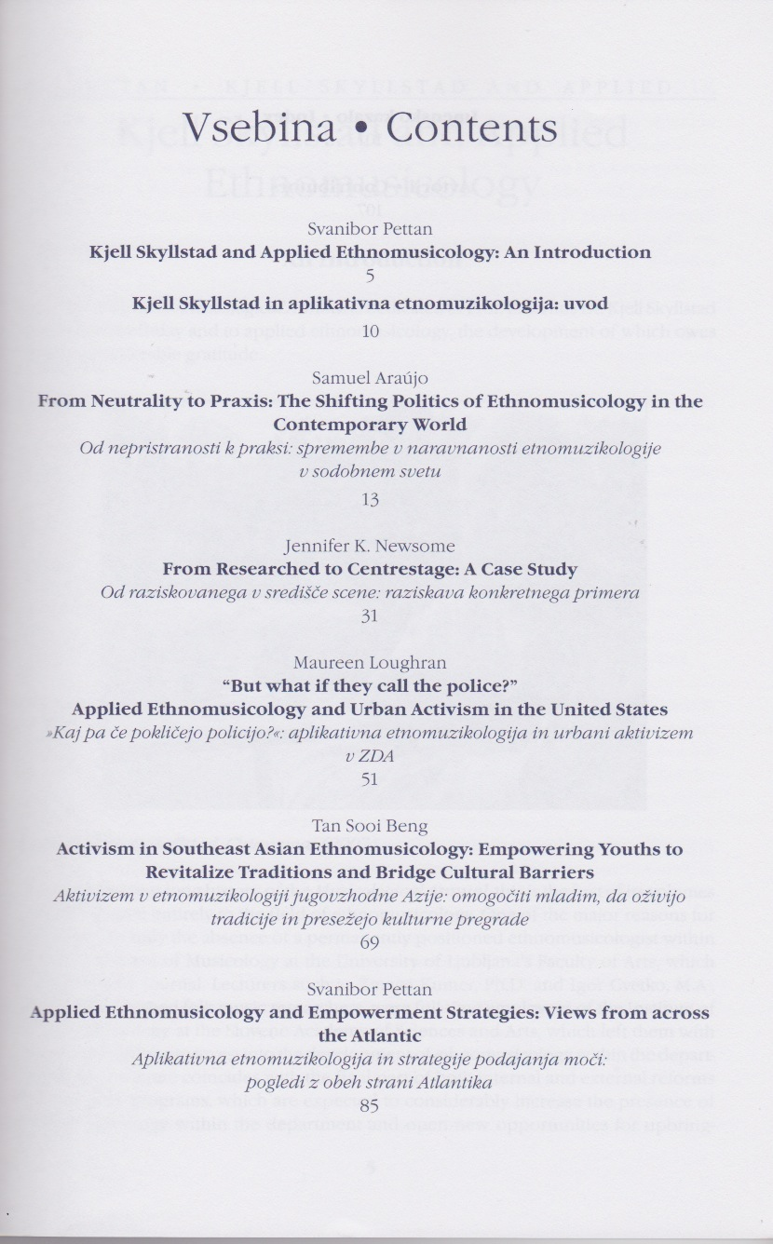

Slide 29
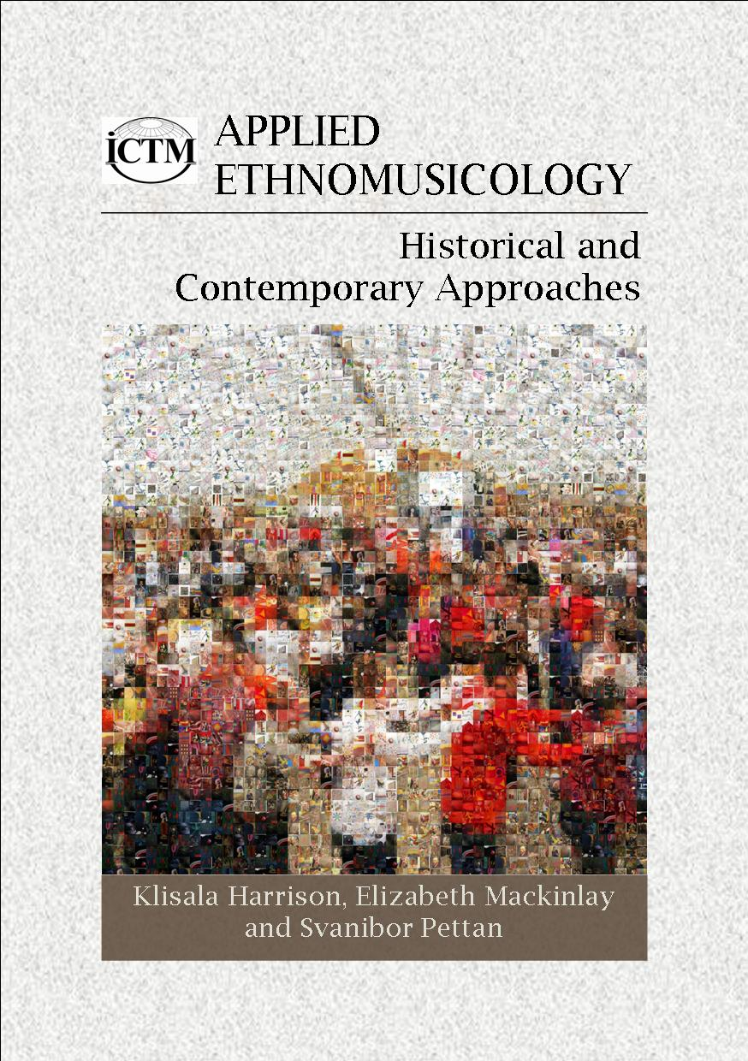
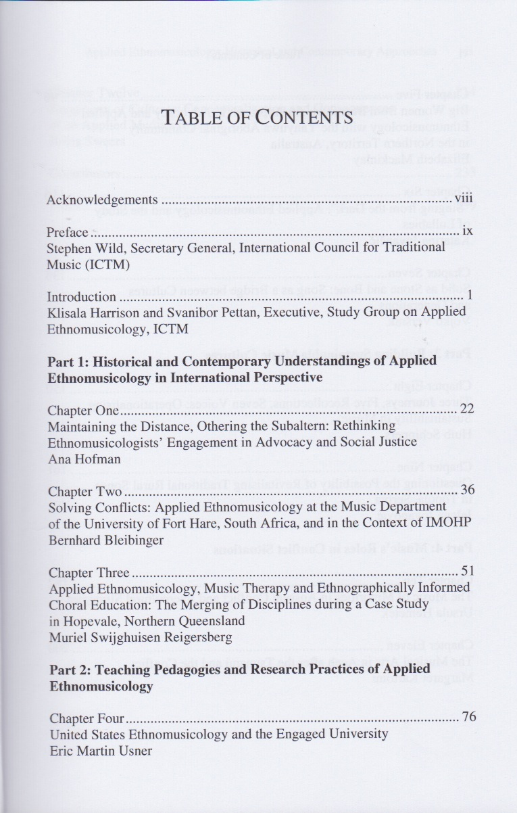

Slide 30
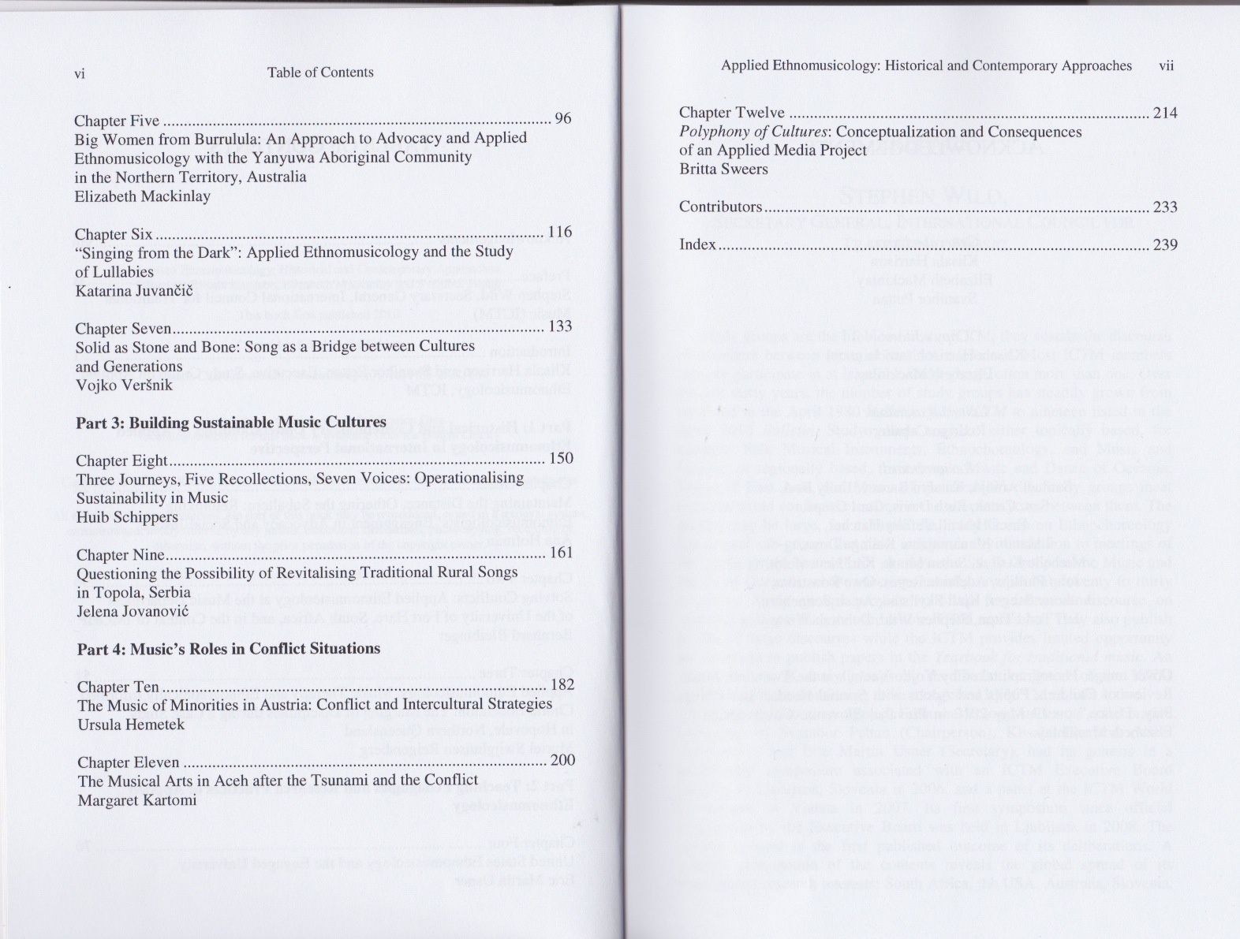

Slide 31
YEARBOOK FOR TRADITIONAL MUSIC #45 (2013)
Special section “Music and Poverty”
‘The Relationship of Poverty to Music’ by Klisala Harrison.
‘“Nobody Should Be Forced to Make a Living by Begging”: Social Exclusion and Cultural Rights of Gāine/Gandharva Musicians of Nepal’ by Pirkko Moisala.
‘Sound Praxis, Poverty, and Social Participation: Perspectives from a Collaborative Study in Rio de Janeiro’ by Samuel Araújo and Vincenzo Cambria.
‘Surviving Material Poverty by Employing Cultural Wealth: Putting Music in the Service of Community in Haiti’ by Rebecca Dirksen.
‘Music, Health, and Socio-economic Status: A Perspective on Urban Poverty in Canada’ by Klisala Harrison.
‘Music and the US War on Poverty: Some Reflections’ by Jeff Todd Titon.
‘Of Lack and Loss: Assessing Cultural and Musical Poverty in Uttarakhand’ by Stefan Fiol.

Slide 32
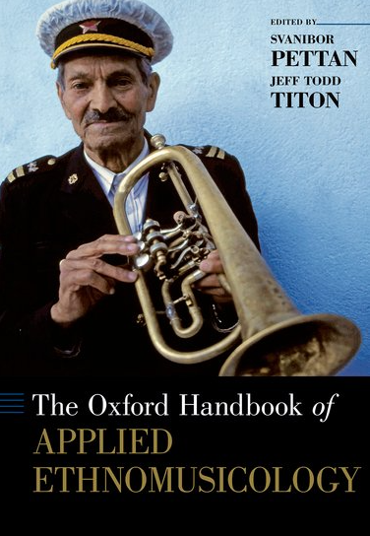
Table of cntents
TABLE OF CONTENTS
Introduction: Applied Ethnomusicology, Challenges and Potentials
Theoretical and Methodological Considerations
Advocacy
Indigenous Peoples
Conflicts
Education
Agencies

Slide 33
Part 1. Jeff Todd Titon (USA): Applied Ethnomusicology, a Descriptive and Historical Account
Part 2. Svanibor Pettan (Slovenia): Applied Ethnomusicology in the Global Arena
Part 3. Jeff Todd Titon and Svanibor Pettan: An Introduction to the Essays
1. Dan Bendrups (Australia): Transcending Researcher Vulnerability through Applied Ethnomusicology
2. Klisala Harrison (Finland): Evaluating Values in Applied Ethnomusicology
3. Tan Sooi Beng (Malaysia): Cultural Engagement and Ownership through Participatory Approaches in Applied Ethnomusicology
4. Huib Schippers (Australia): Applied Ethnomusicology and Intangible Cultural Heritage: Understanding 'Ecosystems' of Music as a Tool for Sustainability
5. Jeff Todd Titon (USA): Sustainability, Resilience and Adaptive Management for Applied Ethnomusicology
6. Jeffrey A. Summit (USA): Advocacy and the Ethnomusicologist: Assessing Capacity, Developing Initiatives, Setting Limits, and Making Sustainable Contributions
7. Ursula Hemetek (Austria): Applied Ethnomusicology as an Intercultural Tool: Some Experiences from the Last 25 Years of Minority Research in Austria
8. Michael B. Bakan (USA): Being Applied in the Ethnomusicology of Autism
9. Brian Schrag (USA): Motivations and Methods for Encouraging Artists in Longer Traditions
10. Zoe C. Sherinian (USA): Activist Ethnomusicology and Marginalized Musics of South Asia
11. Elizabeth Mackinlay (Australia): Decolonisation and Applied Ethnomusicology: Story-ing the Personal-Political-Possible in Our Work
12. Holly Wissler (USA): Andean Q'eros and Amazonian Wachiperi: Indigenous Voice in Grassroots Tourism, Safeguarding, and Ownership Projects
13. Erica Haskell (USA): The Role of Applied Ethnomusicology in Post-conflict and Post-catastrophe Communities
14. Joshua D. Pilzer (Canada): The Study of Survivors' Music
15. Britta Sweers (Switzerland): The Public Display of Migrants in National(ist) Conflict Situations in Europe: An Analytical Reflection on University-Based Ethnomusicological Activism
16. Susan E. Oehler Herrick (USA): Strategies and Opportunities in the Education Sector for Applied Ethnomusicology
17. John Morgan O'Connell (UK): Music and Humanism in the Aga Khan Humanities Project
18. Patricia Sheehan Campbell (USA) and Lee Higgins (UK): Intersections between Ethnomusicology, Music Education and Community Music
19. Dan Lundberg (Sweden): Archives and Applied Ethnomusicology
20. Clifford Murphy (USA): The Applied Ethnomusicologist as Public Folklorist: Ethnomusicological Practice in the Context of a Government Agency in the USA.
21. Zhang Boyu (China): Applied Ethnomusicology in China: An Analytical Review of Practice
22. Alan Williams (USA): The Problem and Potential of Commerce

Slide 34



Slide 35
CULTURAL AND ETHNOMUSICOLOGICAL SOCIETY FOLK SLOVENIA
IS
THE SLOVENIAN NATIONAL COMMITTEE OF THE INTERNATIONAL COUNCIL FOR TRADITIONAL MUSIC.
IT IS A CREATIVE MEETING POINT OF CULTURE AND SCHOLARSHIP, PRAXIS AND THEORY, RURAL AND URBAN DOMAINS, MAJORITY AND MINORITIES, MUSICIANSHIP WITH NO BORDERS.
IT ORGANIZES THEMATIC ANNUAL CONCERTS…

Slide 36
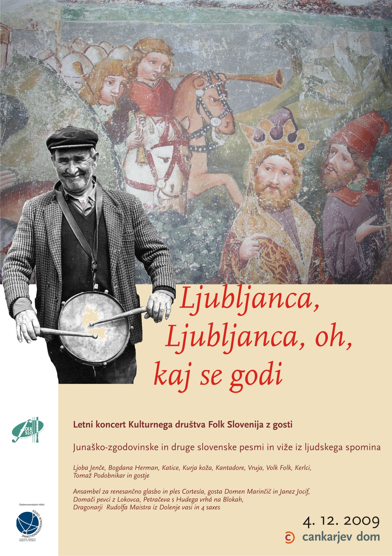

Slide 37
WORKSHOPS OF
TRADITIONAL SINGING, INSTRUMENTAL MUSIC,
AND DANCE…

Slide 38
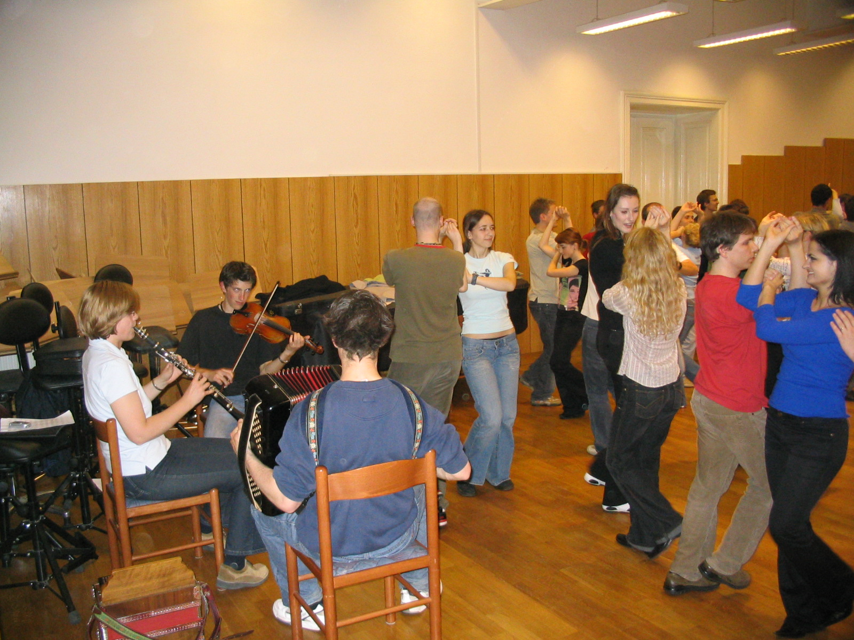

Slide 39
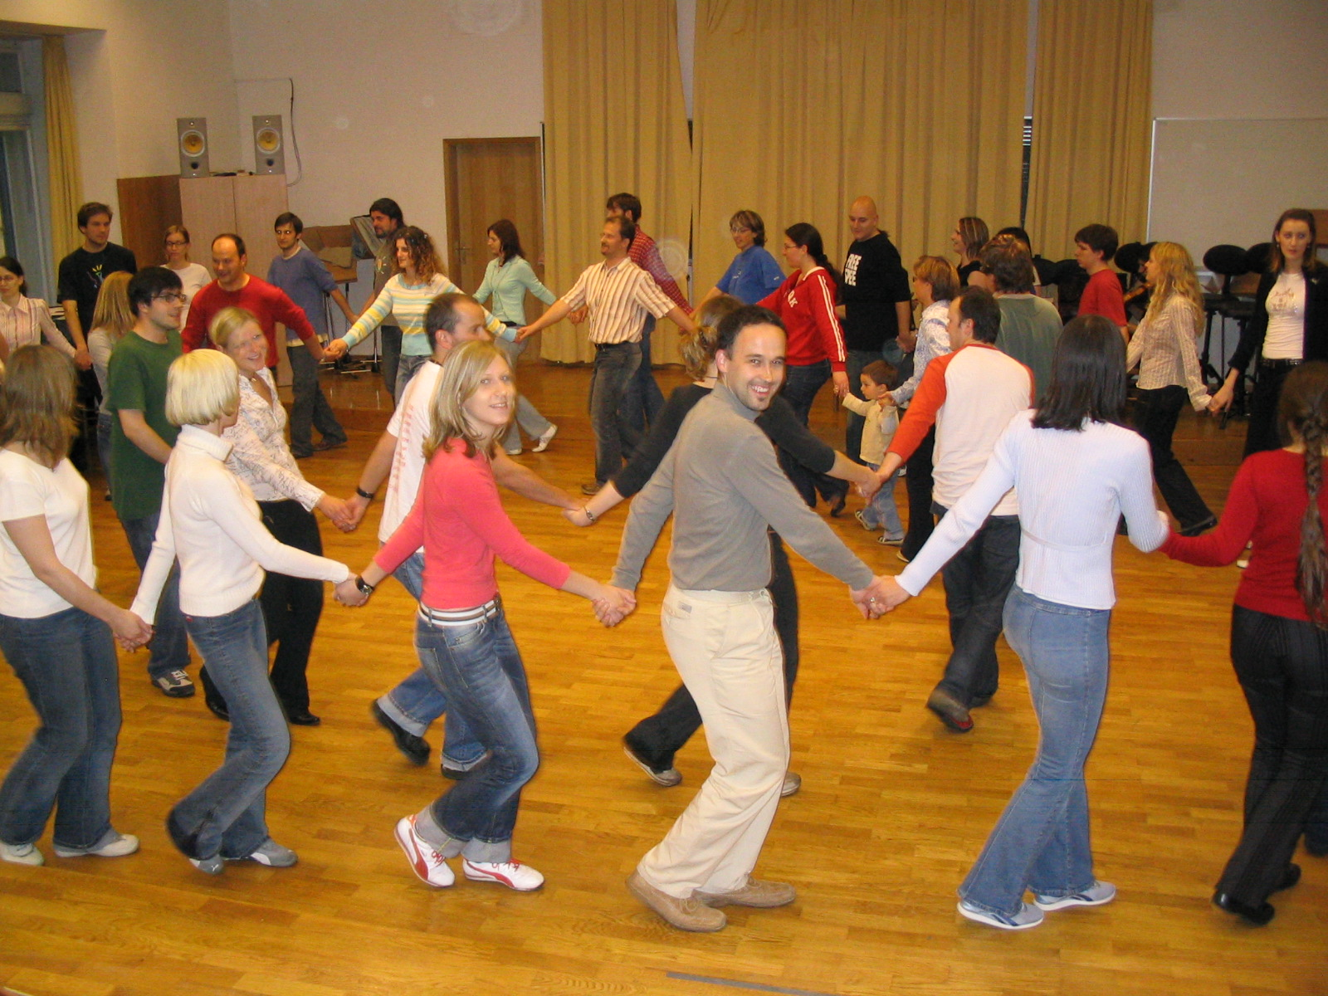

Slide 40
SYMPOSIA,
ROUNDTABLES,
LECTURES…

Slide 41
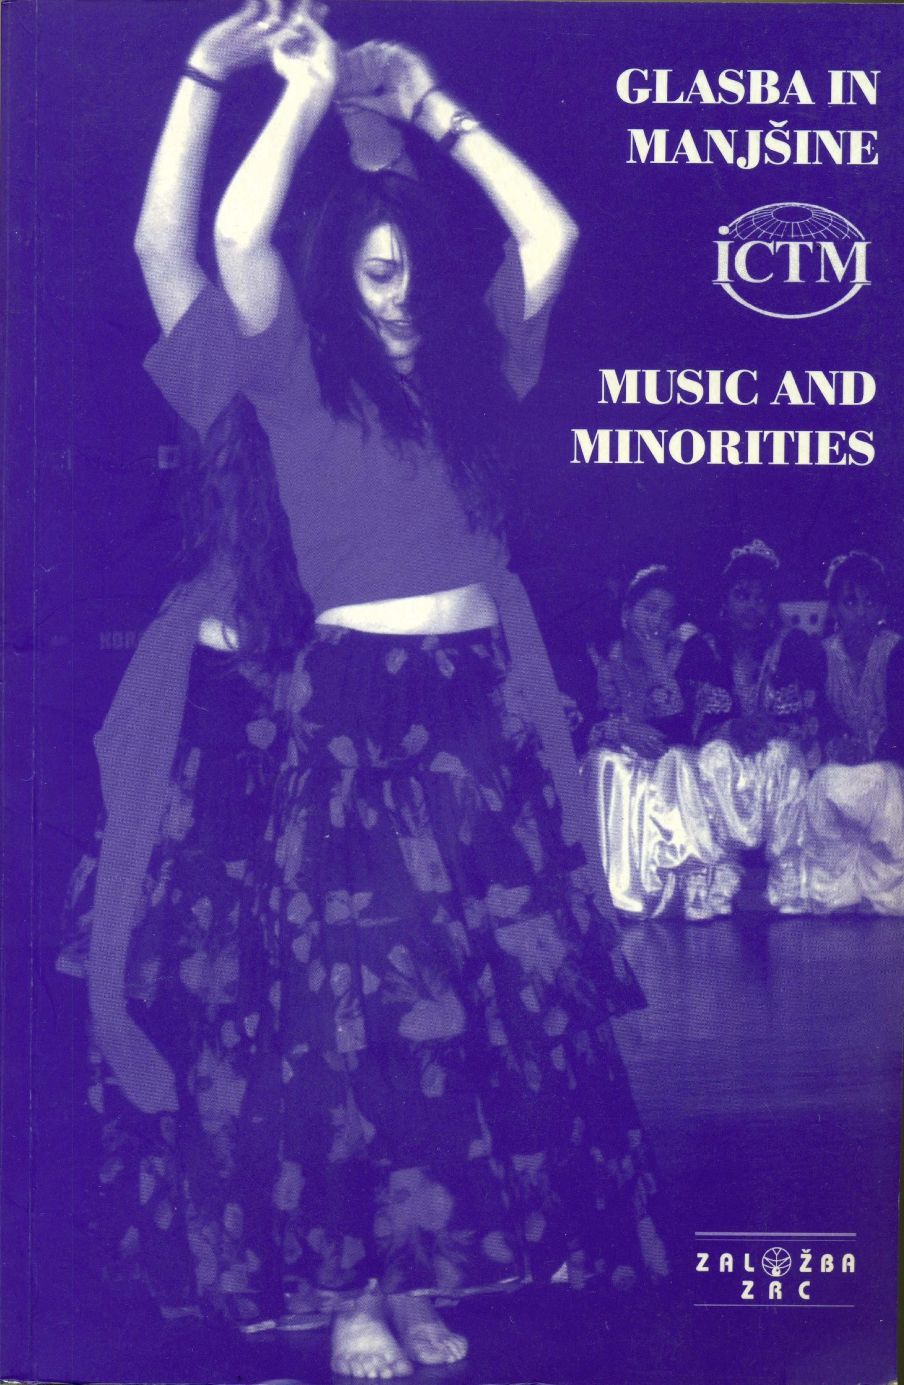
2000
Ljubljana (Slovenia)
1st symposium,
attended by 31 scholar
from 15 countries.
Themes:
Music and Dance of Minorities:
Research Traditions and Cultural
Policies
Music, Dance and Identity of
Minority Cultures
Minorities in Slovenia and Neighboring Countries

Slide 42
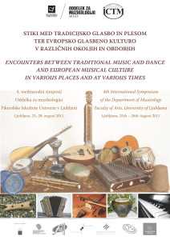

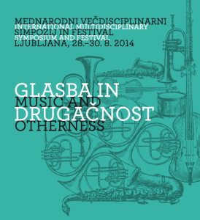
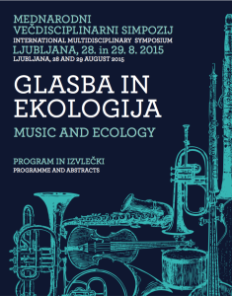

Slide 43
CULTURAL EXCHANGES,
FOR INSTANCE, WITH PROFESSORS AND STUDENTS FROM THE CHULALONGKORN UNIVERSITY FROM BANGKOK, THAILAND …

Slide 44
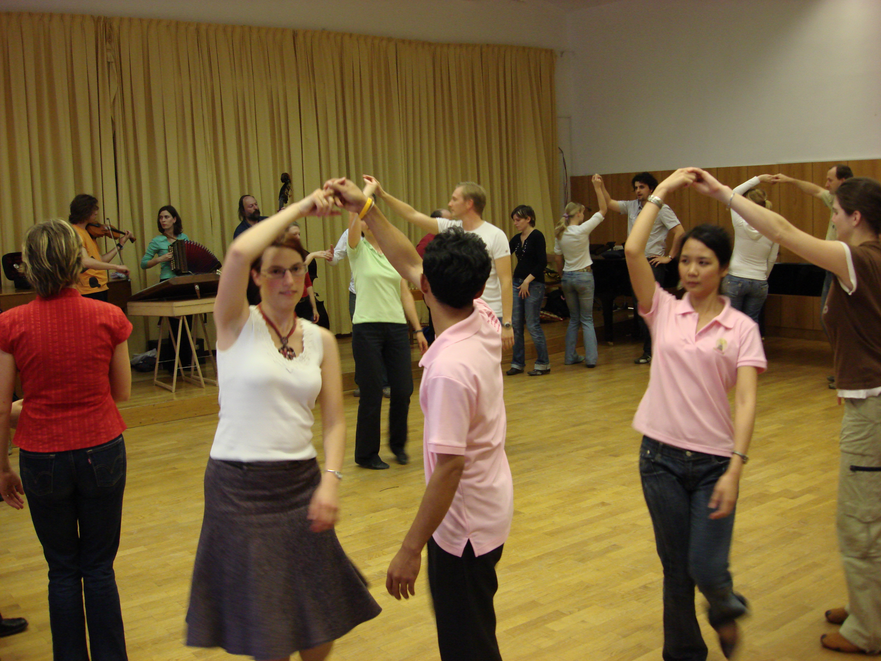

Slide 45
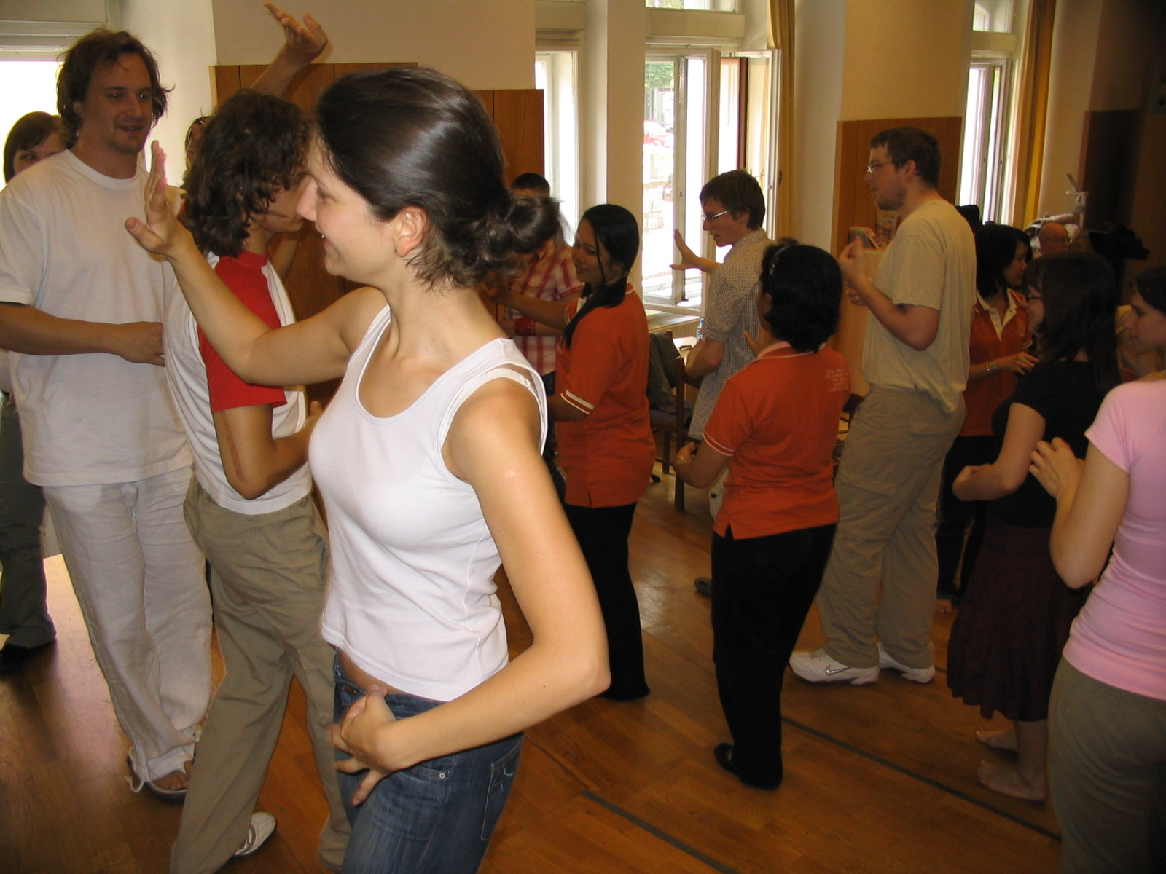

Slide 46
AN OVERTONE SINGING WORKSHOP WITH TRAN QUANG HAI
AND SLOVENIAN FOLK DANCE WORKSHOP…

Slide 47
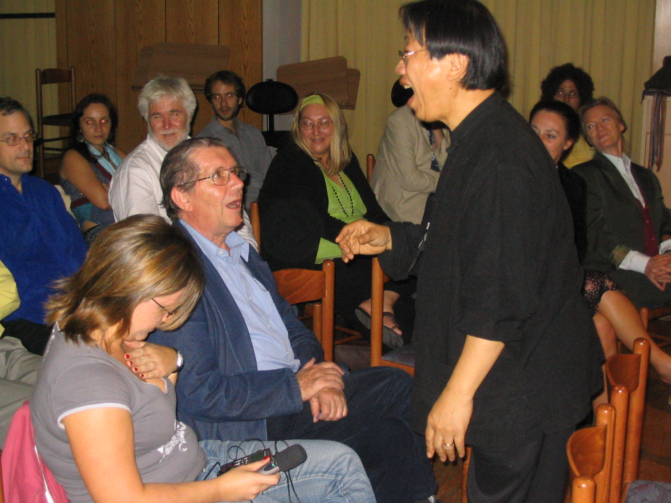

Slide 48
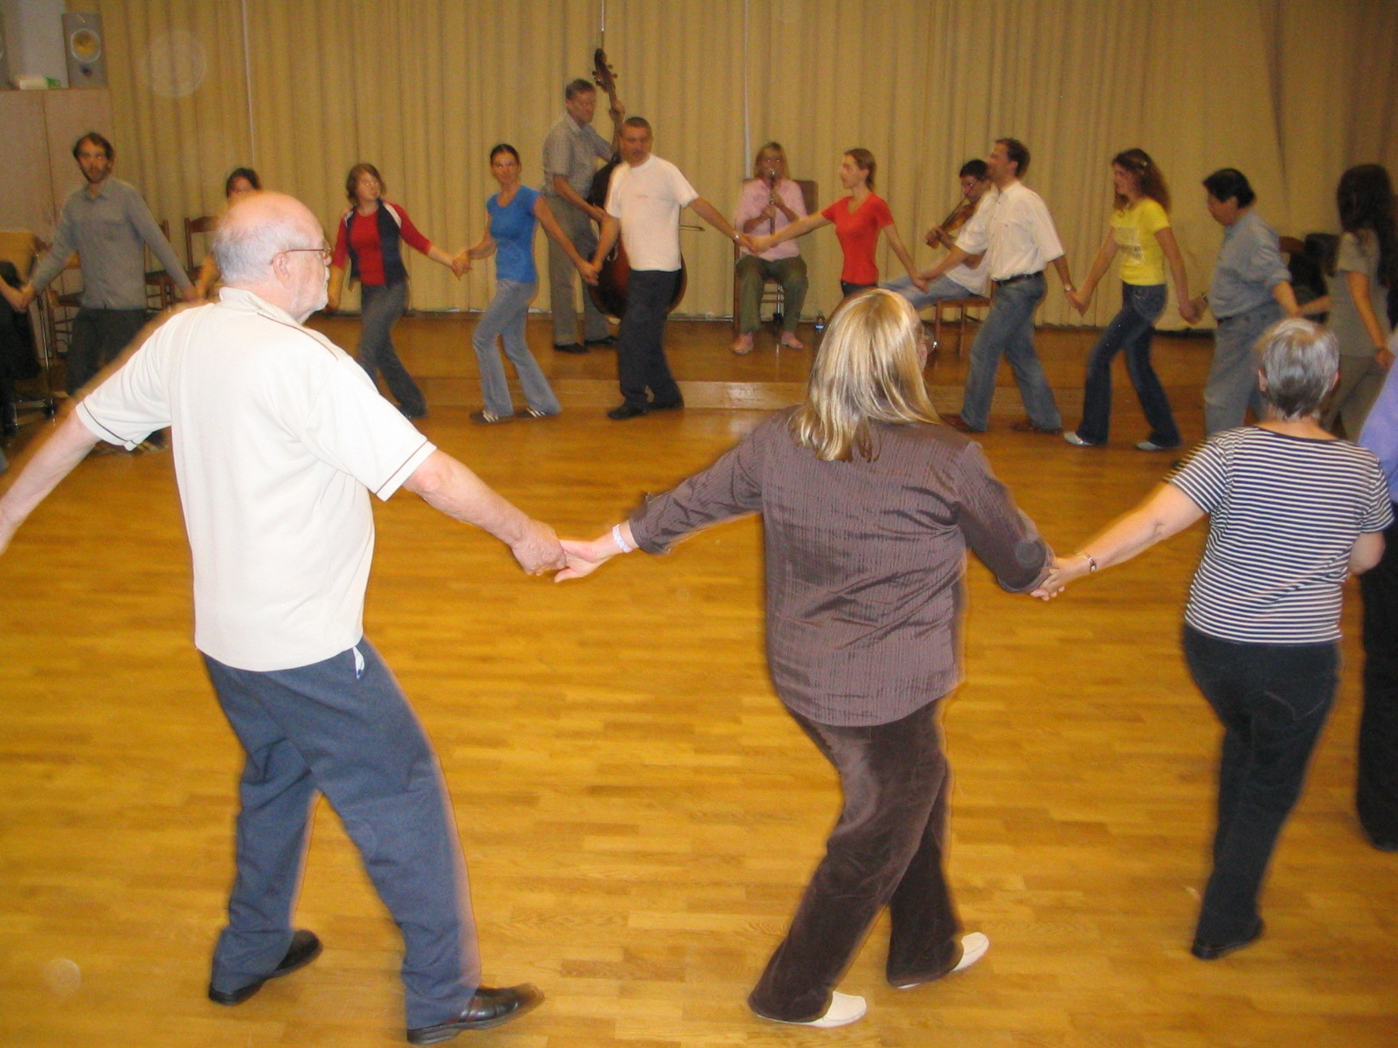

Slide 49
PUBLISHING OF
STUDY MATERIALS,
INCLUDING COMPACT DISCS…

Slide 50
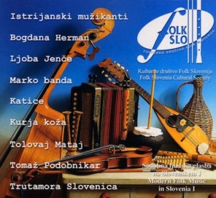




Slide 51


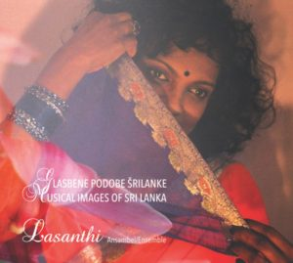
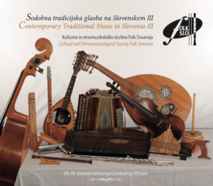

Slide 52
THANK YOU
FOR YOUR KIND ATTENTION!
www.ictmusic.org
svanibor.pettan@gmail.com

