Slide 1
Human Dignity Advancement in Urban Populations:
Concept and Implementation

Slide 2
Session Goal
To explore advancing
human dignity
through the concepts and tools of organizational development

Slide 3
Central Question
How does a systematic inquiry, focused on the value of human dignity, lead to significant organizational change?

Slide 4
What is human dignity?

Slide 5
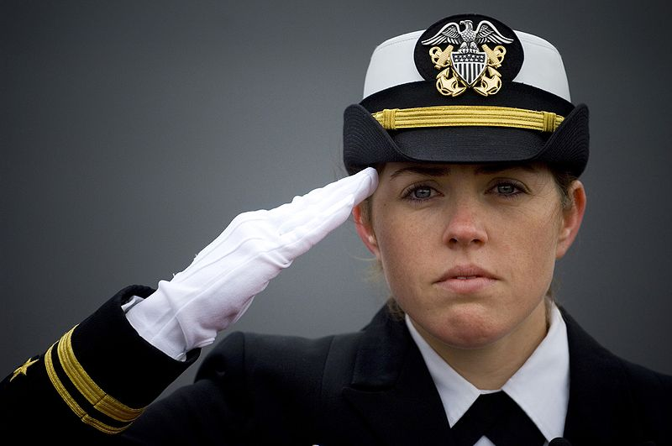
Honor
To show someone outward signs of acknowledgement
Honor is accorded due to one’s status
Notes:
5

Slide 6
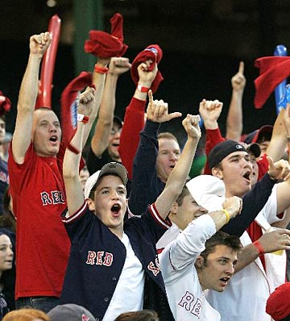
Respect
To acknowledge someone for their deeds, achievement, abilities, etc.
Respect is accorded due to one’s actions
Notes:
6

Slide 7
Dignity
To acknowledge the humanity that exists in each person
Dignity is accorded to a person inasmuch he/she is a human being
Notes:
7

Slide 8
Three approaches
Honor
Accorded due to one’s status
Respect
Accorded due to one’s actions
Dignity
Accorded to a person inasmuch he/she is a human being
Notes:
8

Slide 9
Human dignity tension
To treat a person with dignity
To belittle a person

Slide 10
Three basic assumptions:
Promoting human dignity can reduce violence,.1
hate and humiliation
2. Social change – a link between human dignity and
organizational development
3. Empowering change agents

Slide 11
Elements of an organizational development approach
System-wide: everyone included
Leadership development
Team-building
Assessment

Slide 12
Main Goal
Human dignity will be, as a value, as a language and as a behavior, an integral part of the daily life in the city.

Slide 13
What are the guiding principles and courses of action?

Slide 14
Question for discussion
How can we create a model of intervention in urban population?

Slide 15
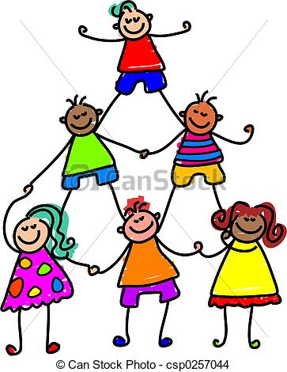
Thank you for your cooperation

