Slide 1

Human Dignity Advancement in Schools

Slide 2
Session Goal
To explore advancing
human dignity
through the concepts and tools of organizational development

Slide 3

Central Question
How does a systematic inquiry, focused on the value of human dignity, lead to significant organizational change?

Slide 4
What is human dignity?

Slide 5
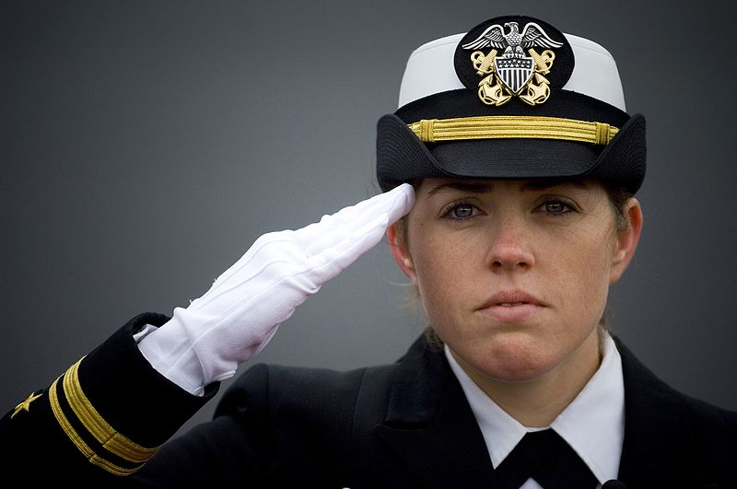
Honor
To show someone outward signs of acknowledgement
Honor is accorded due to one’s status
Notes:
5

Slide 6
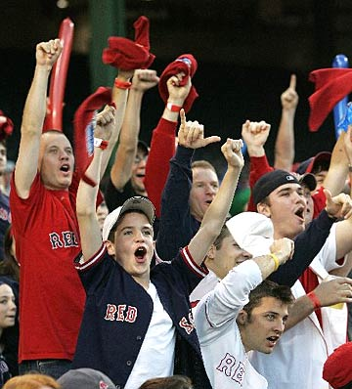
Respect
To acknowledge someone for their deeds, achievement, abilities, etc.
Respect is accorded due to one’s actions
Notes:
6

Slide 7
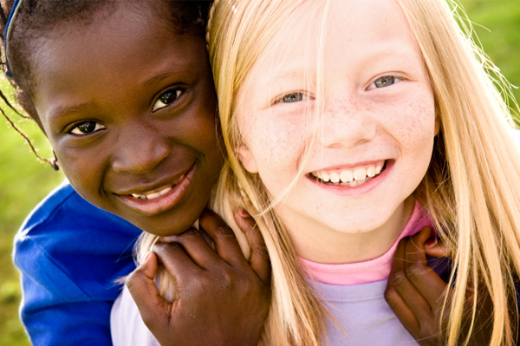
Dignity
To acknowledge the humanity that exists in each person
Dignity is accorded to a person
inasmuch he/she is a human being
Notes:
7

Slide 8
Three approaches
Honor
Accorded due to one’s status
Respect
Accorded due to one’s actions
Dignity
Accorded to a person inasmuch
he/she is a human being
Notes:
8

Slide 9
What is the human dignity reality in Israeli schools?
Research among students indicates:
43% of the students: “Teachers don’t respect us”
Students feel that “teachers relate to us as ‘students’ and not as unique human beings”
Girls experience a higher level of dignity
than boys
(Friedman, 1999)

Slide 10
Students’ dignity expectations in the teacher-student relationship
Fairness
Trust
No condescension
No undermining of student’s self- confidence
Good-spirited acceptance of students’ sense of humor
Teach without rigidity and toughness
Don’t shout

Slide 11
How can we integrate a culture of dignified behavior into the daily life of a school?

Slide 12
Elements of an organizational development approach
System-wide: everyone included
Leadership development
Team-building
Assessment

Slide 13
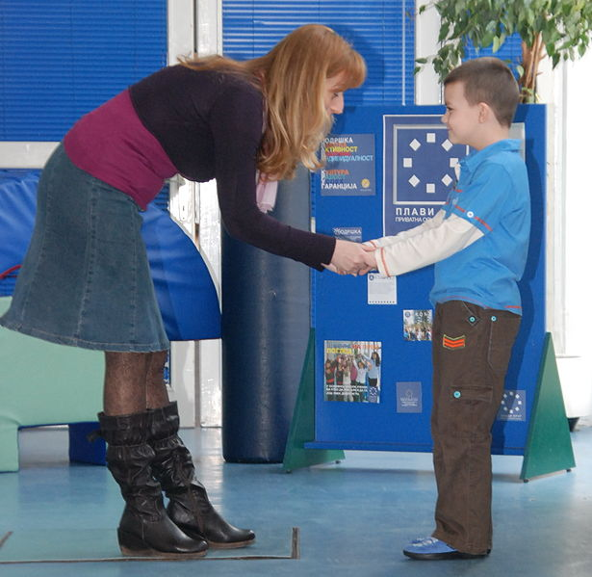
The structure of a human dignity school intervention

Slide 14
Stage one: organizational diagnosis
Organization’s characteristics
Dignity
Typical examples of
dignity and indignity
Energy for change
Notes:
14

Slide 15
Stage two: consciousness raising
Goals
> Raising awareness of dignity and indignity
in the life of the school
> Establishing a common “Dignity Language”
Workshops
Identifying situations
Analyzing incidents
Simulation games
Skill-building

Slide 16
Human dignity tension
To treat a person with dignity
To belittle a person

Slide 17

The camera exercise
Let’s get active
An opportunity to experience
a basic component of the human dignity workshop

Slide 18
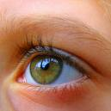

Stage three: creating organizational structures for change
An organizational structure =
translating the workshop insights
into visible behaviors:
which are repeated in the life
of the organization
and which express human dignity
Notes:
18

Slide 19

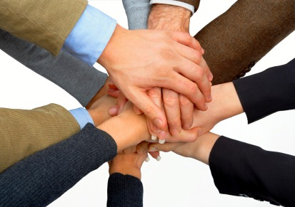
Organizational structures: examples
Human dignity
Observers
2. Common behavioral codes

Slide 20
Two axes of activity
Consciousness raising
Organizational structures
Visible change

Slide 21
Stage four:
program conclusion
The organization integrates and maintains human dignity, using its inner resources
Questionnaires and assessment
Summing up activities and separation from the consultants

Slide 22
Student’s questionnaires – an example
Teachers – students relationships
 |  | (N=117)before |  |  | (N=78)after
question |  | dignity | indignity | No answer | dignity | indignity | No answer
Teachers believe in their students | 1 | 58% | 42% | 8% | 69% | 31% | 1%
Teachers don’t give the same attention to all students | 2 | 50% | 50% | 4% | 69% | 31% | 0%
Teachers listen to students that approach them | 3 | 75% | 25% | 0% | 81% | 19% | 0%
Teachers shout at students | 4 | 37% | 63% | 1% | 40% | 60% | 0%
Teachers hurt students | 5 | 28% | 72% | 2% | 74% | 26% | 0%
Teachers use interesting ways of teaching | 6 | 17% | 83% | 1% | 78% | 22% | 0%
Teachers avoid listening to their students | 7 | 22% | 78% | 1% | 83% | 17% | 0%
Teachers help students solve their academic problems | 8 | 16% | 84% | 0% | 87% | 13% | 0%
Total |  | 38% | 62% | 2% | 73% | 27% | 0%

Slide 23

Question for discussion
If you were to mount a human dignity intervention in your organization
What would be the major opportunities?
What would be some obstacles to be overcome?

Slide 24
Racism as I explained to my daughter
"You must know, my daughter, that all human beings are a miracle. Everyone is special. You will never find two completely identical faces. Each face is a sign of life. Each life is worthy of respect. No one has the right to humiliate another. Each person has the right to respect. In respecting people we are respecting through them life at its most beautiful, its most wonderful, we are respecting all of life's variety, and its unexpected quality. In respecting the other, we in fact are respecting ourselves.“
(Taher Ben Jaloon)

Slide 25
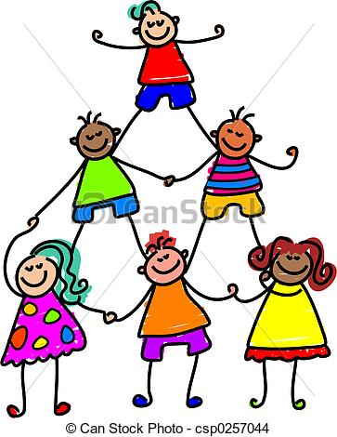
Thank you for your cooperation

