Slide 1
Problem of Manual Scavenging in India: The story of Humiliation in Kanpur City
Dr. Shashi Kumar
Associate Professor
Department of Human Rights,
B. B. Ambedkar University, Lucknow(India)
Email. shashibbau@gmail.com

Slide 2
Manual Scavenging : social facts
Inhuman and degrading practice of manual scavenging is in practice for long period directly related to Indian caste ridden social system.(nearly 3000 years)
Hindu caste system divided people into mainly four hierarchal order –from Lower caste to Upper caste i.e Brahmin, (priesthood) , Kshatryas ( warriors), Vaisya( Traders/workers) and Shudra (servants) . Shudras are treated as lowest caste people, historically discriminated and exploited by upper caste as polluted and unclean community. They have been called as Untouchables, Dalits and Scheduled Caste.
Manual Scavengers are Shudras community and treated untouchables. They are present in all parts of the country and known with different caste names: Bhangi, mahtar, Churas(punjab) Balmiki (Delhi and north india), Doms, ( Bengal) , Ghasia, mahar etc.
Forms of manual Scavengers : Wada laterins, Dry laterines, Dabba(Jaroo), Box collecting, Wadoliya(backyard defection), Open defection, Kharku(pit or well), Man-hole at the sewer lines, cleaning of Spetic tanks and Flush laterines etc.

Slide 3
Manual Scavenging : Some facts
As per Census of India 2011: 26 lakhs dry laterines in the country. 73% of the dry laterines are in rural areas. 13,14,652 toilets where human excreta are flushed into open drains.
Manual Scavengers are mostly still practice in states i.e Madhya Pradesh, Gujrat, Chhattisgarh, Maharashtra, Haryana, Andhra Pradesh, Rajasthan and Jharkhand.
Problems of Manual Scavengers in Uttar Pradesh: as per UP Government data of 2012, there are 5,530 human scavengers in 42 districts.

Slide 4
Manual Scavenging
Human Dignity
Human Respect
Humanity
Equality
Love
Intimacy
Affection
Peace
Human Indignity
Humiliation
Inhumanity
Discrimination
Hate
Untouchability
Enmity
Violence

Slide 5
Manual Scavenging
Manual Scavenging is a caste-based occupation involving the removal of untreated human excreta from bucket toilets or pit latrines, that has been officially abolished by law in India as a dehumaninsing practice.

Slide 6
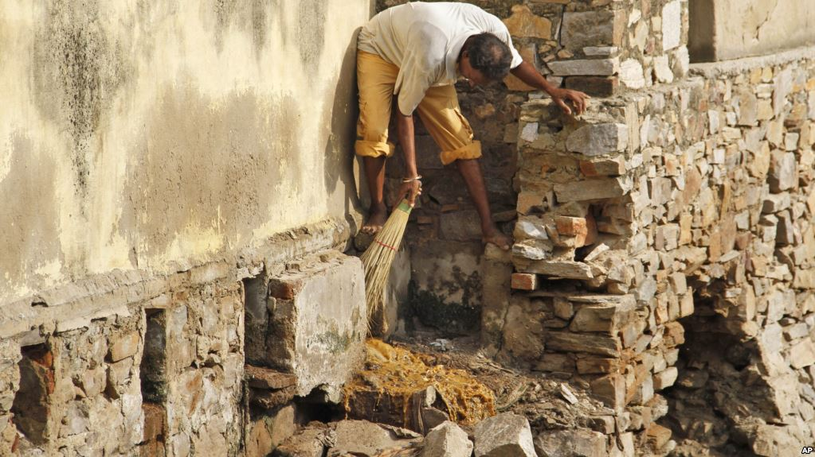

Slide 7
A scavenger is one not because of the job he does; he becomes one by his birth. The plight of the scavenger is inextricably tied to the brutal realties of the caste system. The human scavengers are treated as pariahs even by others at the bottom of Hinduism’s caste hierarchy, while ironically; the homes that they visit to clean are inevitably of the higher caste. They are subjected to brutal caste oppression. They are then the ultimate untoucables.
Dr. B R Ambedkar

Slide 8
Human Rights and Manual Scavenging
Human Rights framework for Protecting Manual Scavengers: International Perspectives-
Universal Declaration of Human Rights, 1948- “ All human beings are born free and equal in dignity and rights. They are endowed with reason and conscience and should act towards one another in a spirit of brotherhood.”(Art.1)
Everyone is entitled to all the rights and freedom set forth in this declaration, without distinction of any kind, such as race, color, sex, language, religion, political or other opinion, national or social origin, property, birth or other status(Art.2(1))
International Covenant on Economic, Social and Cultural Rights(ICESCR), 1966- the States parties to this Covenant recognize the right of everyone to the enjoyment of just and favorable conditions of work which ensure, n particular safe and healthy working conditions.(Art.7)
International Covenant on Civil and Political Rights(ICCPR),1966- the Preamble of ICCPR imbibes and recognizes the inherent dignity together with equal and inalienable rights of the human family.

Slide 9
Human Rights and Manual Scavenging
International Convention on the Elimination of all Forms of Racial Discrimination, 1965- the Convention aims to eliminate all forms of ‘Racial Discrimination’ means- any distinction, exclusion, restriction, or preference based on race, color, descent, or national or ethnic origin which has the purpose or effect of nullifying or impairing the recognition, enjoyment or exercise on an equal footing , of human right and fundamental freedoms in the political, economic, social, cultural, or any other field of public life.(Art.1)
Each State party shall take effective measures to review governmental, national and local policies and to amend, rescind or nullify any laws and regulations which have the effect of creating or perpetuating racial discrimination wherever it exists.(Art.2(i))
International labour Organisation(ILO) : Discrimination (Employment and Occupation) Convention no.111(1958) deals with issues of unequal treatment of workers on a number of discriminatory grounds, such as race, political opinion or religion. Social origin refers to Caste in indian context is another ground of discrimination mentioned in the Convention.

Slide 10
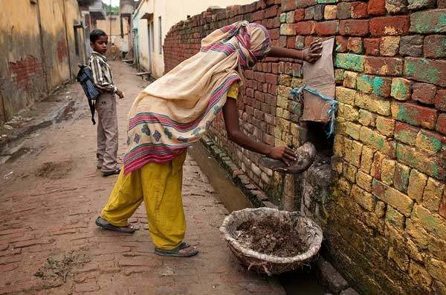

Slide 11
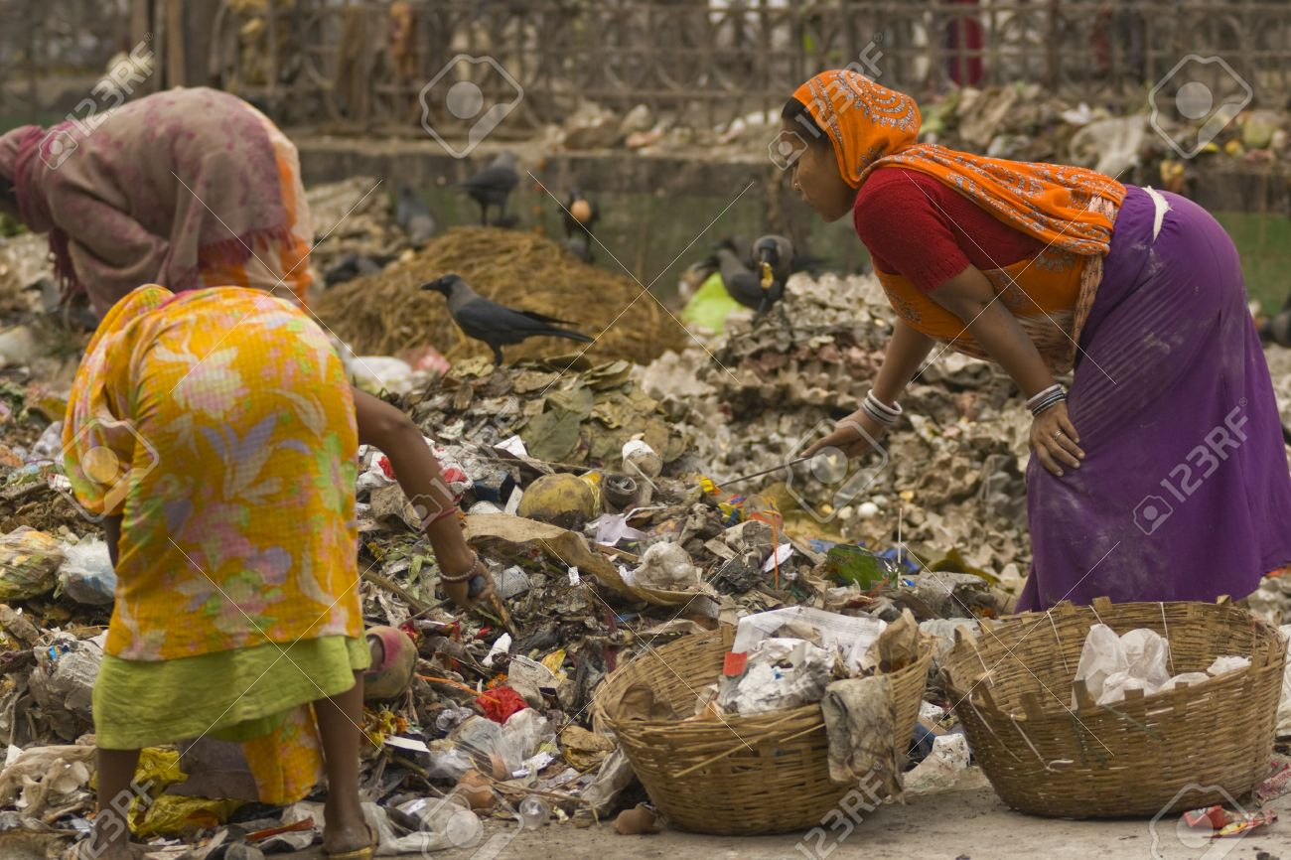

Slide 12
Indian laws and Manual Scavenging
Indian Constitution : Right to Equality- ‘The State shall not deny to any person equality before the law or equal protection of the laws within the territory of India prohibition of discrimination on grounds of religion, race, caste, sex or place of birth.’(Art.14)
Art.17 – under this article, the ‘Untouchability’ is abolished and its practice in any form is a punishable offence. To effect this provision, Govt. of India enacted Untouchability( Offences) Act, 1955 later amended and renamed as Protection of Civil Rights Act in 1976.
Other provisions such as Prohibition of traffic in human beings and forced labour etc(Art. 23); Right to work(Art. 41); Just and human conditions of work(Art.42); Promotion of educational and economic interests of Scheduled Caste, Scheduled Tribes and Other weaker sections(Art. 46)
The Scheduled Caste and Scheduled Tribes (prevention of atrocities) Act, 1989- the Act specifies some types of offences as atrocities , provides for imposition of stricter penalties for the guilty and setting up of special courts for speedy trial of such cases.
National Commission for Safai Karamchari Act, 1993- National Commission for Safai karmachari was established in 1993 to syudy , evaluate and monitor the implementation of various schemes for Safai Karamcharis as an autonomous body and also to provide redressal of grievances of manual scavengers.

Slide 13
Indian laws and Manual Scavenging
Employment of Manual Scavengers and Construction of Dry Laterines (Prohibition ) Act, 1993 - provides for prohibition of manual scavengers as well as construction or continuance of dry laterins and for the regulation of construction and manitenance of water sealed laterins and matters connected therewith. Act also provides for penalty of imprisionment up to one year.
The Prohibition of Employment as Manual Scavengers and Their Rehabilitation Act, 2013- to create more stringent provisions for the prohibition of insanity laterins and rehabilitation of manual scavengers.
The Act prohibit the employment of manual scavengers, the manual cleaning of sewers and septic tanks without protective equipment, and construction of insanity laterins.
The definition of ‘manual scavengers’ has been widened to include a person engaged or employed , inter alia’ for manual cleaning of human excreta in an insanitary latrine or in an open drain or pit, railway tracks etc.
Vigilance and Monitoring Committees to be set up at the sub-division, District, state and Central levels
Rehabilitation of Manual Scavengers: Manual scavengers shall be rehabilated with one-time cash assistance, scholarship for their children and residential plot with financial assistance for construction of houses. A subsidy and concessional loan shall be given for taking up an alternative occupation.

Slide 14
Government policies and Schemes
For allocating resources to modernize sanitation system in the country, for reforming social and economic condition of manual scavengers , the Government of India has introduced many national and State levels policy and Schemes. Some of the national sanitations schemes are:
Sulabh Shauchalaya, 1974
Integrated Low Cost Sanitation Scheme, 1981
Valmiki Malin Basti Awas Yojana, 2001
Self-Employed Scheme for Rehabilitation of Manual Scavengers, 2007
Nirmal Bharat Abhiyan , 2009
Swacch Bharat Abhiyyan, 2014-aims to eliminate open defection; eradication of manual scavenging; modern and scientific Municipal Solid Waste Management; to effect behavioral changes in regard to the healthy sanitation practices

Slide 15
Field survey study in Kanpur(Uttar Pradesh)
To know the social and economic condition of manual Scavengers living in Kanpur city, a brief survey of manual scavengers inhabited areas has been taken up.
Slum areas Kanpur City: Moolganj-11%; Chamangang-18%; Near Kanpur Central -14%; Near Govindpuri Station-22%; Juhi Depot-35%
Chamanganj: Muslim dominated backward area, it has highest number of dry latrines. Women who cleans dry toilets known as ‘balti-wali(buket women).

Slide 16
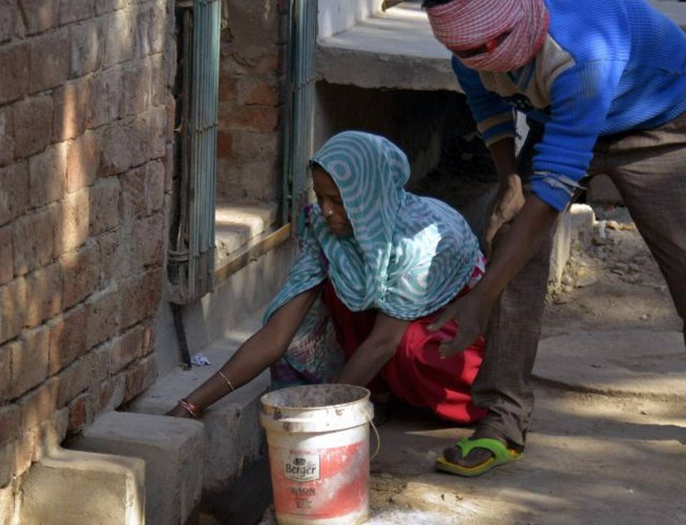

Slide 17
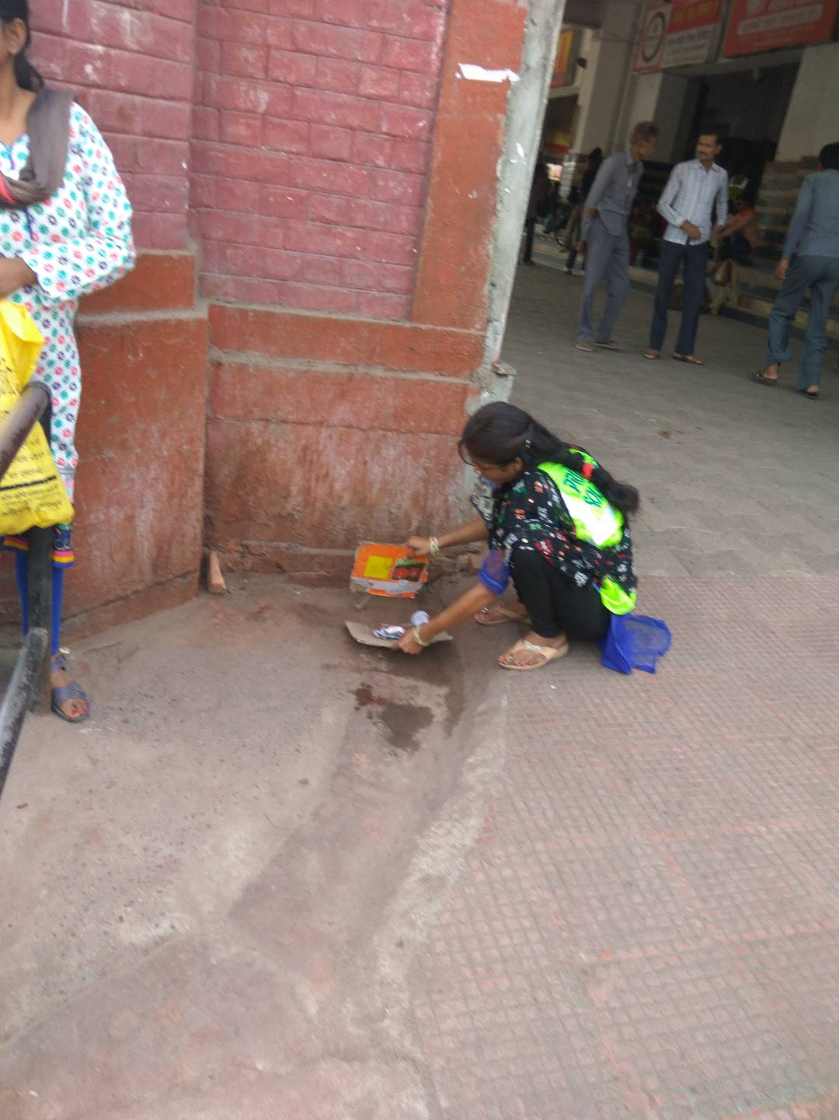

Slide 18
Manual Scavengers
Manual scavengers are engaged in this occupation for generations. Kallu says he cleans sewer lines for 30 years.
They are living in poor, unclean, unhygienic houses or tent shelters.
Slum locality near Kanpur Central and Govindpuri Railways station are mostly unhygienic regions. piling of garbage heaps, water logging, improper sewage system and people are residing in unhealthy condition.
Lack of proper drinking water, poor sewage, toilets-open defection near railway tracks.
Children do not have proper access to school.

Slide 19
Manual Scavengers
Shaktideen told that he was hired on contract basis for sweeping broom on the railway platforms. He does this work without any safety measures i.e wihout gloves, boots, mask etc.
Ruby says , ‘handling of unhygienic waste without proper tools and protective measures often makes them prone to various health hazards.’ she also suffers problem of sexual harassment and abuse.
While visiting in area of Moolganj, it was found people lives in improper and inadequate spaces. They say that ‘due to insufficient spaces for living and lack of financial resources , open defection is the only alternative they could adopt.’
Local Municipalities also engage manual scavengers for removal of clogged gutters, storm water drains, sewer manholes and septic tanks without having proper working condition and healthy-hygenic measures .

Slide 20
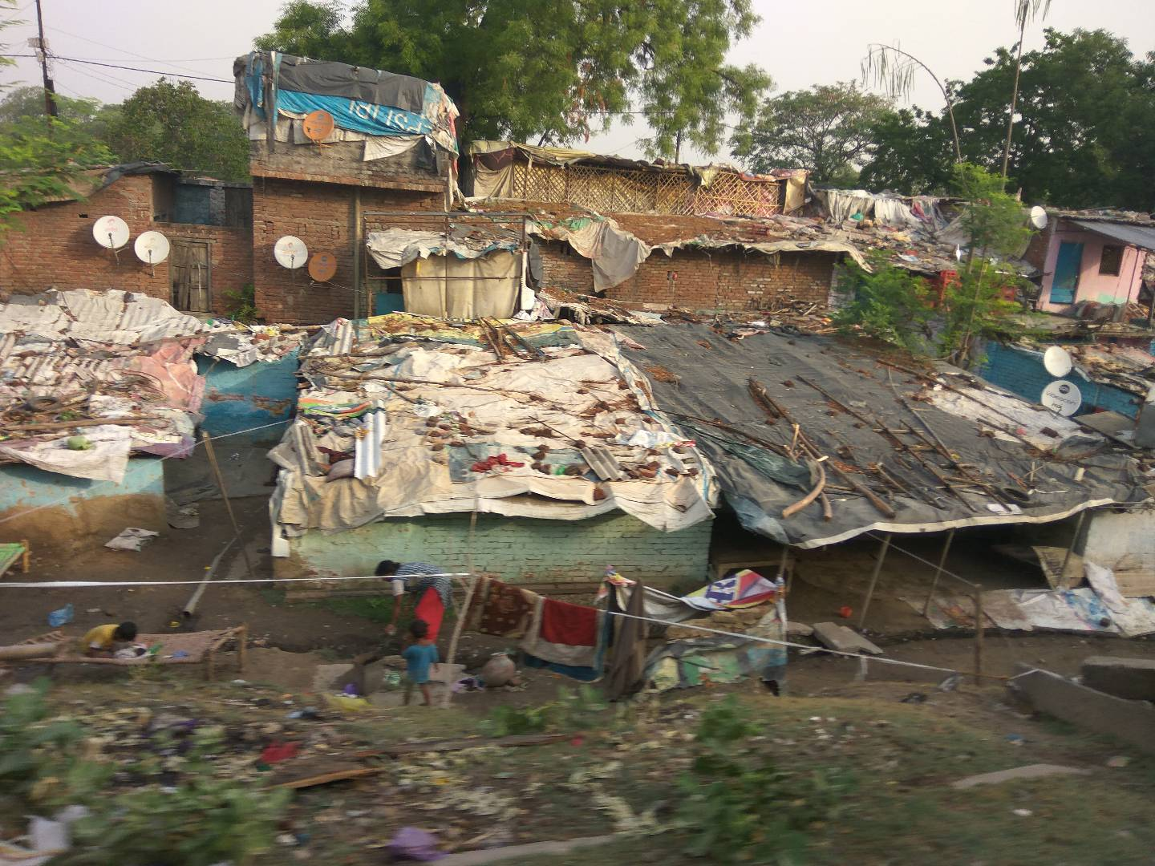

Slide 21
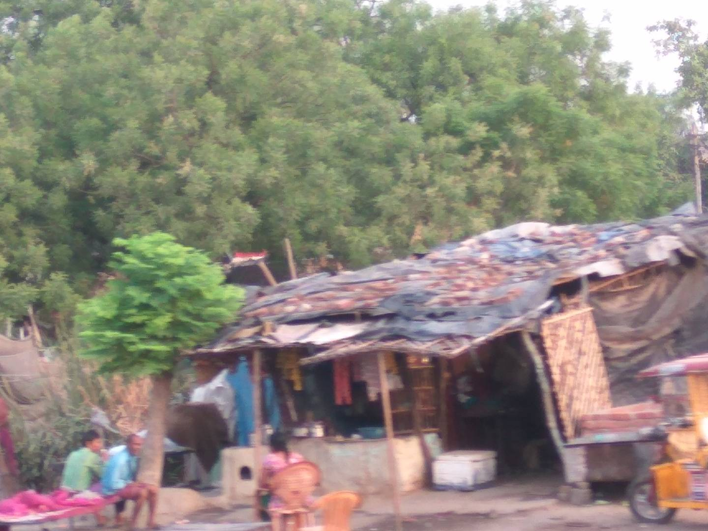

Slide 22
Manual Scavengers at Railway Track without safety tools

Slide 23
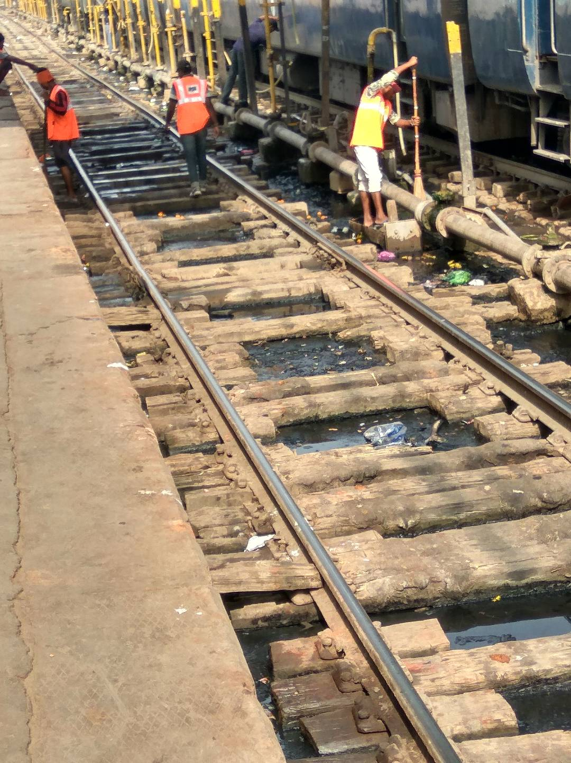
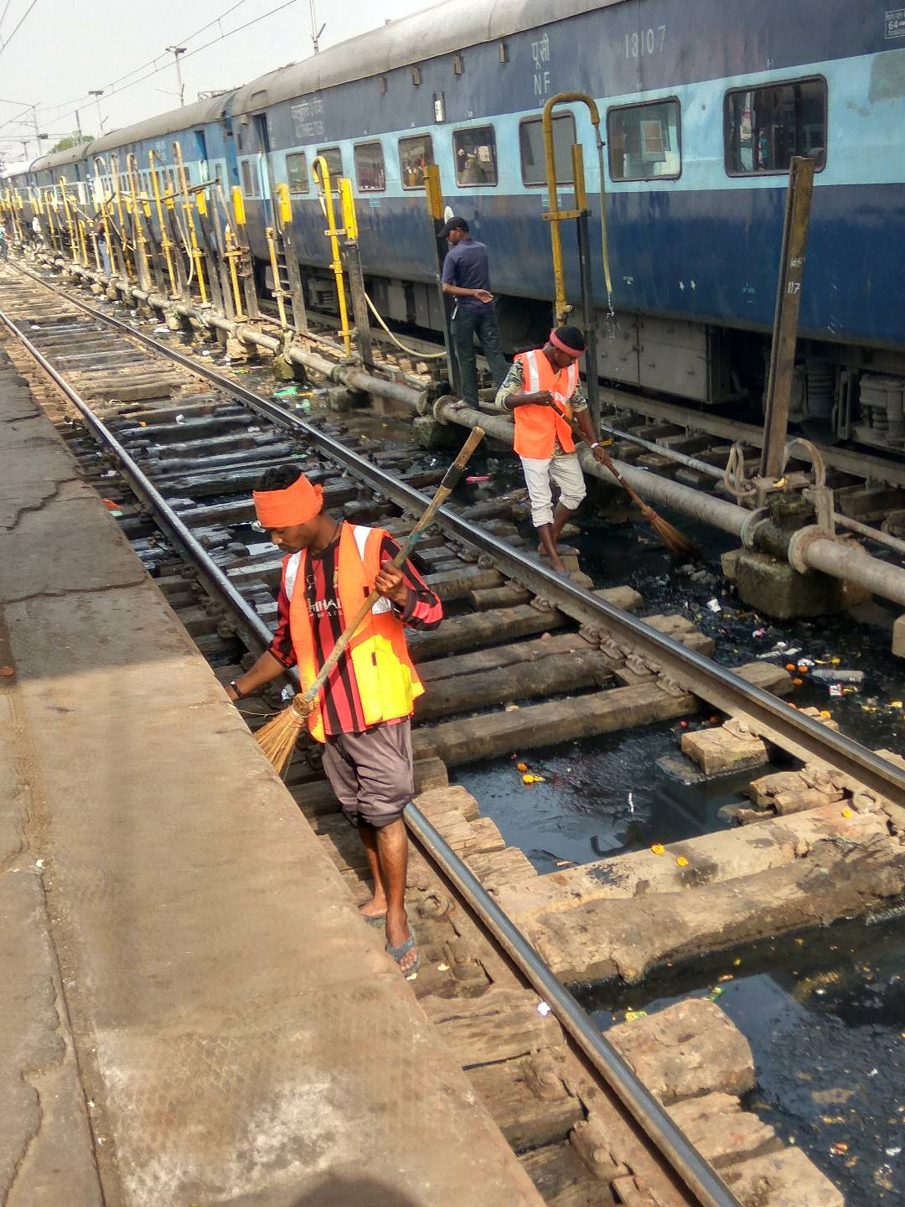
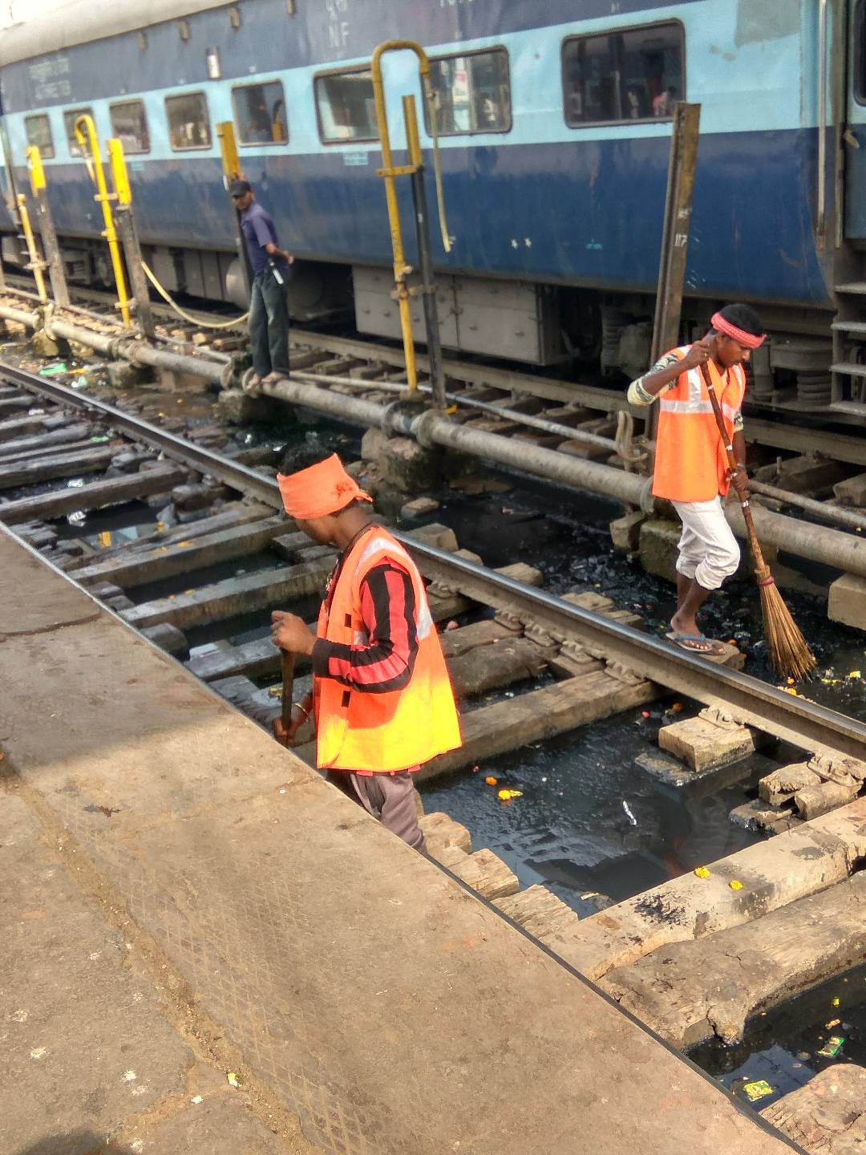

Slide 24
Conclusion
Manual scavengers are living in poor, unhealthy, unhygienic condition without any civic amenities .
While working in sewage, the manual scavengers do not get safety items such as mask, gloves, shoes etc to protect themselves from various health hazardous.
Due to unemployment , traditional occupational legacy, and not having other source of income, the manual scavengers are forced to do manual scavenging jobs.
They suffer caste discrimination, social exclusion, humiliation and physical exploitation everyday life. Their children suffers access of education.
Women scavengers suffer sexual harassment by their contractors.
Many schemes were launched by government to change condition of manual scavengers but due to lack of awareness, complexion of red- tapism, corruption, all these schemes have not benefited the manual scavengers.

Slide 25
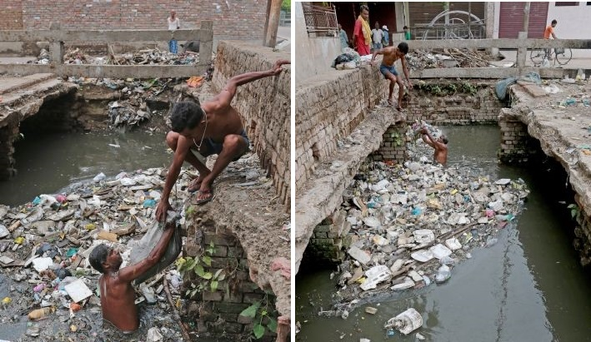

Slide 26
Clean India Campaign : Swachha Bharat Abhyian
Eradicate Manual Scavenging :
Respect Human Dignity of Manual Scavengers

Slide 27
Human Dignity
Respect for Humanity, Non-discrimination, Non-huminliation and Protection of Human Rights
THANKING YOU

