Slide 1
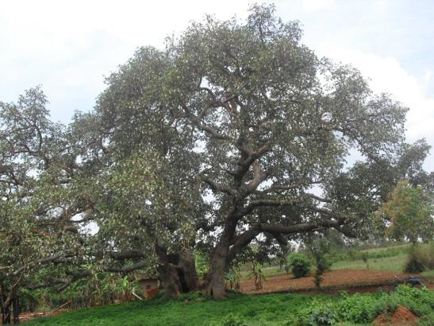
Seeds of Hope
By Steven Shyaka
Nyamata, Rwanda
October 28, 2010

Slide 2
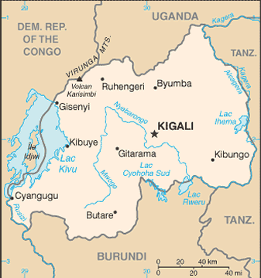
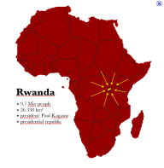
About the Presenter
Nyamata
Steven Shyaka
Age 23, Nyamata, Rwanda
Translator, Writer
Co-founder, Healing Through Arts and Drama

Slide 3
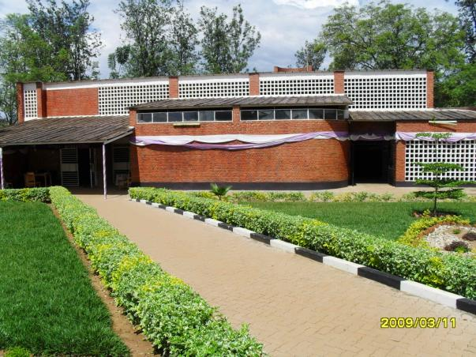
Never Forget
An estimated 10,000 Tutsis and moderate Hutus were killed in and around Nyamata church in April 1994. Today, the building serves as the Nyamata Genocide Memorial Centre.

Slide 4
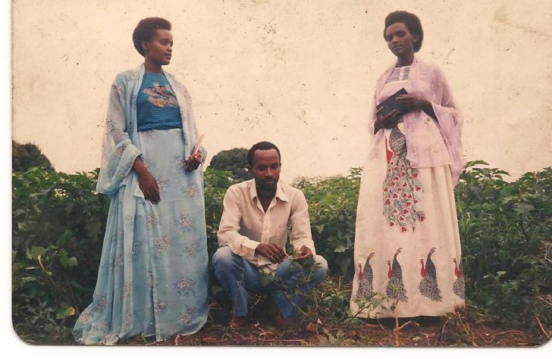
Childhood Memories
From L to R: Steven’s Maternal Aunt, Father, and Mother (circa 1990).

Slide 5
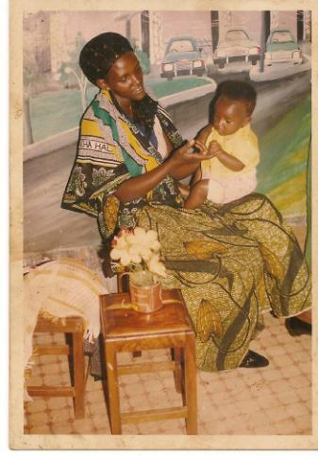
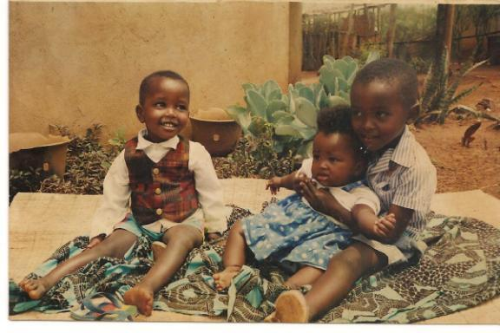
Growing Up in Nyamata Village
L to R: Steven (then known by his French name “Etienne”), with Jeanne and brother Mutima (circa 1990)
Above: Steven’s Mom with sister Jeanne

Slide 6
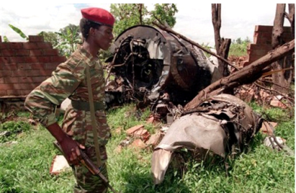
1994: Life changes forever…
Apr 6: Plane carrying Rwandan President Habyarimana, a Hutu, is shot down
Apr 7: Massacre of Tutsis and moderate Hutus commence for 4 months
800,000 killed
Mass exodus of refugees to bordering countries
June 23: Western Military intervention
Steven was eight years old at the time
Wreckage of plane crash that killed both the Presidents of Rwanda and Burundi.

Slide 7
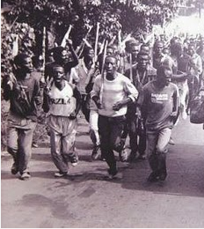
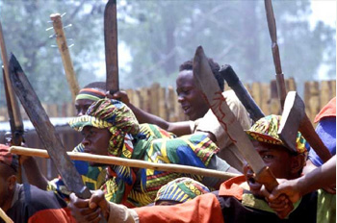
Family Attacked
April 1994: Steven’s family and home (pictured above) attacked and ransacked by Hutu extremists. Steven’s mother, father, two brothers, and uncle were killed.

Slide 8
The Escape
Jeanne and Asteria (grandmother) hid in this swamp to escape the killers. Steven was captured by soldiers, then taking to the home of a notorious Tutsi killer named Kamoti.

Slide 9
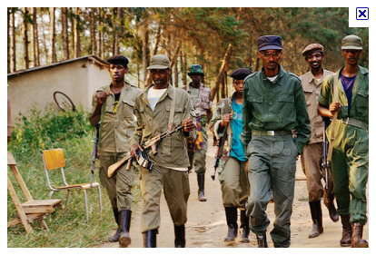
Rescued at Last
Gen. Paul Kagame
This banana grove served as Steven’s hiding spot for seven days, thanks to the assistance of Kamoti’s daughter, Claudine. Eventually, Steven was rescued by Kagame’s RPF army and taken to hospital for treatment.

Slide 10
1996: A new beginning
Steven (age 10) at the home of his adopted parents, Nicholas and Dativa. Dativa beat and tortured Steven for two years. Remarkably, Dativa’s two brothers were discovered years later to be the killers of Steven’s parents. Nicholas and Dativa have since fled to the Congo.

Slide 11
A Reunion Beyond Imagination
In 1998, Red Cross representatives played a key role in reuniting Steven with his sister, Jeanne, and his grandmother, Asteria. Until that point, Steven had no idea whether or not they were still alive.

Slide 12
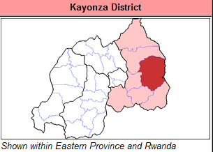
High School Years
Studied at Groupe Scolaire de Gahini in Kayonza District
Where his older brother had attended
Leader of support group for students affected by genocide
Supported Jeanne through trauma and nightmares

Slide 13
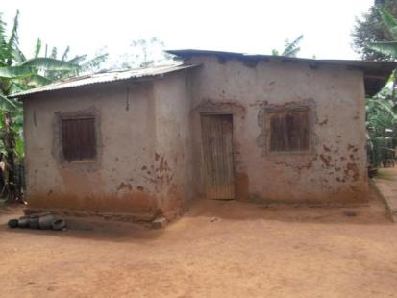
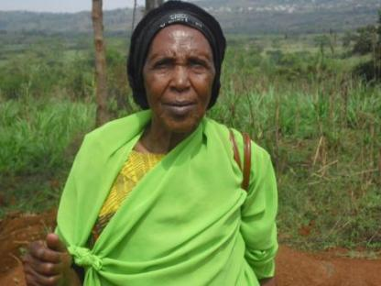
Building a New Life
Left: Steven with sister Jeanne (Sept 2010)
Top Right: Steven’s current home
Right: Steven’s grandmother, Asteria (age approx. 83)

Slide 14
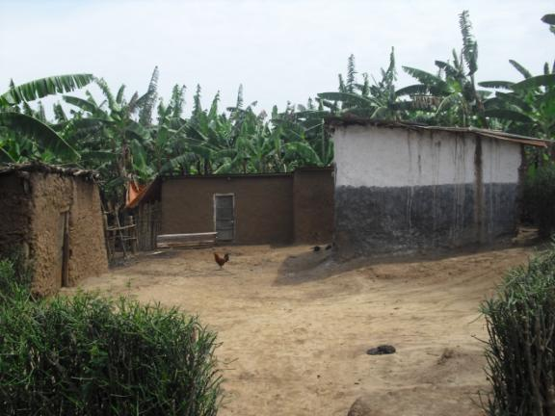
Life Alongside the Killers
The son of the killer of Steven’s uncle. Pictured at home (above and right), the man is located just 2 km from Steven’s home.

Slide 15
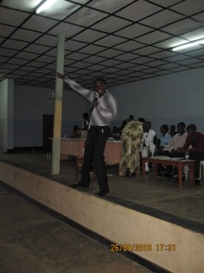
Healing Through Arts and Music
A social support group for genocide survivors, their families, and the criminals themselves. Launched by Steven and Charles Mugabe. Healing emotional scars through music, dance, poetry and theatre.
HTAD co-founder Charles Mugabe sings a song he wrote: “Never Again”, at HTAD event (Sept 2010)

Slide 16
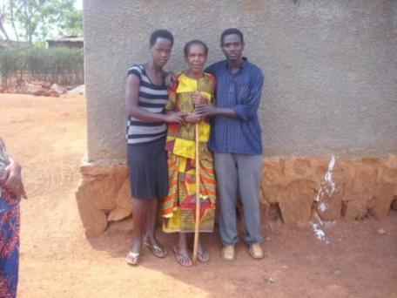
Get Involved!
www.Meaningfulworld.com
www.thestrongestoak.org/htad
Join the Survivors Voice Facebook group
Hire Steven for private speaking engagements
Steven, Jeanne, and Asteria outside of home (Sept 2010)

Slide 17
Steven Graduating from Law School
Steven has graduated from law school
Steven has volunteered with Meaningfulworld Humanitarian Teams from 2010-present
Steven has volunteered and mentored by Meaningfulworld and The StrongestOak

