Slide 1
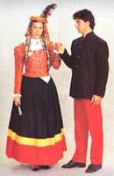
Balkan Dances for Social Sharing. Reflektions on Urban Traditions and Cultural.

Slide 2
Dance to protect the sheeps from the wolfs.

Slide 3
Konavli - Dubrovnik

Slide 4
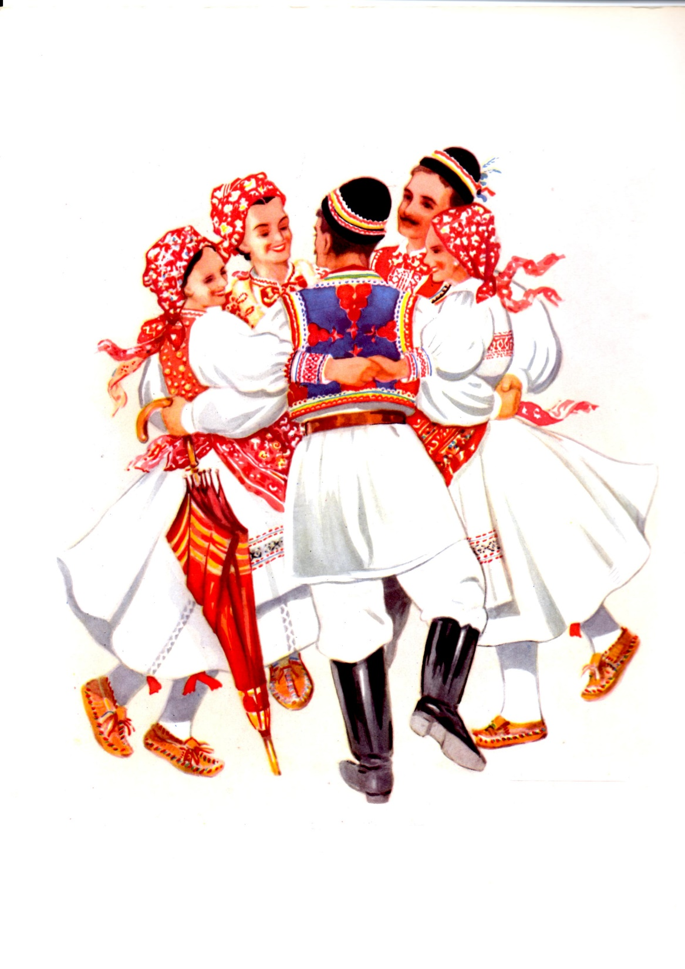
Drmes-Sestine-Croatia

Slide 5
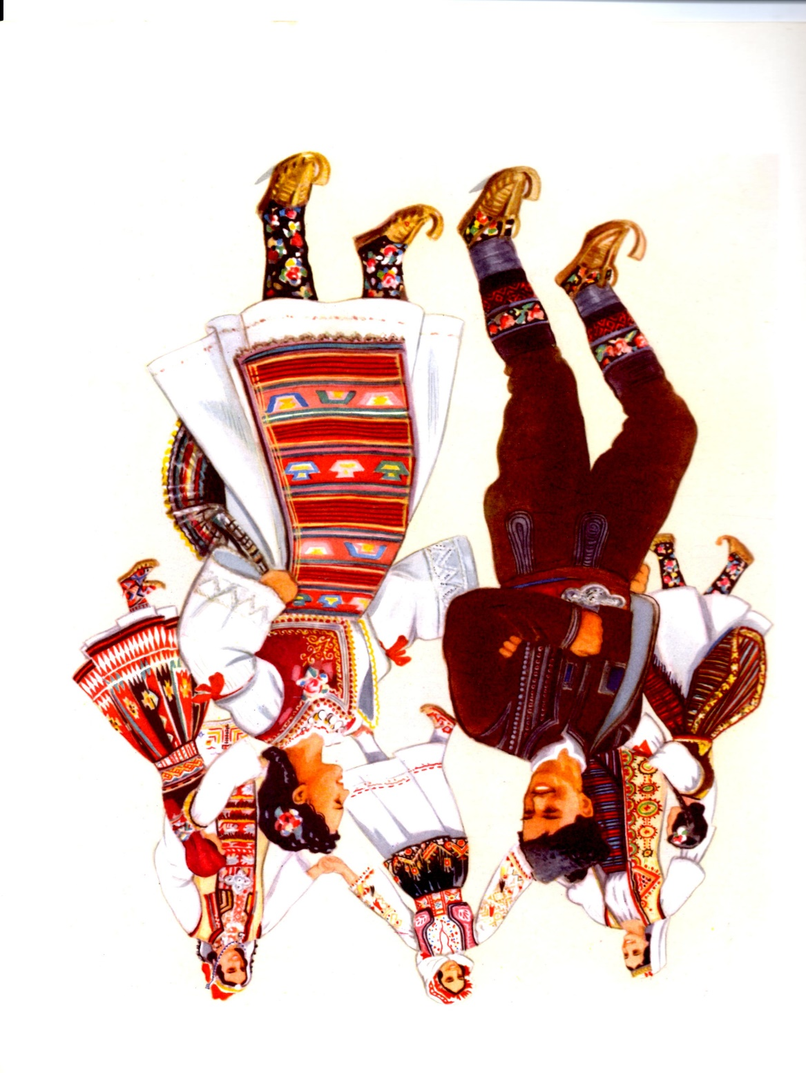
KOLO-SUMADIJA,SERBIA

Slide 6
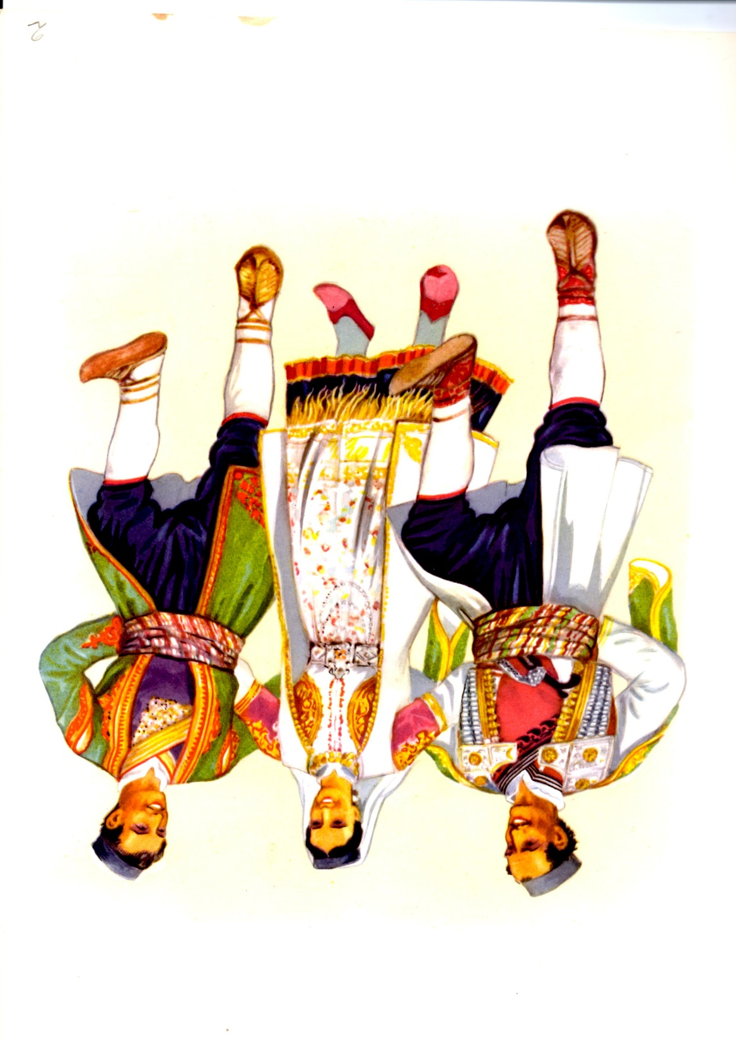
Kolo – Cetinje – Montenegro

Slide 7
Vojvodina-Bunjevci

Slide 8
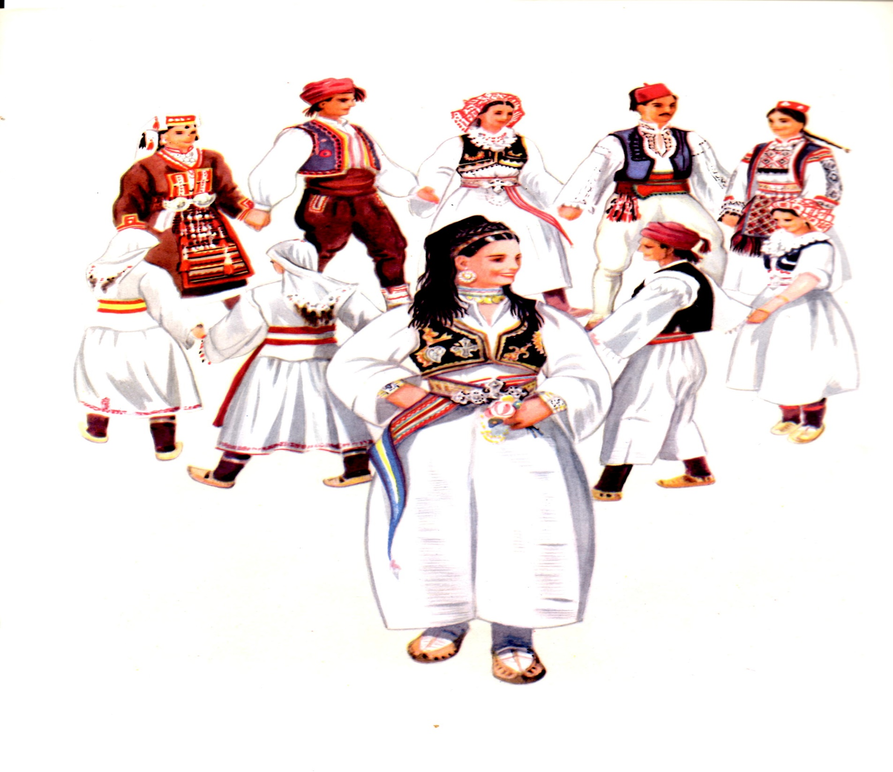
BOSNIA-Travnik

Slide 9
LJUBLJANA-Slovenija

Slide 10
Folklorna grupa Brodosplit-Split

Slide 11
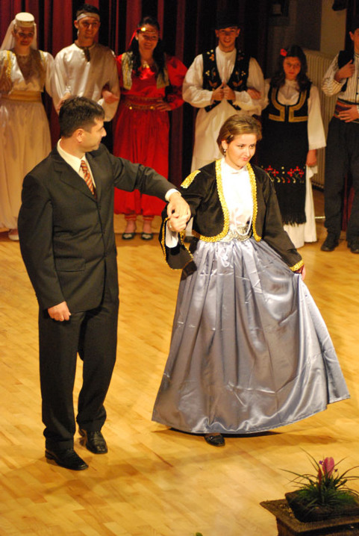
Gradska zenska nosnja

Slide 12
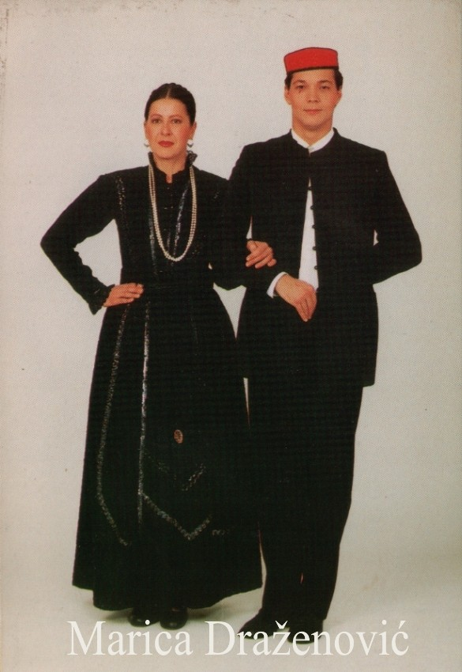
Split-gradski kostim

Slide 13
Kolo gradske igre
https://youtu.be/hTJjnOjvd4c

Slide 14
Gradski plesovi Hrvatske
http://www.youtube.com/watch?v=Kj9xoVQrNr0

Slide 15
Splitska kvadrilja
https://www.youtube.com/watch?v=MuMoZzuBN9E

